Slide 1
The Changing Landscape of Semiconductor Contact
Exploring the Impact of the Stop Plus Phenomenon

Slide 2
Introduction
• Semiconductor contact plays a crucial role in product performance
• Stop plus phenomenon has revolutionized the field
• This presentation delves into the effects and implications
• Get ready for an exciting journey!
Photo by Pexels

Slide 3
Understanding Semiconductor Contact
• Semiconductor materials and their role in contact
• Different types of contact structures and their properties
• Importance of contact resistance and its impact on device performance
• Advancements in semiconductor contact technology
Photo by Pexels

Slide 4
The Stop Plus Phenomenon
• Definition and explanation of the stop plus phenomenon
• Effects of the stop plus phenomenon on semiconductor contact
• Advantages and disadvantages of stop plus technology
• Examples of successful integration in real-world applications
Photo by Pexels

Slide 5
Applications and Future Implications
• Current and potential applications of stop plus technology
• Future trends and developments in semiconductor contact
• Challenges and considerations for future implementation
• Opportunities for further research and innovation
Photo by Pexels

Slide 6
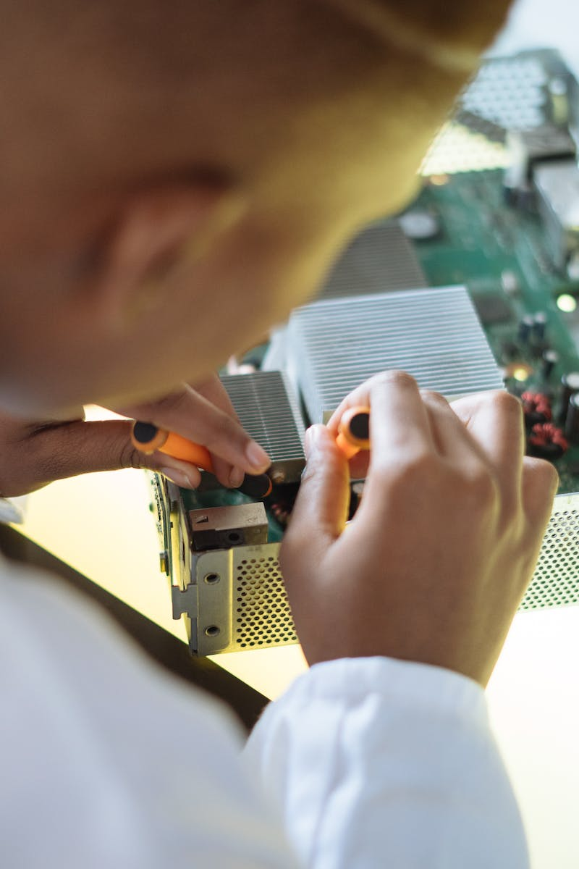
Conclusion
• Recap of the key points discussed
• Emphasize the significance of the stop plus phenomenon
• Encourage further exploration and understanding
• Thank the audience for their attention
Photo by Pexels

