Slide 1
Managing Anger and Conflict Resolution
Finding Peace through Effective Communication

Slide 2
Introduction
• Music and Emotions
• Conflict with Dika
• Expressing Anger
• The Importance of Respect
Photo by Pexels

Slide 3
Expressing Anger
• Reacting impulsively
• Physical outburst
• Reflection and self-control
• Channeling anger constructively
Photo by Pexels

Slide 4
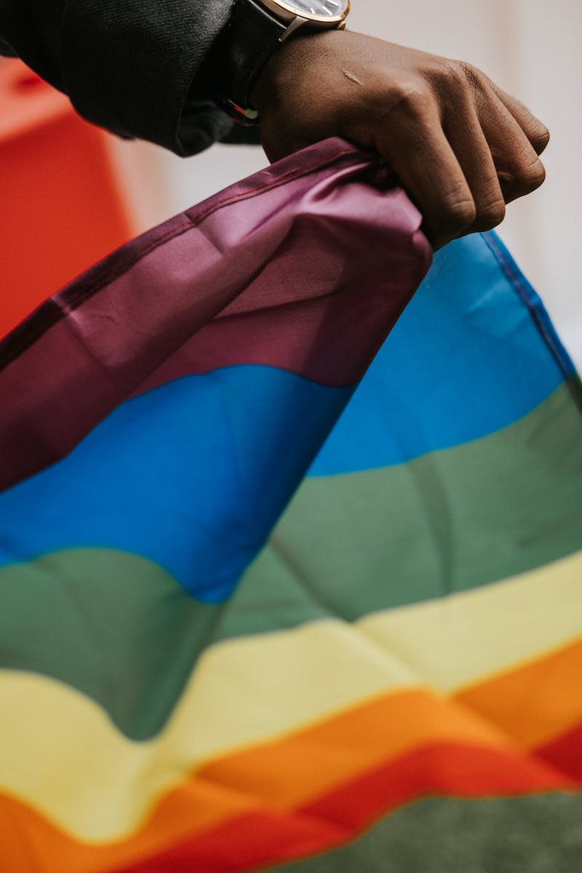
The Power of Respecting Others
• Respecting classmates
• Avoiding cheating
• Maintaining integrity
• Reporting misconduct
Photo by Pexels

Slide 5
Handling Conflict Appropriately
• Patience and understanding
• Seeking resolution
• Reporting to teachers
• Contributing to a positive learning environment
Photo by Pexels

Slide 6
Conclusion
• The importance of self-improvement
• Commitment to positive behavior
• Creating a harmonious classroom
• Moving forward with patience and resilience
Photo by Pexels

