Slide 1
Transforming Customer Experience: The Future of NPS
From traditional surveys to outcome-driven initiatives

Slide 2
Introduction
• Customer experience is a key driver of success
• Organizational alignment is critical for program success
• Challenges to realizing value in customer experience
• The need for quality data and compelling insights
Photo by Pexels

Slide 3
Challenges in Data and Perception
• Data side of customer experience has a troubled history
• Human stories have more psychological weight than statistics
• Legacy processes and incentive systems make employees wary
• Responsive organizations need quality data and insights
Photo by Pexels

Slide 4
Structural Challenges
• Customer-driven growth requires a shift in focus
• Traditional corporate processes may hinder customer-centricity
• Building end-to-end customer journey models is the solution
• Put the holistic view of the customer journey in employees' hands
Photo by Pexels

Slide 5
Rethinking Financials
• Significant market share gain and profitability improvement at stake
• Cx initiatives require the right data, insights, and execution
• Shift funding from data collection to execution and engagement
• Corporate leadership needs to recognize the importance of Cx
Photo by Pexels

Slide 6
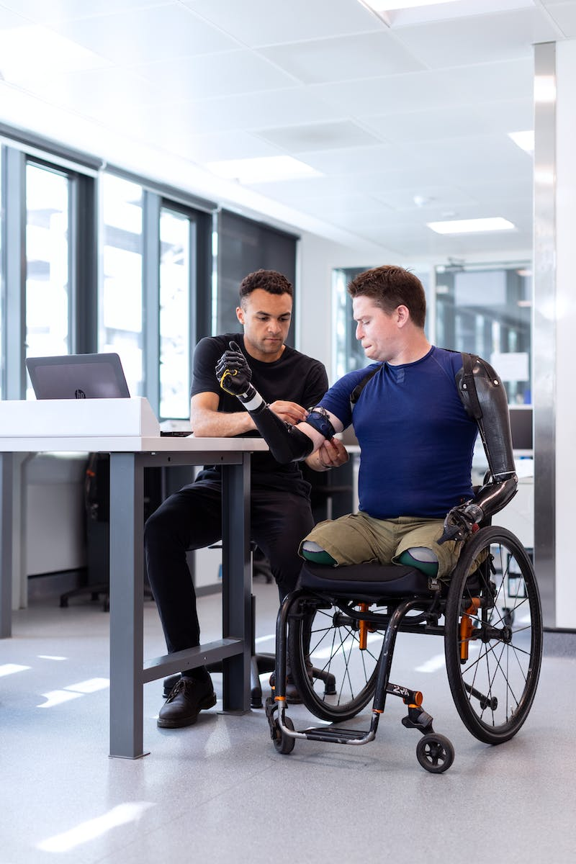
Mps Outcome Engineering
• A new way to plan and execute customer experience initiatives
• Invert the survey-centric view with a value chain perspective
• Link operational process measures, performance measures, and customer experience metrics
• Focus on outcome-driven approaches
Photo by Pexels

Slide 7
Key Techniques of Mps Outcome Engineering
• Built on a new value chain architecture
• Challenge organization to move from survey-first thinking
• Shift from survey-centered NPS to high-quality NPS
• Develop robust real-time insights
Photo by Pexels

Slide 8
Programmatic Approach for Customer Experience
• Construct customer experience initiatives with an expansive view
• Avoid becoming data collection burdens
• Focus on organizational impact and operational duration
• Improve the efficiency and effectiveness of the effort
Photo by Pexels

Slide 9
Future of Customer Experience
• Move away from traditional research methodologies
• Build more capable and insight-driven programs
• Customer experience as a strategic choice
• Provide dialogue-quality data and insights
Photo by Pexels

