Slide 1
The Reality of Starting a Startup
Dispelling the Glamour and Exploring the Challenges

Slide 2
Introduction
• Starting a startup is often romanticized in the media
• However, the reality is far from glamorous
• Entrepreneurship requires hard work and can be extremely stressful
• It's important to have a clear understanding of the challenges before diving in
Photo by Pexels

Slide 3
The Glamorous Image
• Hollywood and the press often romanticize entrepreneurship
• Movies like The Social Network depict parties and rapid success
• However, this doesn't align with the actual day-to-day experience
• Running a startup requires hard work and dedication
Photo by Pexels

Slide 4
The Harsh Reality
• Starting a startup involves long hours and hard work
• It can take a toll on your physical and mental well-being
• Unwanted media attention can add stress and pressure
• There is a high level of commitment and responsibility
Photo by Pexels

Slide 5
The Boss Illusion
• Being the boss can seem appealing, with control over your own schedule
• In reality, founders often face conflicting priorities
• Managing employees, customer demands, and conflicts takes up significant time
• Flexibility can be limited by the demands of the business
Photo by Pexels

Slide 6
The Attraction of Impact and Wealth
• Many founders are attracted to the potential for making a big impact
• They also hope to achieve financial success beyond what they might find in a traditional job
• While these are possible outcomes, they are not guaranteed
• Success in entrepreneurship requires more than just ambition
Photo by Pexels

Slide 7
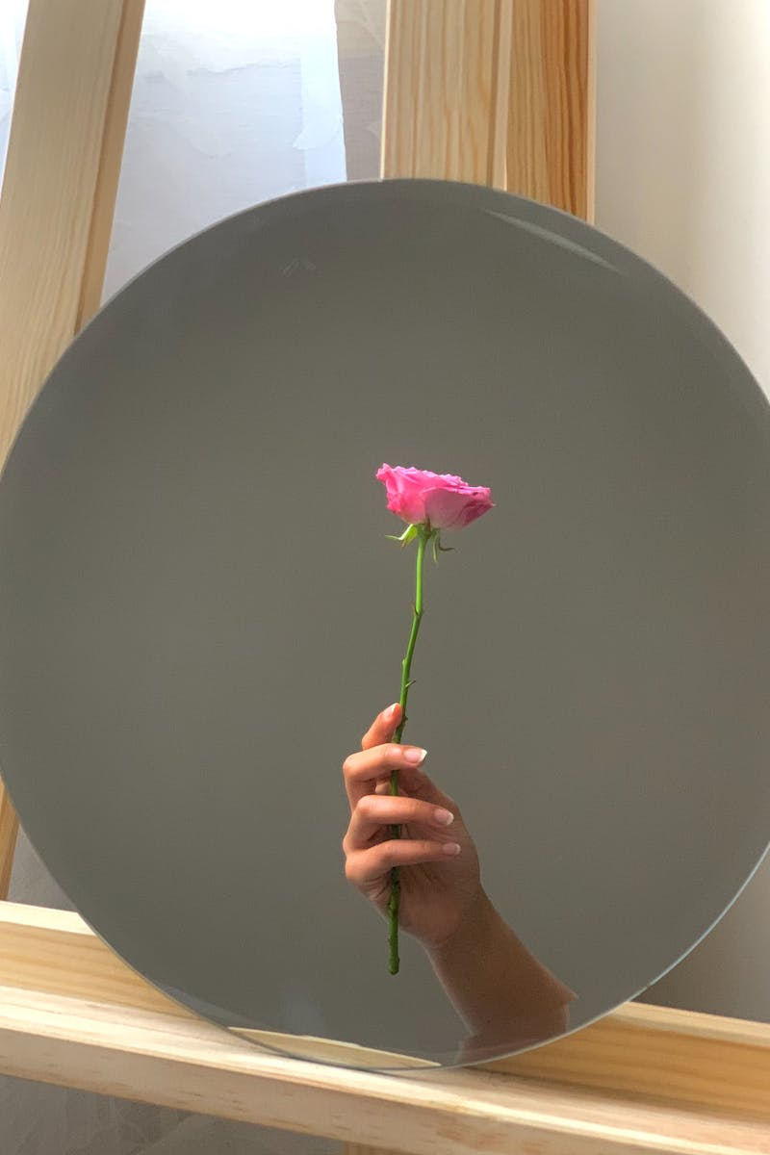
The Real Reason to Start a Startup
• Despite the challenges and misconceptions, there is still a compelling reason to start a startup
• Building a great product and solving a problem you're passionate about
• Creating something that users love and have a real impact on their lives
• Finding joy and fulfillment in the process of building and growing the startup
Photo by Pexels

Slide 8
Conclusion
• Starting a startup is far from glamorous
• It requires hard work, dedication, and the ability to navigate challenges
• However, it can also be incredibly fulfilling and rewarding
• The key is to have a realistic understanding of the journey ahead
Photo by Pexels

