Slide 1
The Power of Artificial Intelligence
Revolutionizing Industries and Changing the World

Slide 2
Introduction to Artificial Intelligence
• AI is the simulation of human intelligence in machines.
• It enables computers to think, learn, and solve problems like humans.
• AI is transforming industries and our daily lives.
• It has potential applications in healthcare, finance, transportation, and more.
Photo by Pexels

Slide 3
Machine Learning: A Key Component of AI
• Machine learning is a subset of AI that allows machines to learn from data.
• It uses algorithms to analyze and interpret patterns in large datasets.
• ML is used in various applications like recommendation systems and fraud detection.
• Deep learning, a type of ML, is inspired by the human brain's neural networks.
Photo by Pexels

Slide 4
AI in Healthcare
• AI can revolutionize healthcare by improving diagnostics and personalized medicine.
• It enables the analysis of large medical datasets to find patterns and predict outcomes.
• AI-powered robots can assist in surgeries and other complex procedures.
• Telemedicine and AI chatbots provide accessible healthcare services to remote areas.
Photo by Pexels

Slide 5
AI in Finance
• AI algorithms can analyze vast amounts of financial data for better investment decisions.
• Robo-advisors provide personalized investment recommendations to individual investors.
• AI-powered fraud detection systems prevent financial crimes more effectively.
• Automated trading algorithms execute trades with speed and accuracy.
Photo by Pexels

Slide 6
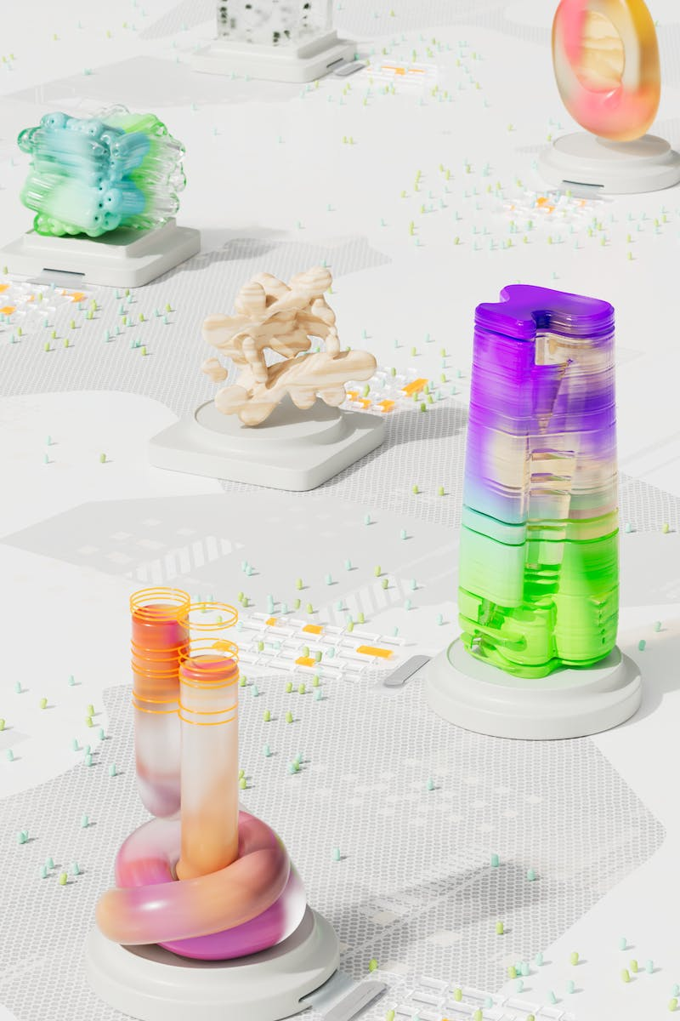
Ethical Considerations and Challenges
• AI raises ethical concerns such as privacy, bias, and job displacement.
• Ensuring transparency and fairness in AI algorithms is crucial.
• Addressing the impact of AI on employment requires proactive planning.
• Developing regulatory frameworks to govern AI usage is necessary.
Photo by Pexels

Slide 7
Conclusion: Embracing the AI Revolution
• AI has the potential to transform industries and solve complex problems.
• Proper regulation and ethical considerations are essential for harnessing its power.
• Collaboration between humans and AI will lead to better outcomes.
• Embracing AI is crucial to stay competitive and drive innovation.
Photo by Pexels

