Slide 1
Q Laura: Fine-tuning Large Language Models with Less Computation Power
Democratizing Language Model Fine-tuning with Q Laura

Slide 2
Introduction
• Q Laura enables fine-tuning of large language models with less computation power
• Q Laura creates new weight matrices while freezing pre-trained weights
• Results in a smaller file size after fine-tuning without compromising performance
• Q Laura allows training large models on a single GPU with 48GB memory
Photo by Pexels

Slide 3
Q Laura vs. Traditional Fine-tuning
• Traditional fine-tuning involves fine-tuning the entire set of weights
• Q Laura creates new update matrices while freezing pre-trained weights
• Pre-trained weights' output activations are augmented by the new update matrices
• Results in a smaller file size after fine-tuning without compromising performance
Photo by Pexels

Slide 4
Benefits of Q Laura
• Train a 65 billion parameter model on just a single GPU with 48GB memory
• Preserve full 16-bit fine-tuning performance
• Reaches 99% performance level of Charge GPT with 24 hours of fine-tuning
• Exciting innovation for democratizing large language model fine-tuning
Photo by Pexels

Slide 5
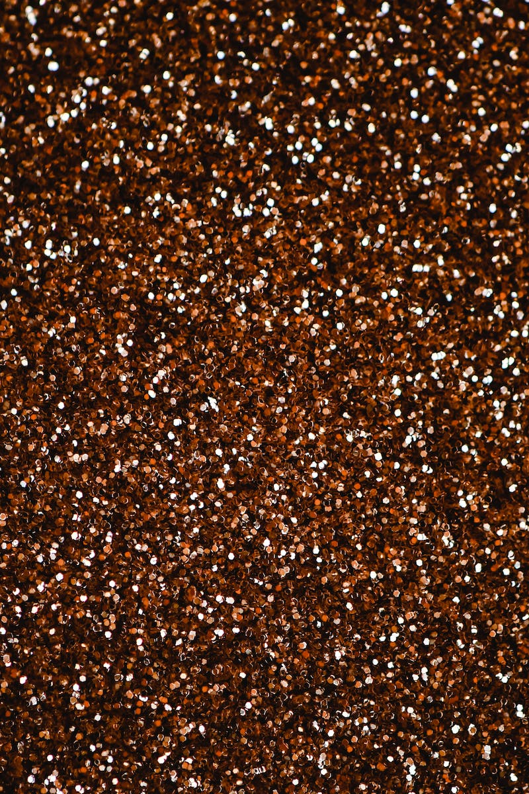
Training with Transformers and Bits and Bytes
• Use Transformers and Bits and Bytes libraries for training
• Install required libraries: Transformers, Bits and Bytes, Pfift, and Datasets
• Load existing model using AutoTokenizer and AutoModel for causal LM
• Specify Bits and Bytes configuration for quantization
Photo by Pexels

Slide 6
Preparing the Model for Training
• Prepare the model for training using 'prepare_model_for_kbit_training'
• Enable gradient checkpointing for the model
• Define Lora configuration for fine-tuning
• Specify the rank factor, target module, and task for the model
Photo by Pexels

Slide 7
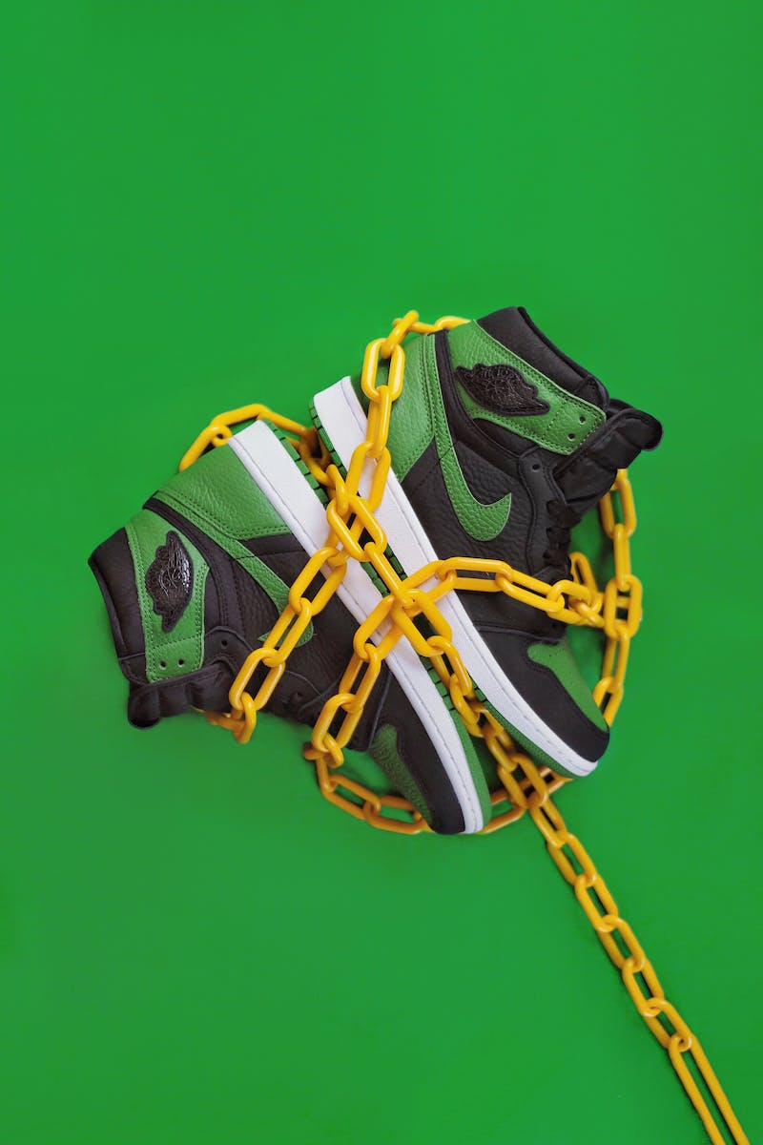
Training the Model
• Load the training dataset and instantiate the Transformer trainer class
• Specify training arguments and output directory
• Train the model using the instantiated trainer
• Monitor training progress and loss values
Photo by Pexels

Slide 8
Using the Fine-Tuned Model
• Save the fine-tuned model locally
• Load the model using the loader configuration
• Combine the base model with the Lora configuration
• Use the model for inference and generation
Photo by Pexels

Slide 9
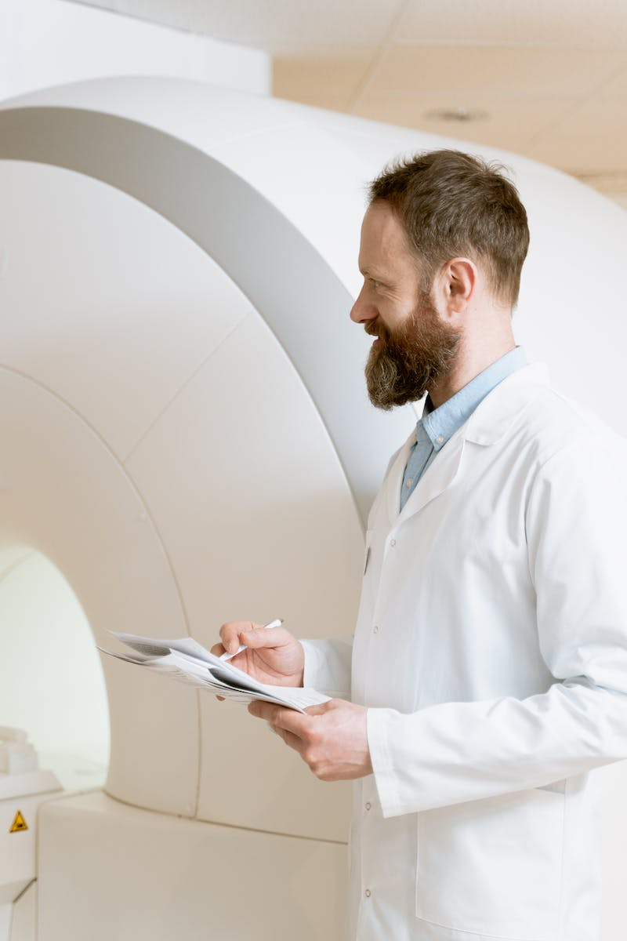
Conclusion
• Q Laura revolutionizes fine-tuning of large language models
• Democratizes the process with reduced computation requirements
• Explore Q Laura models on Hugging Face Model Hub
• Try fine-tuning your own models using the provided Google Colab notebook
Photo by Pexels

