Slide 1
The Power of Artificial Intelligence
Revolutionizing Industries and Transforming Lives

Slide 2
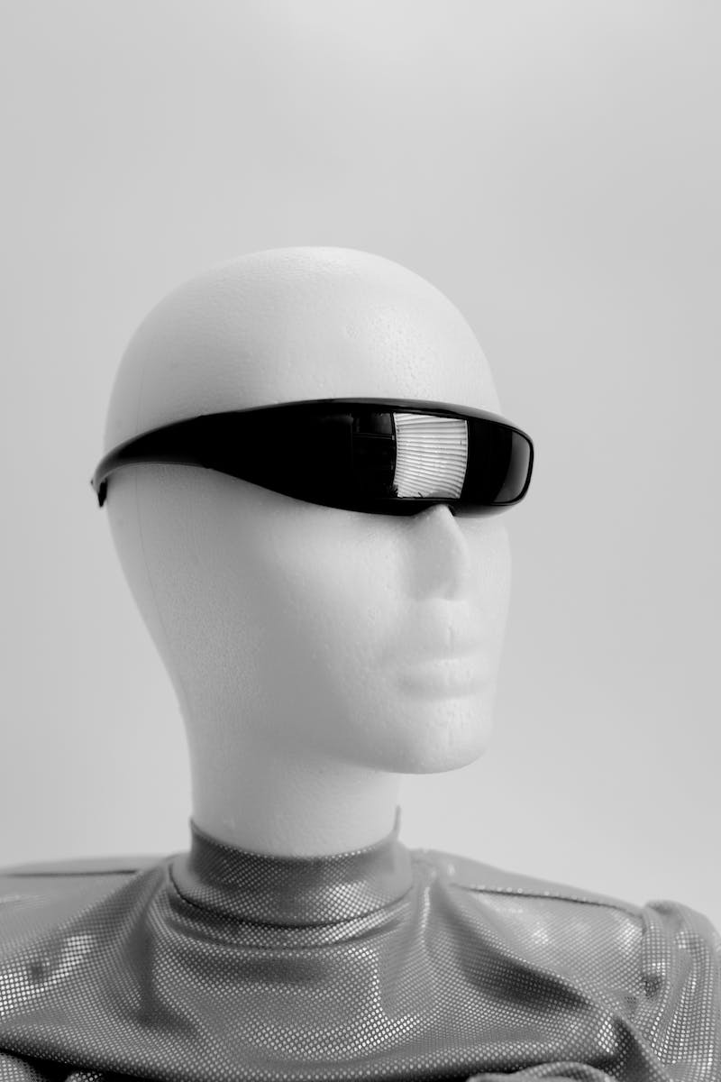
Introduction to Artificial Intelligence
• AI is a branch of computer science that simulates human intelligence.
• It encompasses machine learning, natural language processing, and problem-solving.
• AI has the potential to transform various industries and improve efficiency.
• Image: artificial intelligence
Photo by Pexels

Slide 3
AI in Healthcare
• AI is revolutionizing healthcare by improving diagnosis and treatment.
• Machine learning algorithms can analyze medical data for accurate predictions.
• AI-powered robots can assist in surgical procedures and patient care.
• Image: healthcare technology
• Source: https://www.example.com
Photo by Pexels

Slide 4
AI in Finance
• AI algorithms enable fraud detection and prevention in financial transactions.
• Machine learning models analyze market trends for effective investment strategies.
• Chatbots with AI capabilities provide personalized financial advice to users.
• Image: finance technology
• Source: https://www.example.com
Photo by Pexels

Slide 5
AI in Transportation
• Self-driving cars powered by AI technology have the potential to reduce accidents.
• AI enables efficient route planning and optimization for logistics companies.
• Smart traffic management systems improve traffic flow and reduce congestion.
• Image: autonomous vehicle
• Source: https://www.example.com
Photo by Pexels

Slide 6
Conclusion
• AI is transforming industries and revolutionizing the way we live and work.
• Its potential extends to areas like education, agriculture, and cybersecurity.
• Ethical considerations and responsible AI implementation are crucial.
• Image: technology future
• Source: https://www.example.com
Photo by Pexels

