Slide 1
The Romantic Movement: Rebellion, Passion, and Nature
Exploring the literature and ideals of the Romantic era

Slide 2
Introduction
• The Romantic Movement - an English problematic boom
• Rebellion against the norms
• The true meaning of 'romantic'
• Inspired by the French revolution and industrial revolution
Photo by Pexels

Slide 3
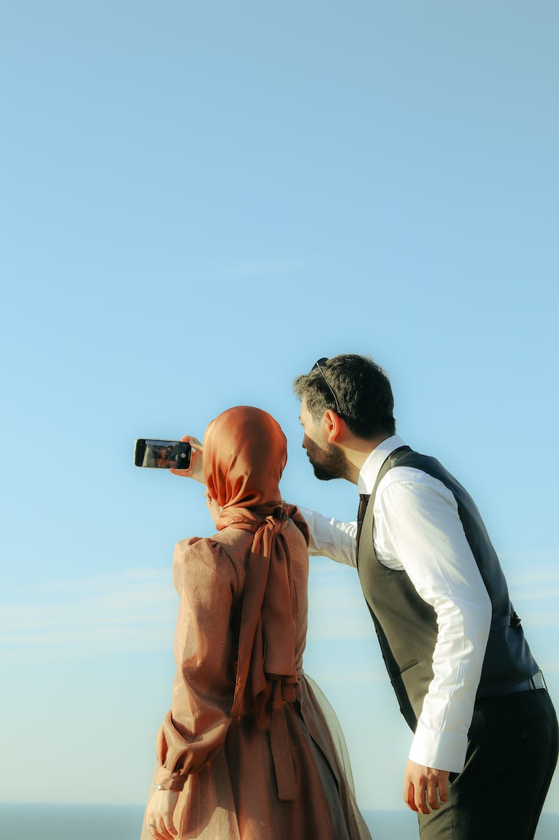
Rebelling Against the Enlightenment
• Contrasting the Enlightenment movement
• The romantic's disdain for science, reason, and logic
• Embracing powerful emotions and taking risks
• Rejecting societal norms imposed by the elite
Photo by Pexels

Slide 4
Folklore and Natural Language
• A preference for natural and spontaneous art
• Rebellion against sophisticated, hard-to-read poetry
• Drawing inspiration from folk stories and popular songs
• William Blake and William Wordsworth as examples
Photo by Pexels

Slide 5
Shakespeare and Rebellion
• Romantic admiration for Shakespeare
• Breaking the rules of classical drama
• Seeing Shakespeare as a champion of the individual
• Mixing comedy and tragedy, royalty and ordinary people
Photo by Pexels

Slide 6
Gothic Fantasies and the Dark Side
• Exploring gothic themes and supernatural elements
• Inspiration from medieval times and darkness of humanity
• Percy and Mary Shelley's connection to Gothic literature
• Exploring dark and terrible forces through their writing
Photo by Pexels

Slide 7
Passionate Love and Sexual Freedom
• Redefining the concept of love
• Passionate and out-of-control love
• Challenging societal views on sexual relationships
• Exploring unconventional views on love, sex, and marriage
Photo by Pexels

Slide 8
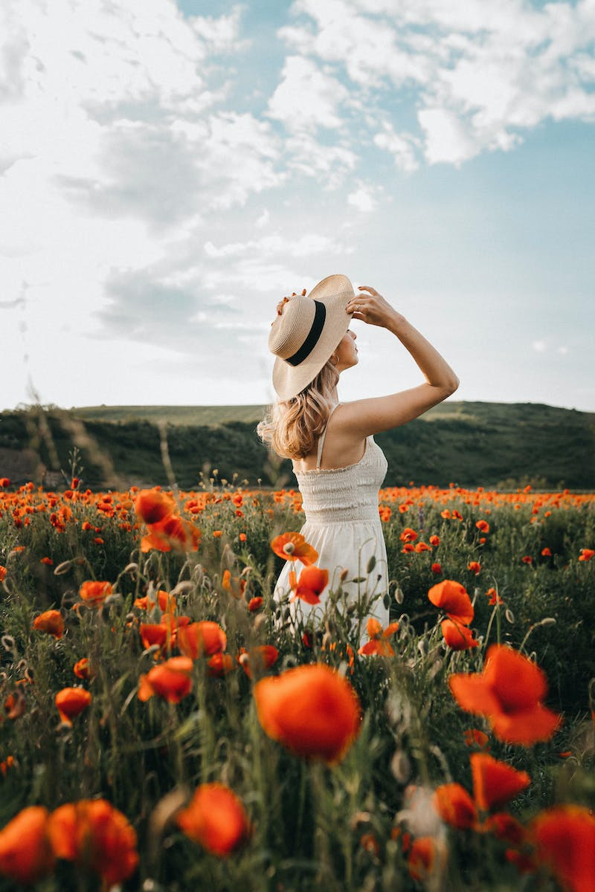
Developing Individualism
• The romantic movement's impact on personal identity
• Teenage rebellion and the search for identity
• Romantic poets as exemplars of living recklessly
• Percy Shelley, John Keats, and Lord Byron as examples
Photo by Pexels

Slide 9
Nature as Inspiration and Rebellion
• Romantic poets' discontent with industrialization
• Celebrating nature and condemning industrialization
• William Blake's poetry on the suffering of the poor
• Inspiring awe and wonder in the natural world
Photo by Pexels

Slide 10
Conclusion
• Summarize the key features and ideas of the romantic movement
• The lasting impact on literature and societal norms
• Reflecting on the influence of the romantic poets
• Questioning how our lives might be affected by their works
Photo by Pexels

