Slide 1
Introduction to Blockchain Technology
Understanding the Basics and Applications

Slide 2
What is a Blockchain?
• A blockchain is a distributed and open ledger
• Consists of blocks containing information
• Initially described in 1991 for timestamping digital documents
• Became popular with the creation of Bitcoin in 2009
Photo by Pexels

Slide 3
How Does a Blockchain Work?
• Each block contains data, hash, and previous block's hash
• Data depends on the type of blockchain
• Hash acts like a unique fingerprint for each block
• Changing a block modifies its hash and invalidates subsequent blocks
Photo by Pexels

Slide 4
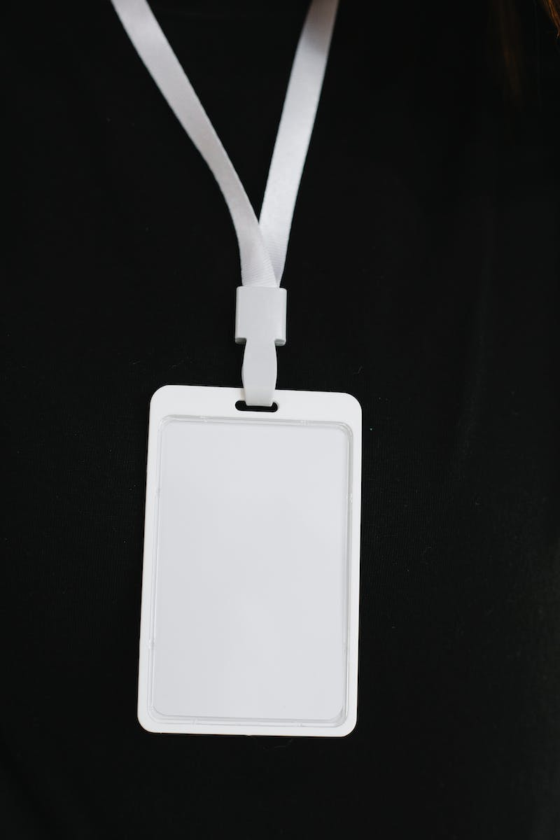
Securing a Blockchain
• Proof of Work mechanism slows down block creation
• Modifying a block requires recalculating proof of work for all subsequent blocks
• Blockchain security also relies on distribution
• Anyone can join the network and verify the blockchain
Photo by Pexels

Slide 5
Uses and Applications
• Blockchain technology has diverse applications
• Used for cryptocurrency, medical records, digital notary, tax collection, etc.
• Constantly evolving with new developments
• Introduction of smart contracts for automated transactions
Photo by Pexels

Slide 6
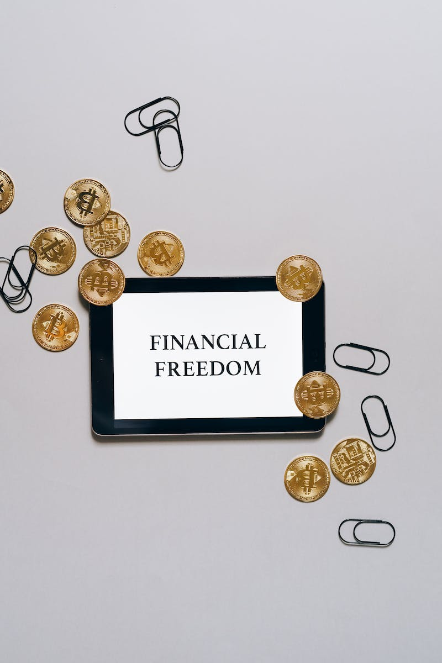
Conclusion
• Blockchain technology offers secure and transparent transactions
• Difficult to tamper with due to encryption and distributed nature
• Continued advancements in the field
• Explore implementation of a simple blockchain with JavaScript
Photo by Pexels

