Slide 1
Group Development Programs for Children's Dance School
Creating a Vibrant and Supportive Dance Community

Slide 2
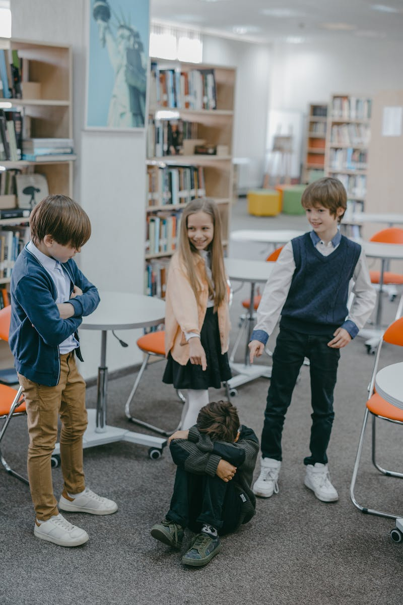
Introduction
• Overview of group development programs
• Importance for dance school children
• Adapting agenda for effective learning
• Fast-paced and engaging sessions
Photo by Pexels

Slide 3
Benefits of Group Development Programs
• Promotes teamwork and collaboration
• Boosts self-confidence and social skills
• Enhances creativity and expression
• Fosters a sense of belonging and community
Photo by Pexels

Slide 4
Adjusting the Agenda
• Structuring sessions for optimal learning
• Incorporating diverse dance styles and techniques
• Balancing practice and theory
• Creating opportunities for individual growth
Photo by Pexels

Slide 5
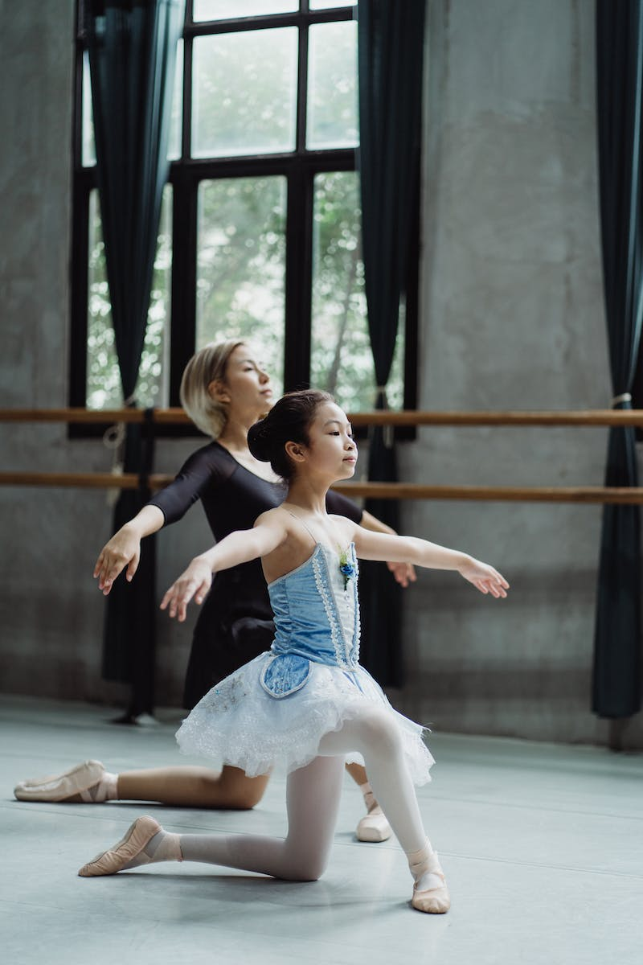
Engaging Fast Sheet
• Utilizing fast-paced activities to maintain interest
• Incorporating interactive games and challenges
• Encouraging participation and active involvement
• Ensuring a dynamic and energizing environment
Photo by Pexels

Slide 6
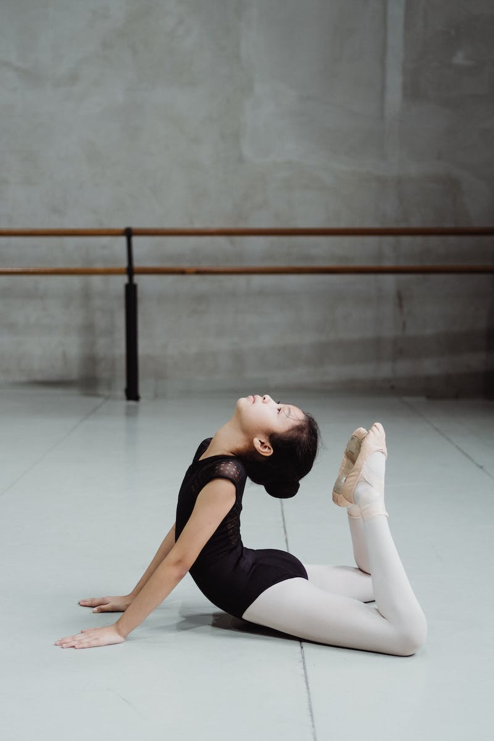
Conclusion
• Reinforcing the benefits of group development programs
• Encouraging continued participation
• Creating a vibrant dance community
• Celebrating achievements and growth
Photo by Pexels

