Slide 1
Platform Revolution: Unleashing the Power of Technology
Exploring the Impact and Potential of Fabric Platforms

Slide 2
Introduction
• The role of fabric platforms in driving innovation
• Understanding the concept of fabric platforms
• Exploring the potential applications of fabric platforms
• The significance of fabric platforms in today's digital economy
Photo by Pexels

Slide 3
Challenges Addressed by Fabric Platforms
• Overcoming the limitations of traditional platforms
• Enabling seamless and secure subcutaneous contracts
• Enhancing privacy and data protection
• Facilitating efficient and transparent transactions
Photo by Pexels

Slide 4
Fabric Platform Architecture
• Understanding the structure and components of fabric platforms
• Exploring the role of fabric platform speech
• The instrumental platform and its significance
• The concept of village and its relationship with fabric platforms
Photo by Pexels

Slide 5
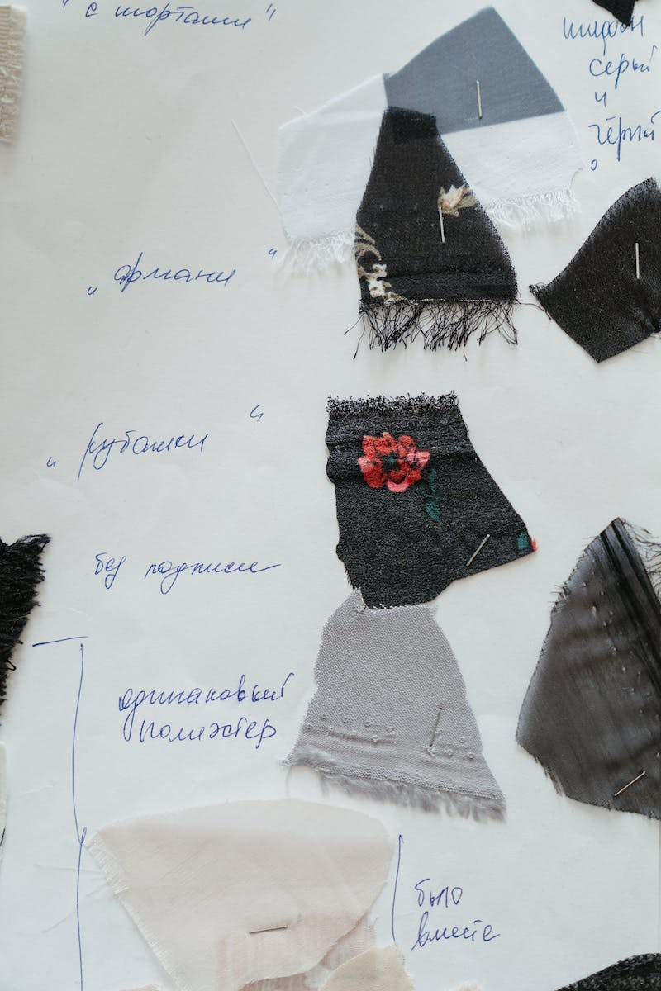
Fabric Platform Examples
• Highlighting real-world examples of fabric platforms
• Exploring the impact and success of fabric platforms
• The role of fabric platforms in transforming industries
• Case studies demonstrating the effectiveness of fabric platforms
Photo by Pexels

Slide 6
Future Outlook
• Predicting the future trajectory of fabric platforms
• Examining potential challenges and opportunities
• The role of innovation and collaboration
• Implications for businesses and society
Photo by Pexels

