Slide 1
The Rise and Fall of the Roman Empire
From a Small Latin Village to a Global Superpower

Slide 2
Introduction
• - The letters we use today are inherited from the Romans
• - Roman-speaking countries are scattered across the world
• - Rome was the first example of globalization
• - Let's take a journey through twelve centuries of Roman history
Photo by Pexels

Slide 3
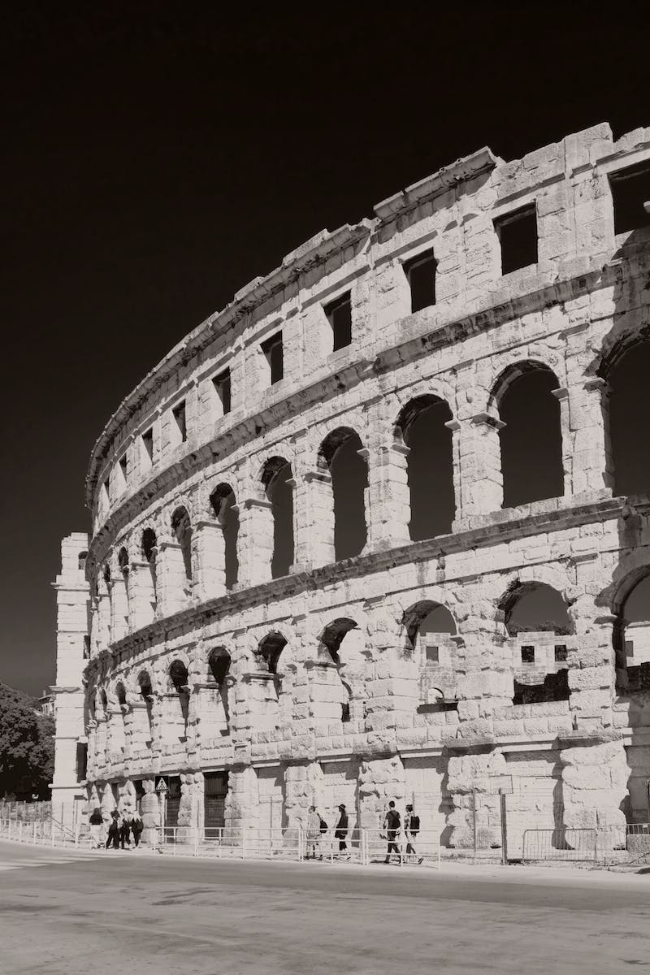
The Birth of Rome
• - Rome started as a small settlement by the Tiber River
• - It benefited from its location at the crossroads of trade routes
• - Rome was a refuge for outcasts, providing opportunities for social mobility
• - The Romans considered themselves descendants of Trojan refugees
Photo by Pexels

Slide 4
The Etruscan Influence
• - The Etruscans were mysterious neighbors to the north
• - They actively traded with the Romans and Greeks
• - This trade network led to the establishment of Rome
• - Many aspects of Roman civilization were borrowed from the Etruscans

Slide 5
Transition to a Republic
• - In 509 BCE, Rome abolished the monarchy and established a republic
• - Consuls were elected annually to share executive power
• - The Senate consisted of patricians who controlled legislation
• - Plebeians fought for equal rights and representation
Photo by Pexels

Slide 6
Punic Wars and Imperial Expansion
• - The Punic Wars against Carthage expanded Rome's influence
• - Rome gradually conquered all of Italy
• - The Roman legions triumphed over the formidable Macedonian phalanx
• - The Roman Empire extended its dominion to Egypt and beyond
Photo by Pexels

Slide 7
The Decline and Fall
• - The empire faced economic challenges due to cheap grain and an influx of slaves
• - Internal power struggles plagued the late empire
• - Discontent among the population led to social unrest
• - The once-mighty empire fell to invading barbarian tribes
Photo by Pexels

Slide 8
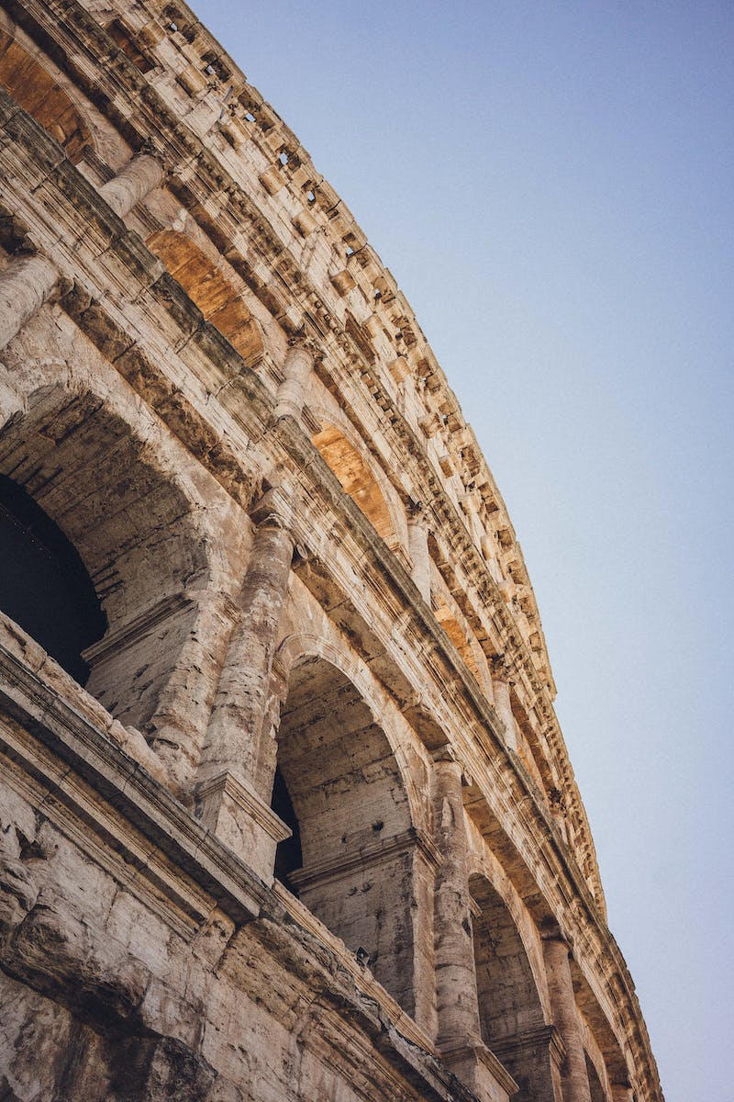
Conclusion
• - Rome's legacy includes a lasting impact on language, culture, and governance
• - The empire's reach and influence laid the foundation for future civilizations
• - We continue to be influenced by Rome's achievements and challenges today
• - The rise and fall of the Roman Empire is a captivating chapter in human history
Photo by Pexels

