Slide 1
Healthy Liver, Healthy Life
Raising Awareness on Liver Health

Slide 2
Introduction
• Joining Apollo Hospital for a huge campaign
• Creating awareness on liver health
• Liver disease is a global epidemic
• 30% of Indian population affected
• Leading cause of failure and death
Photo by Pexels

Slide 3
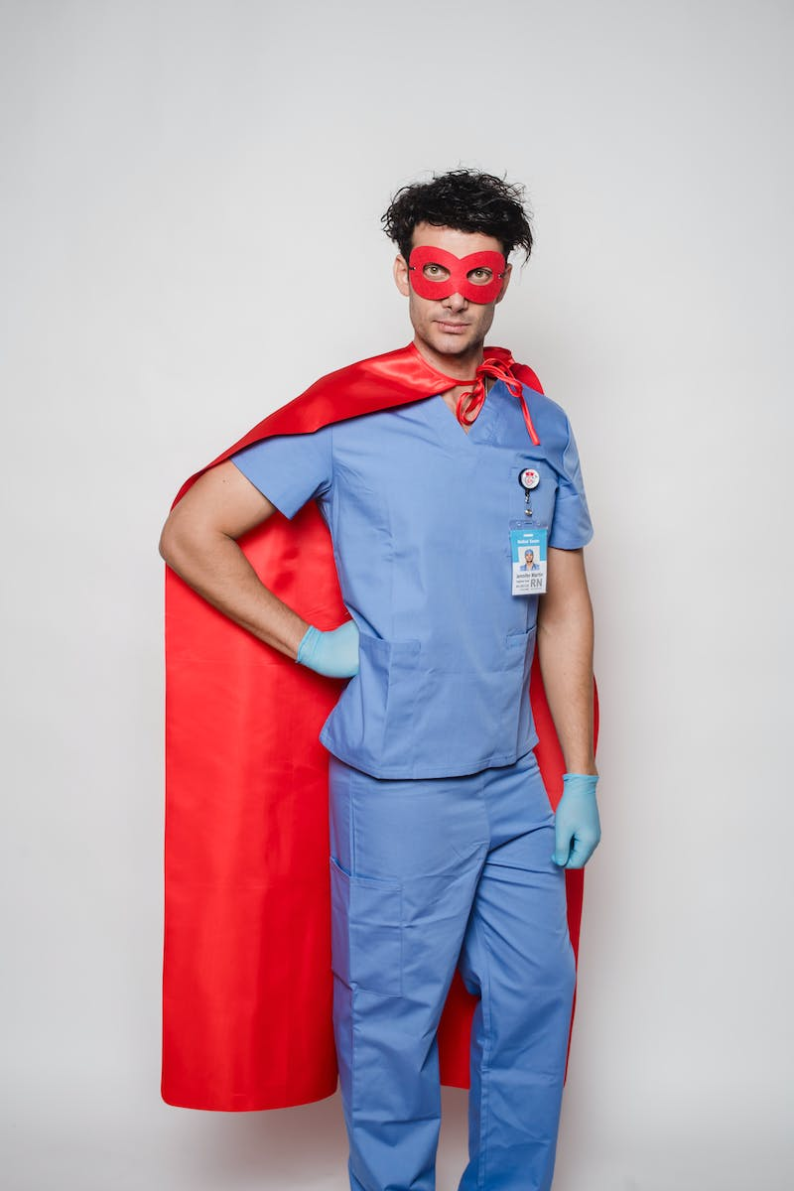
The Silent Killer
• Chronic viral hepatitis as a major cause
• Two deaths every minute
• All deaths are preventable
• Create initiatives for healthy liver
Photo by Pexels

Slide 4
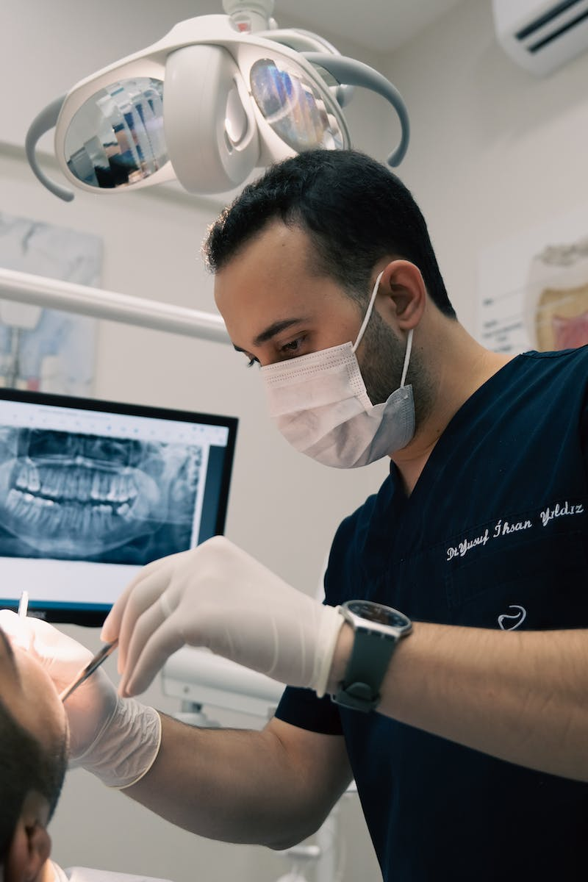
Uniting for Change
• Healthcare organizations, policymakers, and public join hands
• Platform for collaboration
• Creating a reality of healthy liver
• Promoting awareness and education
• Taking necessary steps for prevention
Photo by Pexels

