Slide 1
Henry US Survival Rifle: A Comprehensive Update
Addressing Complaints, Demonstrating Reliability, and Testing Ammunition

Slide 2
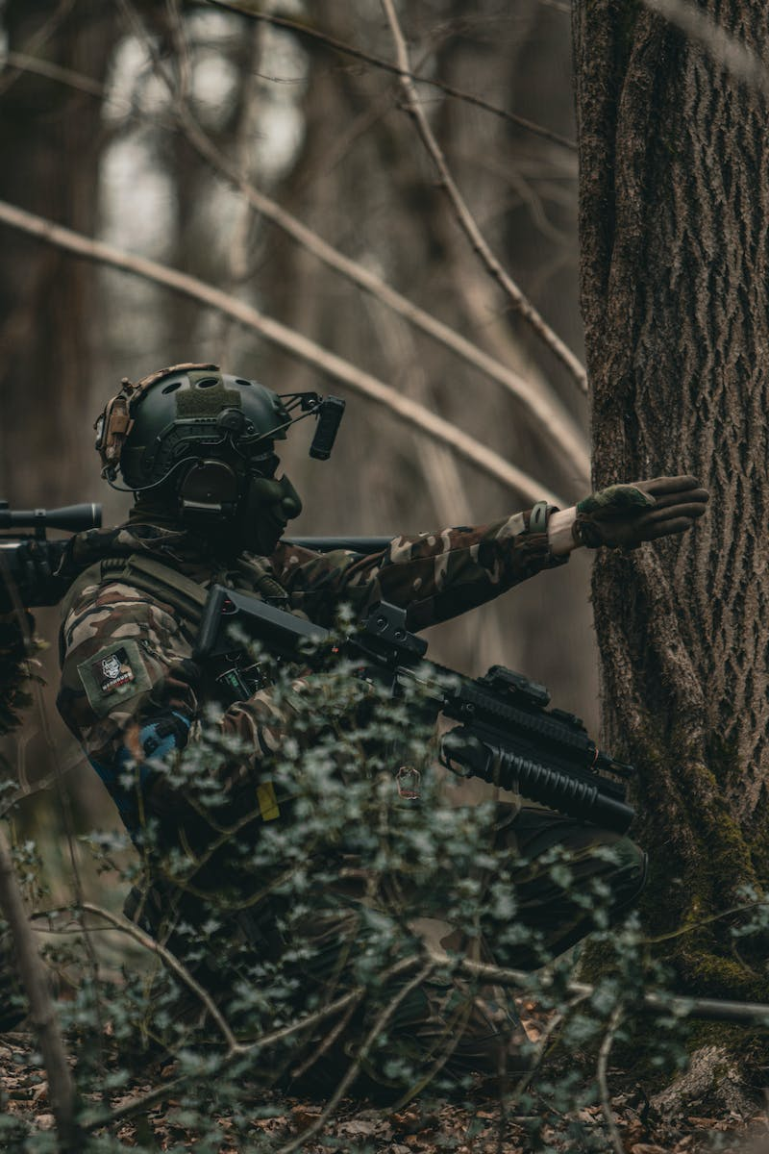
Introduction
• Good morning from Southern Nevada!
• Today, we'll provide a two-year update on the Henry US Survival Rifle (AR-7).
• Overview of the positive feedback received on previous videos.
• Discussion of the two main complaints: front sight and reliability.
Photo by Pexels

Slide 3
Disassembling the Rifle
• Overview of the unique design and portability of the rifle.
• Demonstration of disassembling the rifle and showing the integrated storage compartment.
• Highlighting the 16-inch barrel and receiver.
• Discussion of the convenience of storing magazines in the butt stock.
Photo by Pexels

Slide 4
Addressing Front Sight Complaints
• Description of the plastic front sight and common complaints.
• Options for resolving the front sight issue, including using lock tight or obtaining replacement sights.
• Assurance of personal experience with a secure front sight.
• Emphasizing that the front sight is not a major concern.
Photo by Pexels

Slide 5
Ensuring Reliability
• Discussion of historical complaints about the rifle's reliability.
• Mention of Henry's efforts to address these issues through magazine redesign.
• Common causes of reliability problems, including dirty firearm, faulty magazines, or mechanical malfunctions.
• Recommendation to clean the rifle's chamber, use quality ammunition, and check for magazine-related problems.
Photo by Pexels

Slide 6
Testing Ammunition
• Introduction to the ammunition brands used for testing.
• Demonstration of shooting four different brands: Federal, Winchester, Remington, and CCI.
• Evaluation of each brand's performance and potential issues, if any.
• Conclusion on the rifle's reliability based on the ammunition testing.
Photo by Pexels

Slide 7
Reliability Results and Final Thoughts
• Detailed account of the rifle's reliability during the ammunition testing.
• Review of any malfunctions or issues encountered.
• Applauding the rifle's overall reliability and personal positive experience.
• Reiteration of key factors for ensuring proper functioning: cleanliness, good ammunition, and functional magazines.
Photo by Pexels

Slide 8
Additional Features and Maintenance
• Description of unique design features, such as the offset barrel and fat grip.
• Explanation of the rifle's length and compatibility with scopes.
• Demonstration of the rifle's ease of field stripping and maintenance steps.
• Recommendation to clean the bolt, lubricate the necessary parts, and maintain the barrel.
Photo by Pexels

Slide 9
Demonstration and Conclusion
• Demonstration of accurate shooting and target practice.
• Personal satisfaction with the rifle's performance.
• Closing remarks thanking the audience and encouraging engagement.
• Humorous remark about having breakfast with successful hunting.
• Closing appreciation for watching and requesting likes and notifications.
Photo by Pexels

