Slide 1
Deep Learning on Meshes: Challenges and Applications
Exploring the use of deep learning on irregular mesh data and its applications in computer graphics

Slide 2
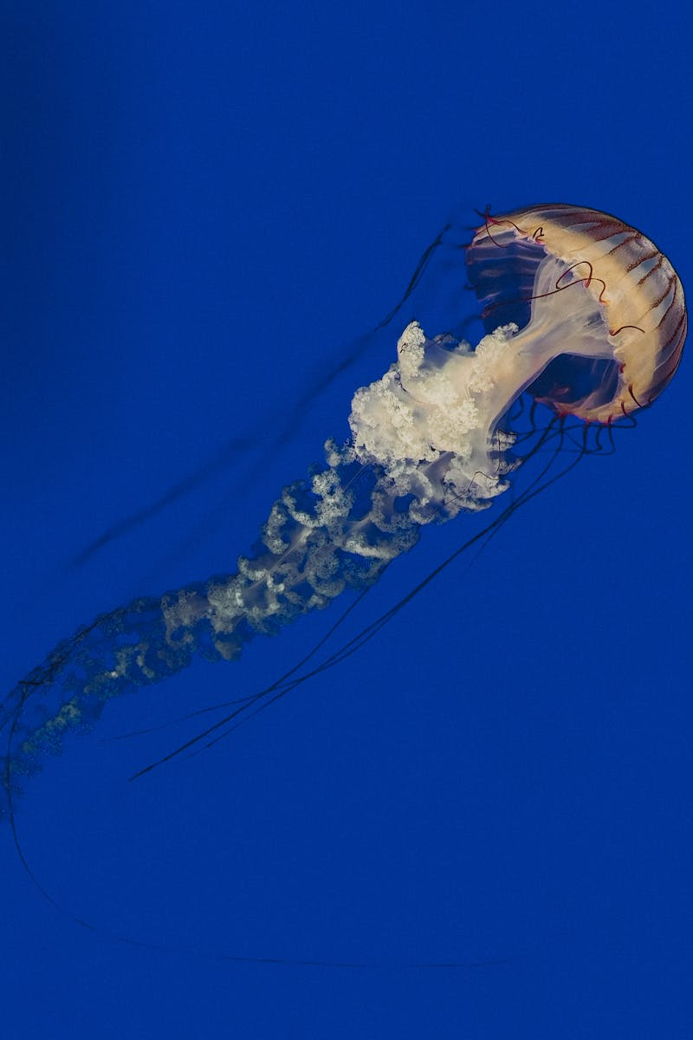
Introduction to Deep Learning on Meshes
• Deep learning has shown success on structured data like images and text
• Interest is growing in applying deep learning to 3D computer graphics
• Meshes are widely used in computer graphics due to their efficiency and flexibility
• Deep learning on meshes opens doors for applications like generative shape modeling and shape analysis tasks
Photo by Pexels

Slide 3
Challenges in Extending Deep Learning to Meshes
• Mesh representation lacks structure and order, making it challenging to apply standard neural network operators
• Mesh triangulations can vary, making it difficult to utilize standard convolution operations
• 3D mesh data is often imperfect and requires manual processing
• The curse of dimensionality in 3D data restricts the amount of available training data
Photo by Pexels

Slide 4
Mesh Convolutional Neural Networks
• Mesh CNNs learn deep features on mesh edges
• Shared weights across the mesh enable efficient and effective feature extraction
• Mesh pooling and unpooling layers increase the receptive field and incorporate more context
• Different approaches like neural subdivision and mesh walker explore variations of mesh convolutions
Photo by Pexels

Slide 5
Learning from a Single Shape Example
• Internal data within a single shape can be used for training deep neural networks
• Self-prior allows learning from unique internal patch data within a shape
• Applications include surface reconstruction from point clouds and shape completion
• The self-prior provides a tailored prior for each individual input, resulting in better reconstructions
Photo by Pexels

Slide 6
Surface Reconstruction with Self-Prior
• Surface reconstruction is traditionally a challenging and ill-posed problem
• Point-to-mesh uses the self-prior to generate more plausible surface reconstructions
• The self-prior is optimized through mesh convolutional neural networks
• The self-prior enables better handling of noise, outliers, and missing parts
Photo by Pexels

Slide 7
Applications of Learning from Single Shape Example
• Learning from a single shape example has various applications in computer graphics
• Shape completion, 3D printing orientation, and internal structure learning are a few examples
• By leveraging internal data, these applications can be more robust and tailored to specific shapes
• The self-prior approach provides a powerful inductive bias for solving these tasks
Photo by Pexels

Slide 8
Conclusion
• Deep learning on meshes opens up new possibilities in computer graphics
• Challenges in mesh representation and data must be addressed
• Mesh convolutional neural networks provide a powerful inductive bias for deep learning on meshes
• Learning from a single shape example enables robust applications without the need for large external data sets
Photo by Pexels

