Slide 1
The Mystery of Blue Blood
Unraveling the Secrets of Artificial Blood

Slide 2
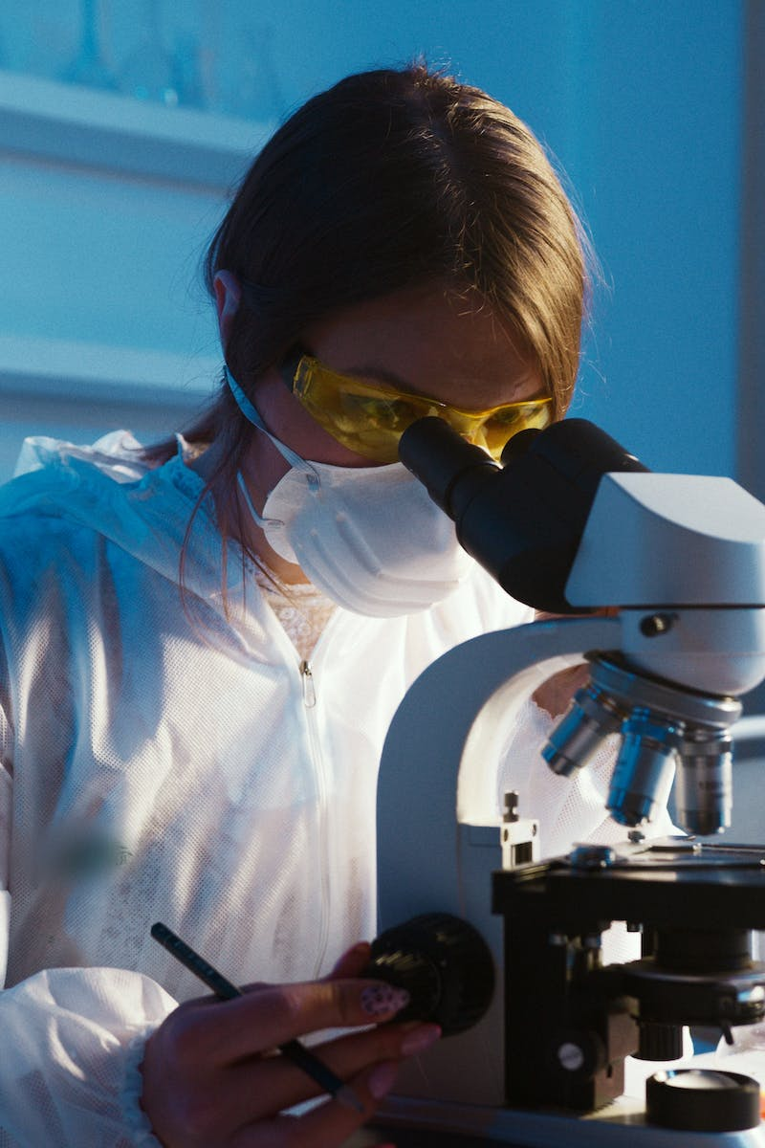
Introduction
• In the early 1980s, Soviet scientist Professor Felix Beloyartsev made a breakthrough
• Announced the creation of an emulsion capable of carrying oxygen throughout the body
• Named the emulsion 'Perforan'
• Questions arise: Did scientists truly recreate human blood? Why was the world's first artificial blood banned in the USSR?
Photo by Pexels

Slide 3
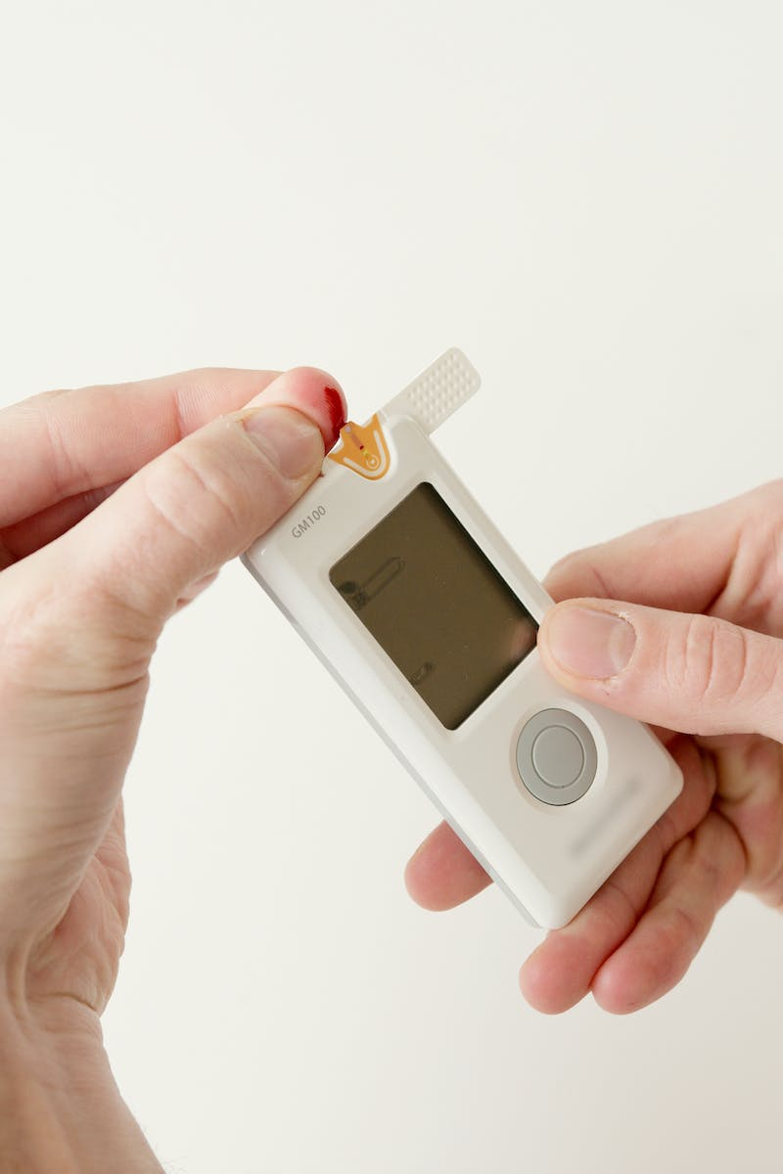
Perforan: The Life-Saver
• Despite the ban, Perforan begins saving lives
• Revolutionary emulsion effectively delivers oxygen to organs
• Prevents death in critical situations
• Source of mystery: Why was it still banned?
Photo by Pexels

Slide 4
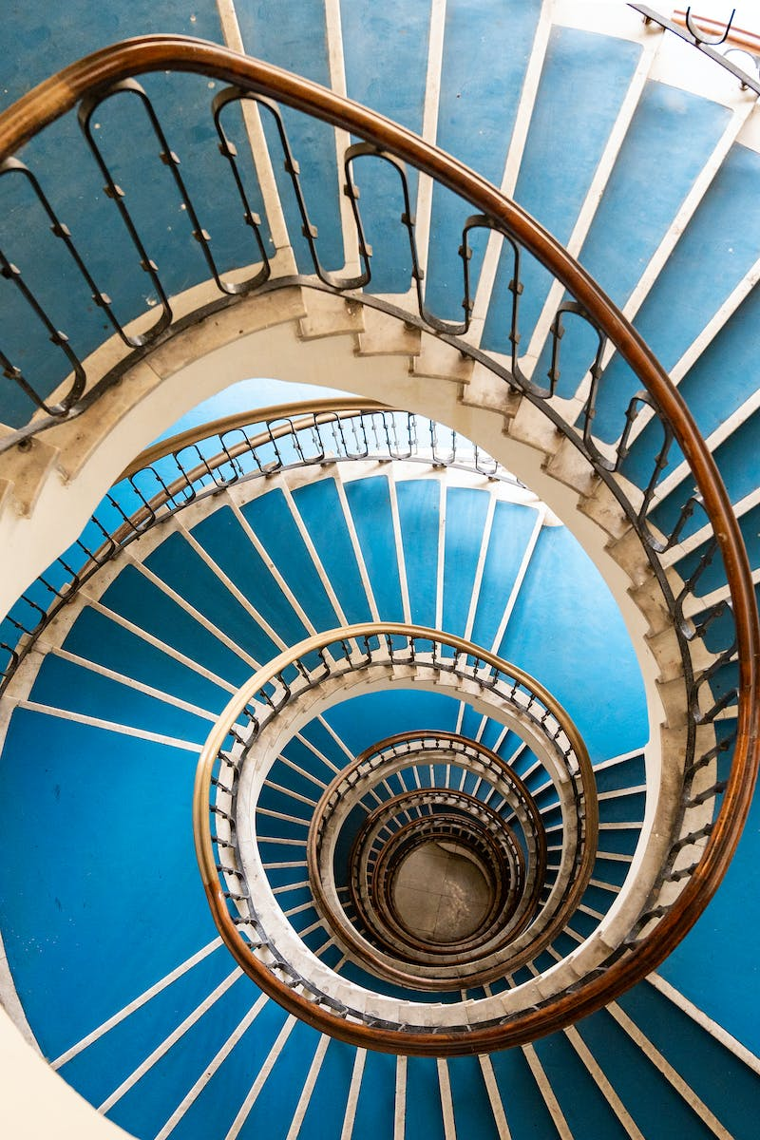
The Blue Blood
• Perforan appears blue when infused into the body
• This unique property captivates researchers and the public
• Initial research conducted in the 1970s
• Why is it called blue blood if it looks white?
• The blue hue in the body highly intriguing
Photo by Pexels

Slide 5
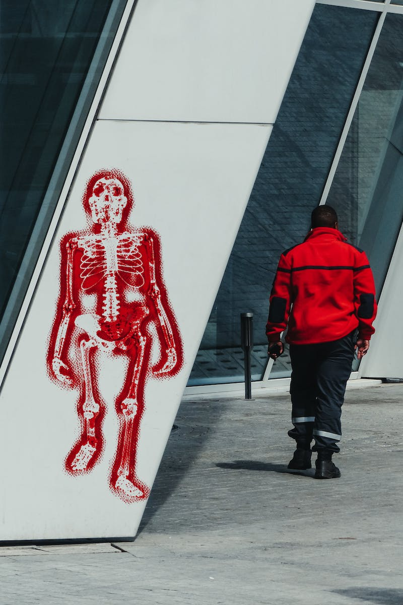
Unanswered Questions
• The shocking event that led to Professor Beloyartsev's death
• Speculation on why he took his own life
• Historian's account of the investigations
• Loss of a brilliant mind and valuable research
• What could have been achieved if allowed to continue?
Photo by Pexels

Slide 6
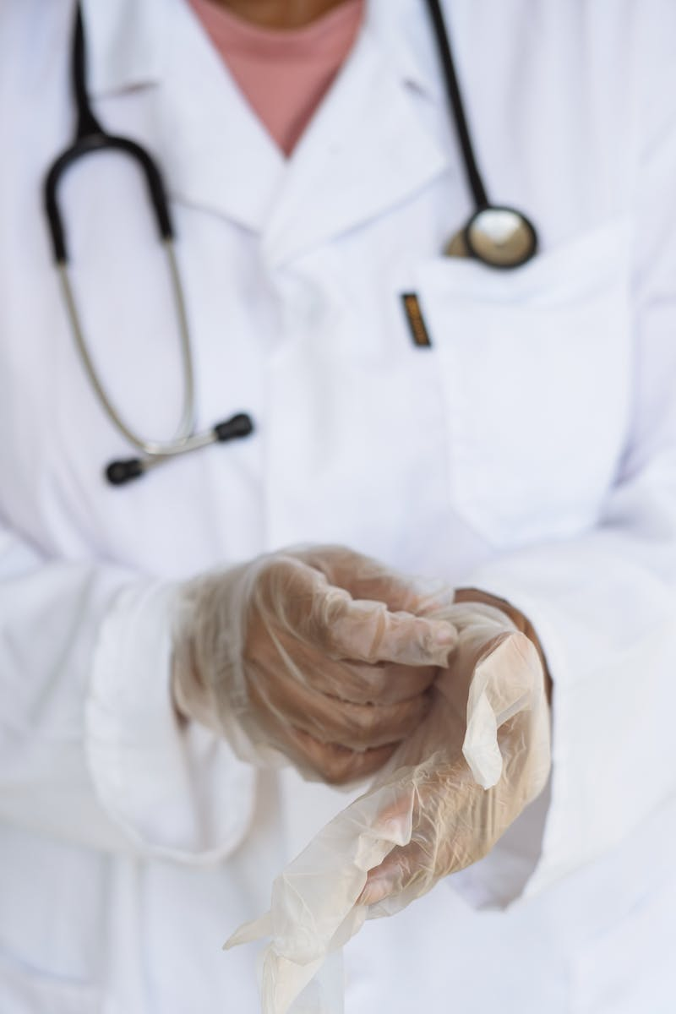
Lost Opportunities
• Current application of Perforan and ozone therapy
• Positive results in wound healing and treatment of infections
• Recommendations for wider use
• Calling for the revival of Perforan research
• The future of artificial blood and medical advancements
Photo by Pexels

