Slide 1
Beauty in Brokenness: Embracing Imperfection and Resilience
Exploring the Japanese Concept of Kin kentucky

Slide 2
Introduction
• Imagine a beautiful vase, a genuine hand-painted Porcelain from 19th-century Japan.
• One day, it gets broken, but a Japanese elder helps repair it using the art of Kin.
• Kin is more than a technique - it embodies a philosophy of appreciating imperfection and embracing brokenness.
• In a society obsessed with perfection, Kin challenges us to view flaws as beautiful and meaningful.
Photo by Pexels

Slide 3
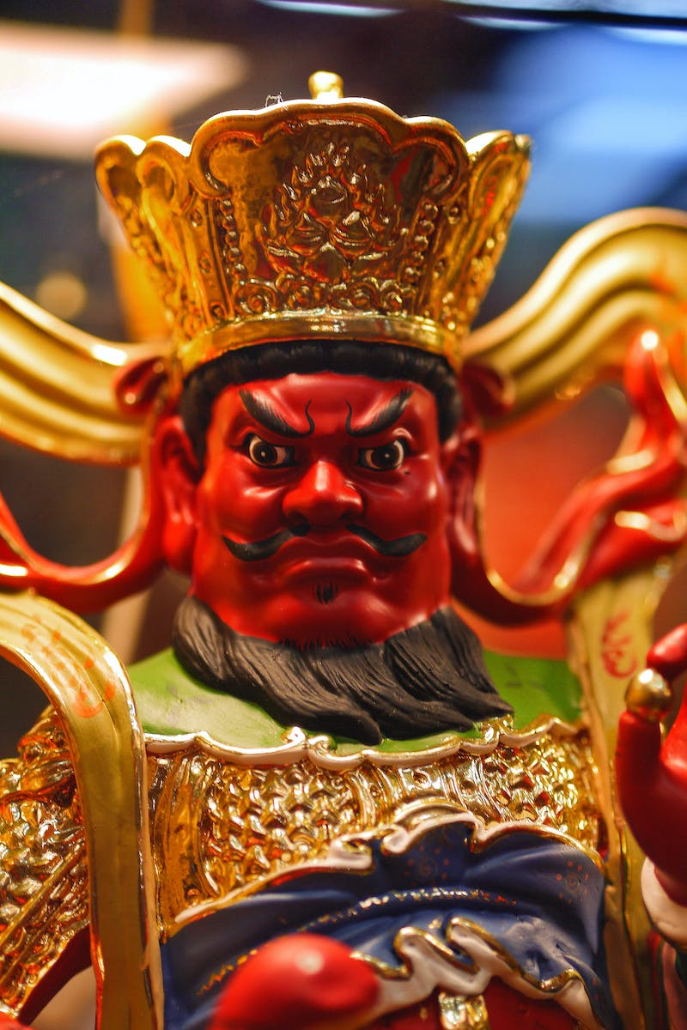
Kin kentucky: Golden Joinery
• Kin originated in 15th-century Japan as an alternative to metal staples for repairing pottery.
• Using Gold Le, the cracks in the repaired pottery are highlighted, symbolizing resilience and history.
• Kin revolutionized how we view damage and repair, seeing fractures as a chapter in the object's life.
• The transition from metal staples to Gold Leg was not just about aesthetics, but a shift in perspective.
Photo by Pexels

Slide 4
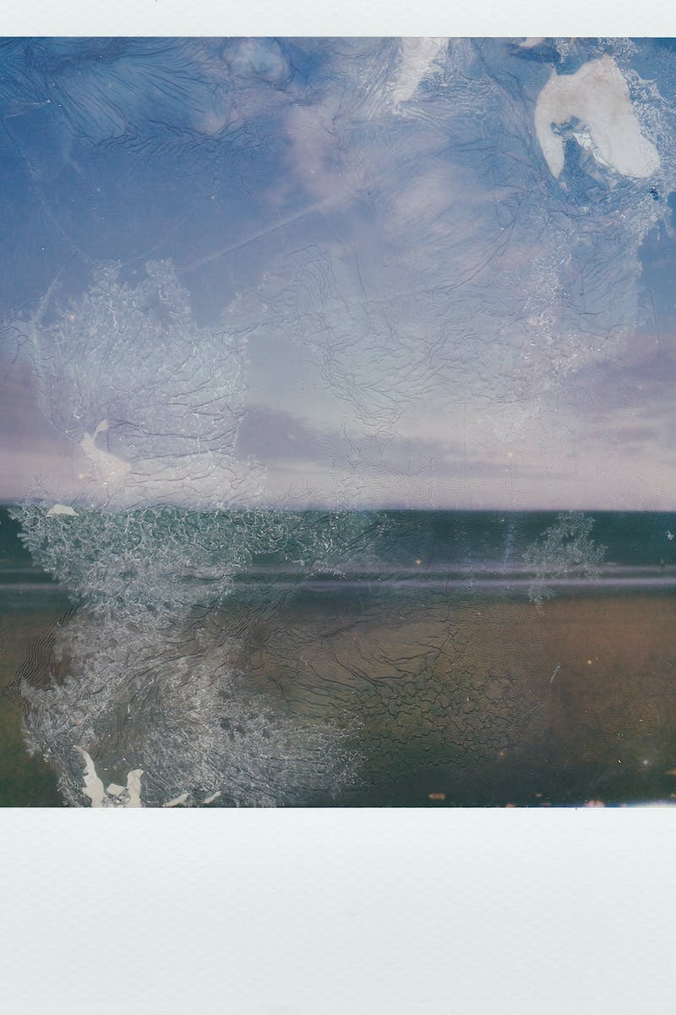
The Philosophy of Kin
• Kin is not just about repairing broken objects, but about embracing imperfection and transience.
• It challenges the societal perception that broken things have less value than intact ones.
• Kin embraces the idea of W sa, appreciating the imperfection and transformation of things touched by time.
• Mona, empathy for things, is another concept that overlaps with Kin, highlighting the gentle sadness of passing things.
Photo by Pexels

Slide 5
Kin in Practice: A Dutch Perspective
• Tilburg, a city in the Netherlands, embraced the concept of Kin in its urban development.
• Instead of demolishing old factory buildings and replacing them, they preserved and repurposed them.
• Tilburg's industrial past, with its visible scars and decay, is now celebrated as part of its beauty.
• The city's approach mirrors the philosophy of Kin, embracing imperfections and turning them into strengths.
Photo by Pexels

Slide 6
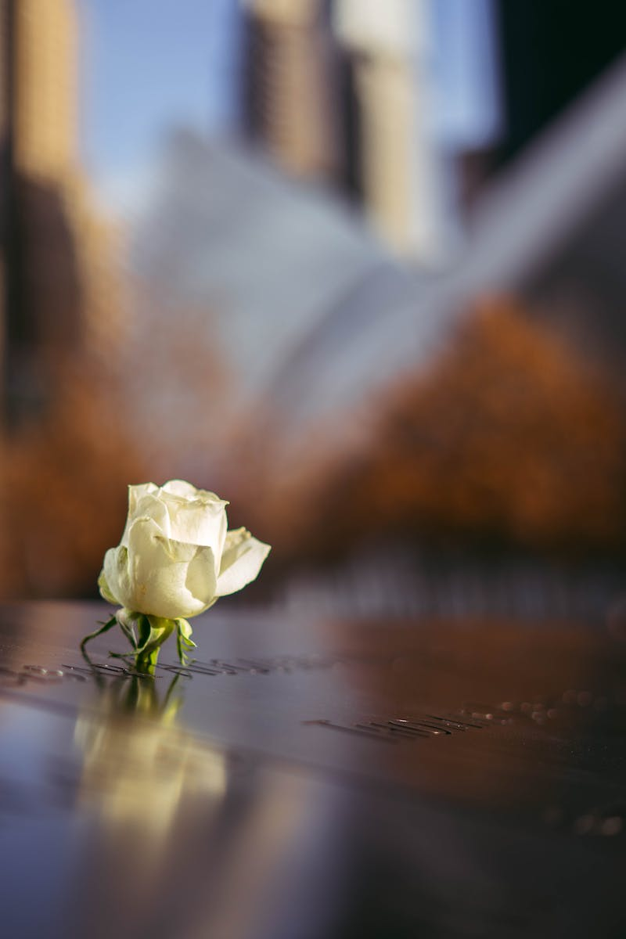
Ground Zero: Embracing Scars
• The 9/11 Memorial in New York City exemplifies the concept of embracing scars.
• The memorial includes two pools representing the void left by the Twin Towers.
• The scars of the destruction are visible, serving as a powerful reminder and landmark.
• The site combines remembrance, solidarity, and resilience, emphasizing the endurance of the city.
Photo by Pexels

Slide 7
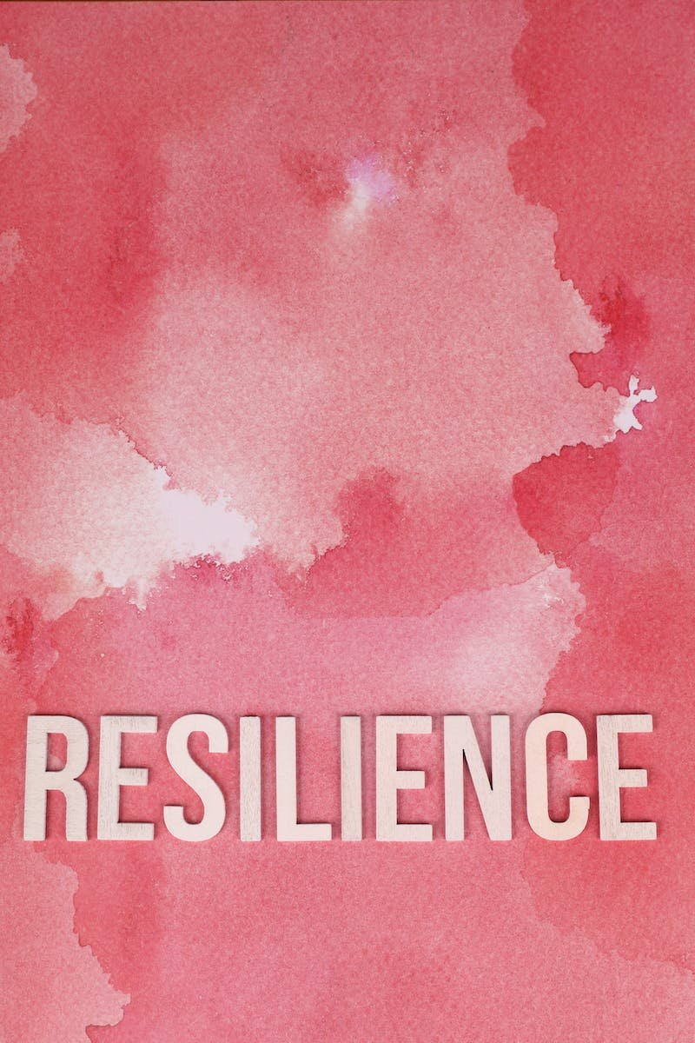
The Beauty of Our Brokenness
• Our personal lives carry scars and imperfections, both visible and hidden.
• Instead of hiding or discarding our brokenness, we can embrace it as part of our story.
• Our scars can become pathways to resilience, personal growth, and empathy for others.
• By embracing our brokenness, we can find beauty in our imperfections and inspire others to do the same.
Photo by Pexels

Slide 8
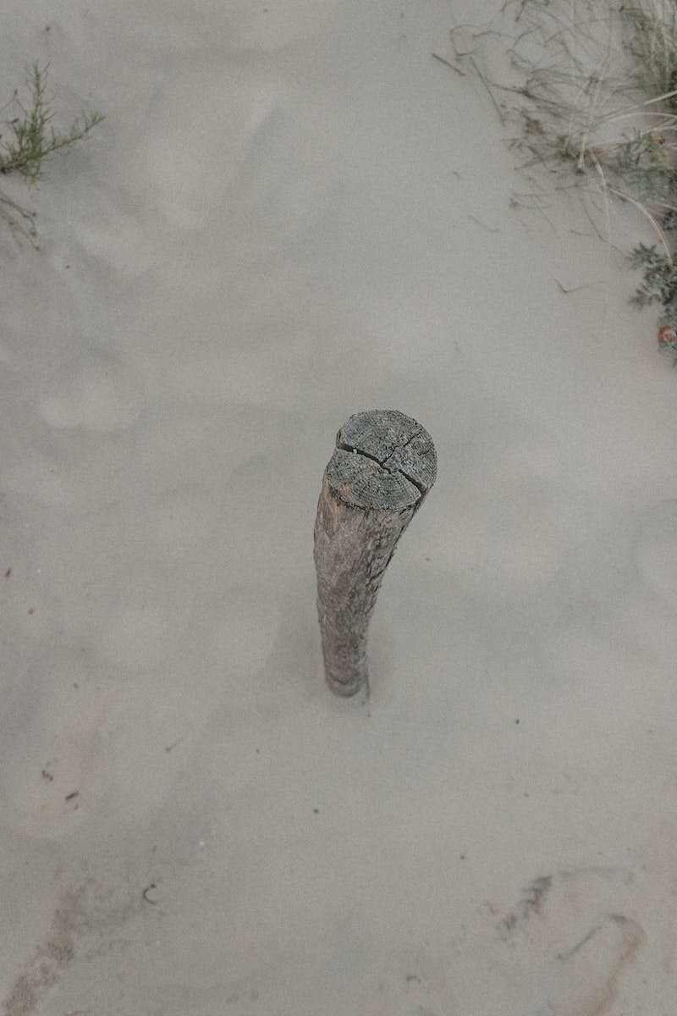
Conclusion
• Kin kentucky teaches us to embrace imperfection and find beauty in brokenness.
• In a society obsessed with perfection, Kin challenges our attitudes towards flaws.
• By embracing our scars and imperfections, we can find resilience and personal growth.
• Kin extends beyond repairing broken objects - it is a philosophy for approaching our lives.
Photo by Pexels

