Slide 1

Sustainable FIU: Driving Change, Parking Smarter
+
+
+
Enhancing Transportation and Parking for a Greener Campus Future
+
+
+

Slide 2



Table of Contents
01
FIU: Driving Sustainability
02
FIU Sustainability: Unveiled
03
MMC: A Green Transformation
04
FIU Sustainability: Data Collection
05
FIU Transportation: Current State
06
Sustainable Commuting Barriers
07
Green Incentives: FIU's Path
08
Driving a Sustainable Future: Policy Priorities
09
Investing in Tomorrow

Slide 3
Table of Contents
10
Sustainable FIU: A Greener Future

Slide 4

FIU: Driving Sustainability
Transportation is a major contributor to global greenhouse gas emissions, accelerating climate change. Consider the impact.
Urban campuses like FIU face high traffic, exacerbating congestion and negatively impacting air quality significantly.
Extensive parking lots and roadways on campus contribute to unsustainable land use practices, reducing green spaces.
These transportation factors directly undermine FIU's environmental sustainability goals, hindering a greener campus.

Slide 5
FIU: Driving Sustainability
FIU has a crucial role in promoting sustainable transportation options, and reducing its environmental footprint overall.
Promoting walking and biking can make our campuses healthier and happier places to learn and grow.

Slide 6



FIU Sustainability: Unveiled
Potential Benefits
Potential Challenges
  Improved air quality on campus due to reduced reliance on personal vehicles and decreased emissions.
  Enhanced student and faculty well-being through promoting active transportation and reducing stress related to parking.
  Cost savings for commuters who utilize public transportation or alternative commuting options with implemented incentives.
  Initial high costs associated with improving public transport infrastructure and implementing commuting incentives.
  Resistance from some students and faculty who are accustomed to driving and may find alternatives inconvenient.
  Difficulty in accurately measuring emissions and tracking the effectiveness of implemented sustainability policies.

Slide 7
FIU Sustainability: Unveiled
Potential Benefits
Potential Challenges
  Positive impact on FIU's reputation and ranking as a sustainable and environmentally conscious institution.
  Potential for increased congestion on public transport routes if a significant number of commuters switch over.

Slide 8

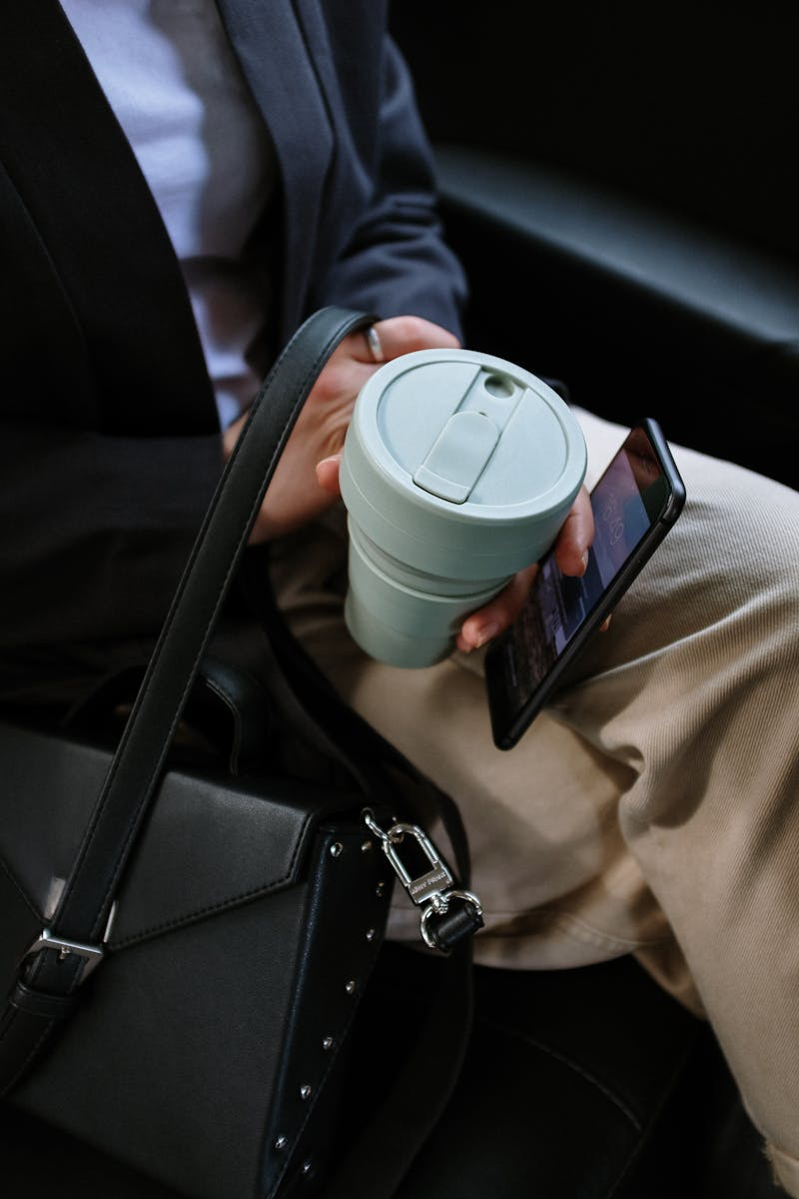
MMC: A Green Transformation
Modesto A. Maidique Campus (MMC) is FIU's largest and busiest campus, serving a diverse community.
Evaluating the current shuttle system to improve routes, frequency, and rider experience on MMC.
Analyzing parking availability and demand to optimize parking resources across the MMC campus.
Examining traffic patterns to identify bottlenecks and propose solutions for smoother traffic flow at MMC.

Slide 9
MMC: A Green Transformation
Aligning transportation improvements with FIU's broader sustainability objectives for a greener MMC.

Slide 10
FIU Sustainability: Data Collection
Gathering broad insights on transportation and parking preferences from the FIU community through comprehensive surveys.
In-depth conversations with stakeholders to understand perspectives and experiences related to FIU's sustainability efforts.
Direct observation of transportation and parking infrastructure to assess current practices and identify improvement opportunities.
Analyzing relevant documents and reports to establish a baseline and track progress in sustainability initiatives.

Slide 11
FIU Sustainability: Data Collection
Combining diverse data sources to create a holistic and reliable evaluation of FIU's sustainability performance.

Slide 12
FIU Transportation: Current State
EV Chargers
14
Shuttle Lines
4
Bike Lanes
Limited
Solo Drivers
High

Slide 13
FIU Transportation: Current State
Solar Panels
None
Shaded Parking
Lack

Slide 14

Sustainable Commuting Barriers
1.
Scheduling Conflicts
2.
Limited Availability
Students find coordinating schedules a challenge, hindering carpool and shuttle participation for sustainable commuting options.
Insufficient carpool and shuttle options, at specific times or locations, restrict student access to sustainable commuting.
3.
High Costs
4.
Carpool Interest
The perceived or actual cost of carpooling or shuttle services proves prohibitive for some students.
Despite barriers, students show a considerable interest in using carpooling to support sustainable commuting practices.

Slide 15
Sustainable Commuting Barriers
5.
Shuttle Demand
Demand is high for shuttle services, signaling potential for improving sustainable commuting among the student population.

Slide 16
Green Incentives: FIU's Path
Key Benefits
Potential Drawbacks
  Reduced carbon footprint through decreased vehicle emissions, contributing to a healthier environment for the FIU community.
  Lower transportation costs for students and staff who opt for carpooling, public transit, or cycling alternatives.
  Improved campus accessibility and reduced traffic congestion, making it easier for everyone to navigate and enjoy FIU.
  Initial investment in infrastructure and incentive programs may require significant financial resources and careful budget allocation.
  Potential resistance from individuals accustomed to driving alone, requiring effective communication and persuasive messaging.
  Dependence on external factors like public transport schedules and weather conditions, which can impact reliability and convenience.

Slide 17
Green Incentives: FIU's Path
Key Benefits
Potential Drawbacks
  Enhanced public image for FIU as a leader in sustainability, attracting environmentally conscious students and faculty.
  Challenges in accurately tracking and verifying participation in incentive programs to ensure fair and effective resource allocation.

Slide 18
Driving a Sustainable Future: Policy Priorities
Implement tax credits and rebates to make electric vehicles more affordable and accessible to a wider range of consumers.
Invest in expanding and modernizing public transportation networks, creating efficient and convenient alternatives to personal vehicles.
Develop dedicated bike lanes and paths to promote cycling as a safe and viable mode of transportation for daily commutes.
Increase the availability of public charging stations for electric vehicles, addressing range anxiety and encouraging adoption.

Slide 19
Driving a Sustainable Future: Policy Priorities
Promote policies supporting sustainable practices across various sectors contributing to a greener and more environmentally conscious society.

Slide 20
Investing in Tomorrow
1.
Sustainable Funding
2.
EV Infrastructure
Financial investments are crucial for propelling a sustainable future. Prioritize environmentally conscious projects for maximum impact.
Allocate resources to expand EV charging stations, supporting the transition to electric vehicles and reducing emissions.
3.
Bike Amenities
4.
Shaded Parking
Improve bike parking facilities, encouraging cycling as a viable and eco-friendly transportation option for commuters.
Invest in shaded parking lots to reduce heat island effect and offer comfortable spaces while minimizing energy consumption.

Slide 21
Investing in Tomorrow
5.
Resource Allocation
Strategically allocate resources for infrastructure improvements, fostering a greener and more sustainable environment for future generations.

Slide 22
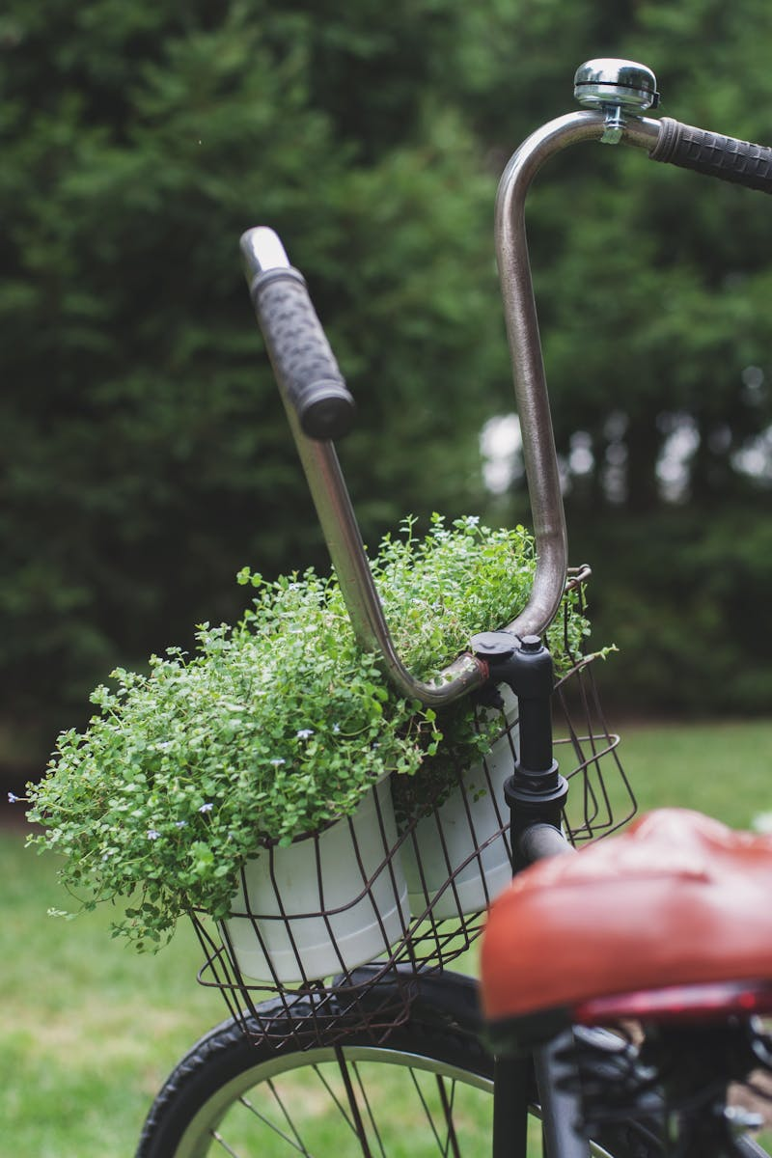
Sustainable FIU: A Greener Future
Prioritizing bicycle infrastructure, electric vehicle charging stations, and carpooling programs reduces our reliance on individual vehicles and lowers emissions.
Implementing smart parking solutions and promoting alternative commuting methods can alleviate congestion and minimize the environmental impact of parking facilities.
By embracing sustainable transportation and parking strategies, FIU actively diminishes its carbon footprint, contributing to a healthier planet.
Improved transportation options, including shuttle services and public transit partnerships, increase campus accessibility for students, faculty, and staff.

Slide 23
Sustainable FIU: A Greener Future
Investing in sustainable transportation and parking fosters a more vibrant and healthier campus community, improving the quality of life for everyone.

