Slide 1

The Last Lesson: A Farewell to Tradition
Exploring loss, regret, and linguistic pride in Alsace-Lorraine.

Slide 2

Table of Contents
1
Alsace-Lorraine: A Stage Set
5
Berlin's Decree: A Language Shift
2
Franz's Morning Dilemma
6
The Price of Neglect: A Language Lost?
3
Eerie Silence
7
Last Lesson: Hamel's Lament
4
The Weight of Tradition
8
Linguistic Identity Matters

Slide 3
9
The Last Lesson: A Farewell to Alsace
10
Honoring Our Classmates

Slide 4

Alsace-Lorraine: A Stage Set
The war's shadow looms large, shaping destinies and fueling the conflict at the heart of the narrative.
Alsace-Lorraine, a contested territory, embodies the clash of cultures and national identities during the period.
Understanding the historical backdrop is crucial to grasping the characters' motivations and the story's themes.
The region, a blend of French and German influences, becomes a microcosm of European tensions and traditions.
Photo by Pexels

Slide 5

Franz's Morning Dilemma
1.Reluctant Steps
2.Apprehensive Heart
Franz feels a deep reluctance toward school, his steps heavy with the weight of obligation and duty.
A sense of apprehension fills young Franz as he anticipates the strict atmosphere and lessons awaiting him.
3.School Avoidance
4.Nature's Call
Franz actively avoids the thought of school, wanting to embrace freedom instead of the classroom's confines.
The warm weather and birdsong create a powerful temptation, pulling Franz away from academic responsibilities and learning.

Slide 6



Eerie Silence
Potential Gains
Possible Losses
Increased focus and concentration in classrooms, fostering a more conducive learning environment for some students.
Reduced distractions lead to improved academic performance and comprehension of complex subjects.
Less noise pollution can create a calmer, more relaxed atmosphere benefiting students with sensory sensitivities.
Lack of social interaction and peer bonding opportunities, hindering social-emotional development and communication skills.
Diminished school spirit and a sense of community due to the absence of lively events and gatherings.
Potential for increased isolation and loneliness among students who thrive on social interaction and group activities.

Slide 7
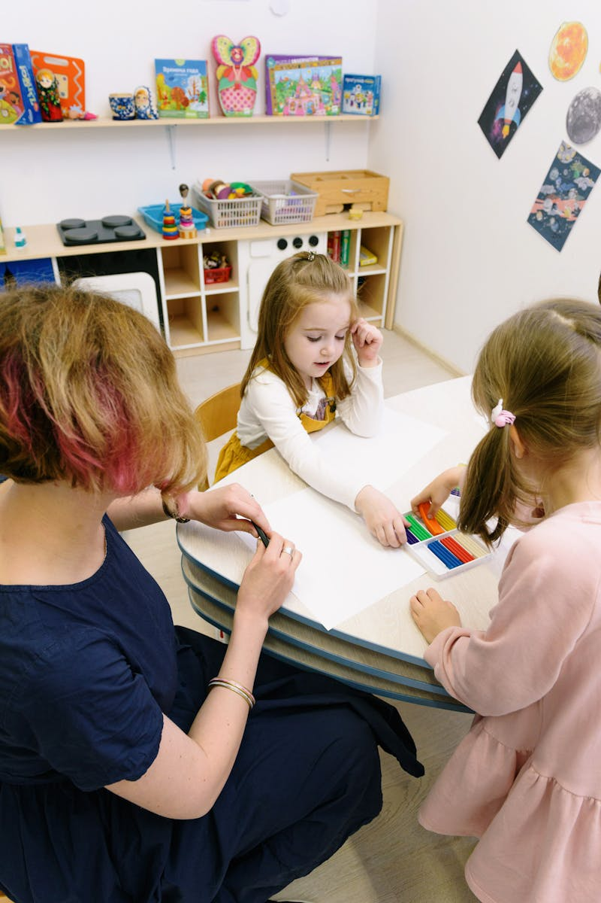
The Weight of Tradition
M. Hamel wears his ceremonial dress, typically reserved for inspections or prize distributions, signaling a special occasion.
His grave expression and quiet demeanor contrast sharply with his usual jovial nature, creating an atmosphere of apprehension.
The change in appearance and behavior foreshadows a significant announcement impacting the students' lives and the village.
The scene suggests the impending loss of innocence and the disruption of the familiar routine of the classroom environment.
Photo by Pexels

Slide 8

1940
✓
Berlin's Decree: A Language Shift
Order from Berlin
The decree arrives from Berlin, signaling a drastic shift in the region's linguistic landscape. This marks the beginning of a concerted effort to suppress the use of French and elevate the German language to a position of prominence.
A pivotal moment of cultural change. A new linguistic order imposed from afar.
✓
1941
German Ascendant
The official announcement mandates the implementation of German language instruction across all educational institutions. This marks a significant step towards cultural assimilation and control. French is actively discouraged in all aspects of public and private life.
1942
✓
French Forbidden
The use of French is formally forbidden in official communications, public signage, and educational settings. The suppression of the French language intensifies, creating a climate of fear and resentment among the local population who value their linguistic heritage.

Slide 9
The Price of Neglect: A Language Lost?
Potential Gains
Lost Ground
Early language acquisition could have broadened horizons, opening doors to diverse cultures and global opportunities.
Fluency in French would have facilitated better communication, fostering understanding and collaboration with neighboring regions.
Mastering French could have boosted the village's economy through trade and cultural exchange with French-speaking communities.
Neglecting French education led to limited career options, hindering economic advancement and personal growth for the villagers.
The loss of fluency eroded cultural ties, weakening the community's connection to its history and traditions.
The language barrier created isolation, preventing the villagers from fully engaging with the wider French-speaking world.

Slide 10
Last Lesson: Hamel's Lament
1.Patriotism Awakened
2.Language's Embrace
M. Hamel's love for France ignites; a realization of its value in the face of loss.
He champions French, highlighting its beauty and logical structure, a source of national pride.
3.Regret's Shadow
4.Missed Opportunities
A poignant sadness surfaces as Hamel acknowledges the neglect of French education in Alsace.
The teacher reflects on past failures, recognizing the missed chances to cherish their heritage.

Slide 11

Linguistic Identity Matters
Language Speakers
200M+
Identity Strength
95%
Cultural Impact
5x
Global Reach
75+

Slide 12

The Last Lesson: A Farewell to Alsace
The classroom's unusual quiet amplifies the students' realization of their impending loss of language and cultural identity.
Despite deep sorrow, M. Hamel maintains composure, delivering the lesson with unwavering dedication and newfound passion.
M. Hamel emphasizes the significance of the French language, viewing it as a key to their freedom and national identity.
"Vive La France!" becomes a powerful statement of defiance and unwavering love for their nation, etched for posterity.
Photo by Pexels

Slide 13
Honoring Our Classmates
Remembering Divanshi's bright ideas and collaborative spirit; a true asset to our learning environment.
Acknowledging Sparsh's dedication and insightful contributions, enriching our discussions and group projects.
Celebrating Dhaniksha's hard work and perseverance, inspiring us all to achieve our academic goals.
Recognizing Navratan's unique perspective and valuable insights, fostering a diverse learning community.

