Slide 1
The Battle of the Chudskoye Lake
Uncovering the truth behind the historical event

Slide 2
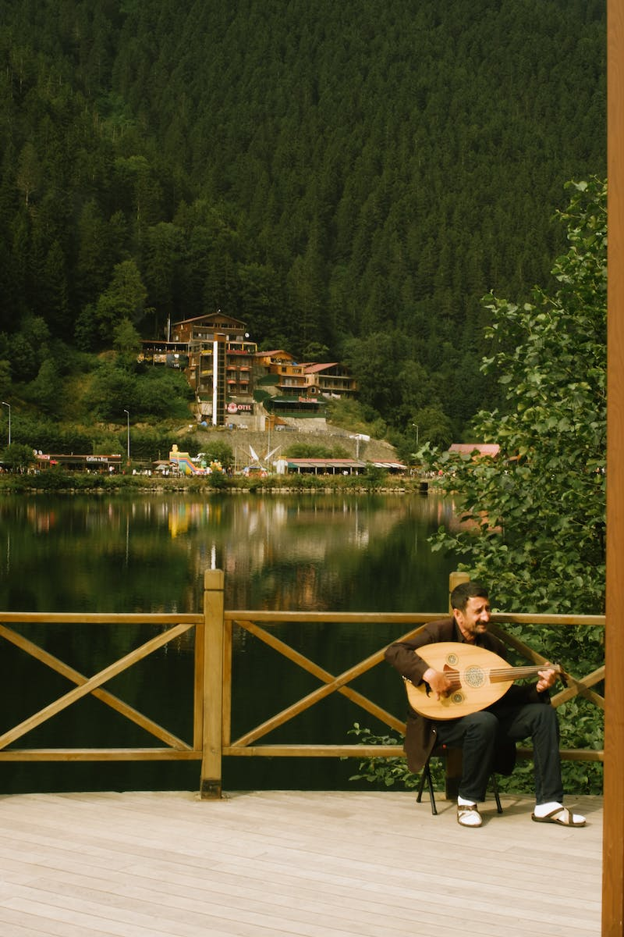
Introduction
• The battle occurred in April during a month-long expedition
• German forces were approaching the lake
• Geography played a crucial role in the strategic decisions
• German chronicles mention 37 Teutonic Knights
• Additional German cavalry and Estonian militia were present
Photo by Pexels

Slide 3
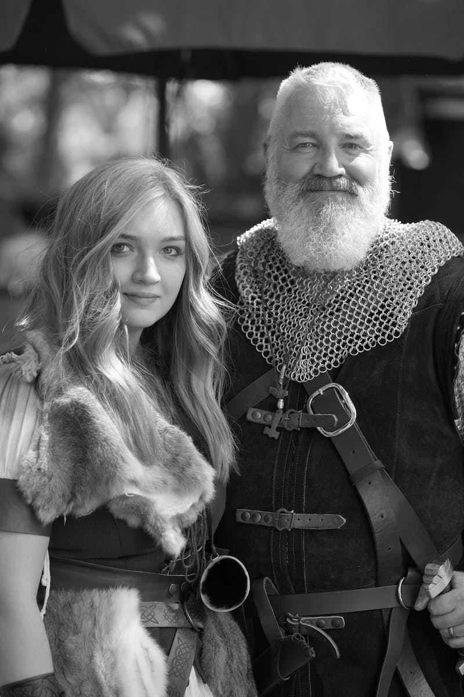
German Forces
• German forces comprised of 37 Teutonic Knights
• Accompanied by 370 German cavalry of inferior quality
• 700 infantrymen and retained troops
• Arbalests were used exclusively by the Germans
• Possessed strong armaments, including spears and pikes
Photo by Pexels

Slide 4
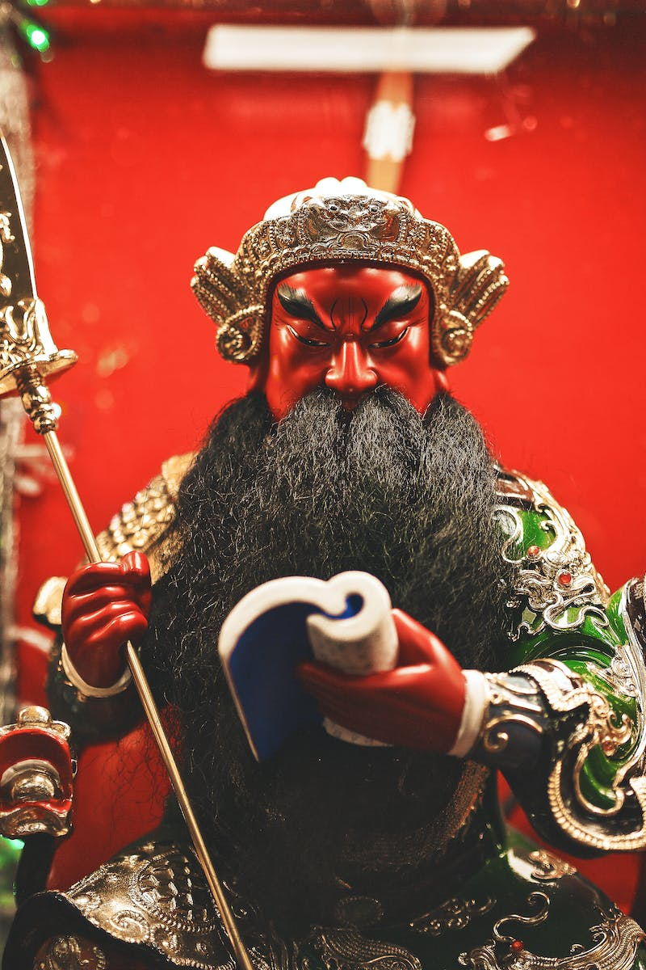
Estonian Militia
• Estonian militia provided assistance
• Armed with cold weapons like axes and chainmail armor
• Religious differences influenced their involvement
• Avoided using arbalests due to mistrust
• Approximately 700 Estonian warriors
Photo by Pexels

Slide 5
Formation and Strategies
• German forces adopted a triangular formation or 'wedge'
• Not a precise spear formation as commonly depicted
• Novgorod militia positioned in the center
• No evidence of specific spear rows described in popular media
• Suzdal archers provided long-range cover
Photo by Pexels

Slide 6
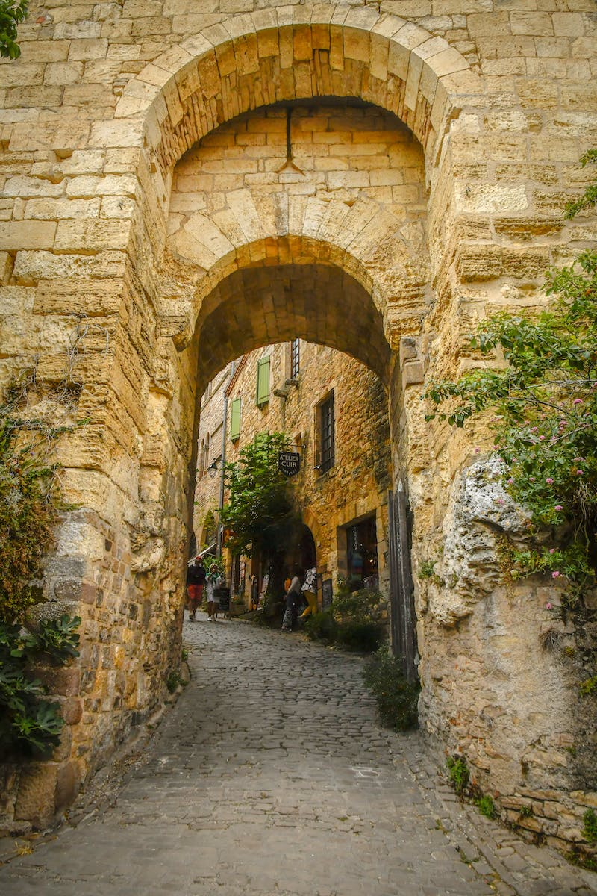
Flank Maneuver
• Alexander and Andrey led the cavalry on the flank
• Waited for an opportunity to strike the enemy flank and rear
• Several dozen Suzdal archers in front
• German forces were obstructed and destructed by archers
• Flank maneuver led to confusion and retreat of German forces
Photo by Pexels

Slide 7
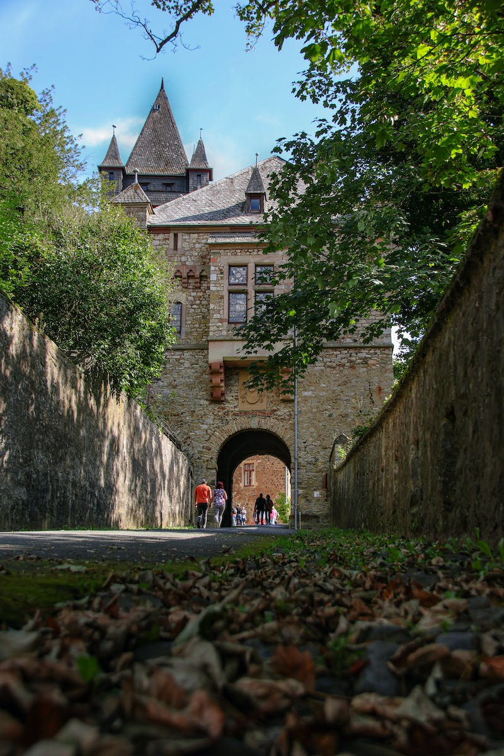
Results
• German forces suffered significant casualties
• Assistance from the Namyu tribe contributed to Russian victory
• Outcome led to the retreat of German forces
• Details of the battle's aftermath remain unclear
• Speculations persist due to the absence of concrete evidence
Photo by Pexels

