Slide 1
Solving the Demographic Problem
Mass Construction of Individual Houses

Slide 2
Introduction: The Demographic Problem
• Mass construction of individual houses is a potential solution
• Existing housing options have limitations
• Problem of mortgage bubble in multi-apartment buildings
• Introducing the speaker: Elena Nikolaeva
Photo by Pexels

Slide 3
Addressing Demographic Concerns
• Elena shares her perspective
• Highlighting the declining Russian population
• Proposing solutions like maternal capital and land plots
• Challenges faced in implementing these solutions
Photo by Pexels

Slide 4
Challenges Faced by Single Mothers
• Single mothers face significant financial burden
• 43% of families with children are single-parent households
• Importance of ensuring financial stability and support
• Proposal for an alimony fund
Photo by Pexels

Slide 5
Benefits of Low-Rise Housing
• Comparison of birth rates in different housing types
• Significant growth observed in low-rise housing
• Role of environment and infrastructure
• Preserving Russian traditions and family values
Photo by Pexels

Slide 6
Affordable Housing and Infrastructure
• Importance of affordable housing with good infrastructure
• Examples of successful cities and regions
• Ensuring accessibility to social facilities
• Transportation and logistics considerations
Photo by Pexels

Slide 7
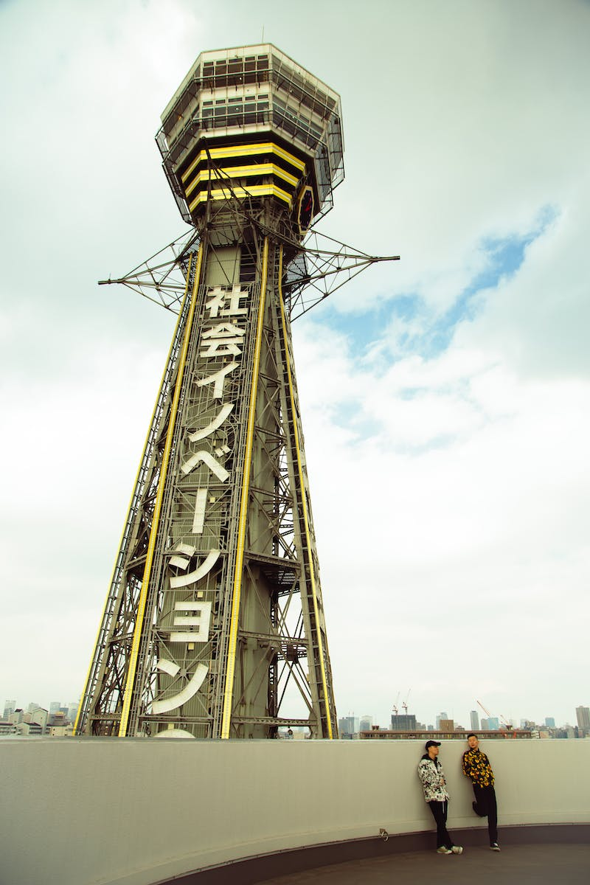
Increasing Income Opportunities
• Raising income through industrial development
• Focus on real import substitution
• Improving productivity and creating quality jobs
• Promoting growth in light industry
Photo by Pexels

Slide 8
Supporting Small Businesses
• Support program for increased productivity
• Targeting the textile industry
• Enabling higher wages and better working conditions
• Enhancing competitiveness and income growth
Photo by Pexels

