Slide 1
The Most Famous Paintings in the World
A journey through the timeless masterpieces that have captivated generations

Slide 2
Introduction
• Only a small fraction of the millions of paintings created worldwide are truly memorable throughout time.
• These iconic works of art shape our history and continue to be recognized by people of all ages.
• Let's explore a group of paintings that are known globally and are likely to remain famous in the future.
Photo by Pexels

Slide 3
Mona Lisa
• Painted by Leonardo da Vinci in 1503-1504, the Mona Lisa is the most famous painting in the world.
• It is the main highlight of the Louvre Museum in Paris, attracting 6 million visitors annually.
• Considered a masterpiece, it showcases Leonardo da Vinci's skill and is a symbol of the art world.
Photo by Pexels

Slide 4
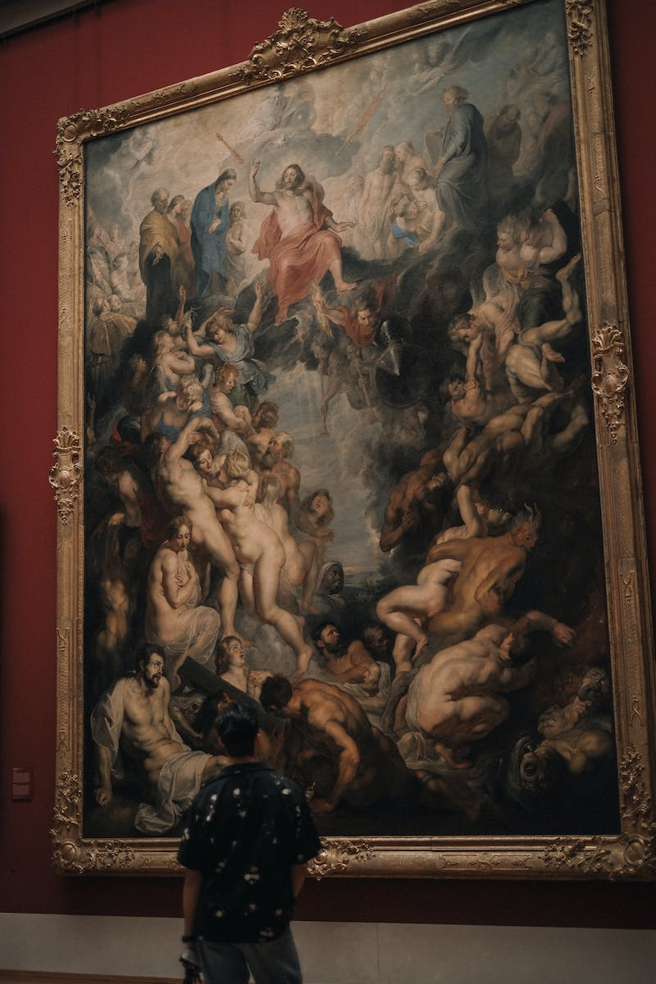
The Last Supper
• Painted by Leonardo da Vinci, The Last Supper is one of the most renowned paintings in the world.
• It is housed in a monastery in Milan and is not displayed in museums due to its location.
• The painting depicts the biblical scene of Jesus' last meal with his disciples.
Photo by Pexels

Slide 5
The Creation of Adam
• Painted by Michelangelo between 1508 and 1512, The Creation of Adam adorns the ceiling of the Sistine Chapel in the Vatican.
• This masterpiece depicts the iconic moment from the Book of Genesis, where God creates Adam.
• It is considered one of the most powerful and influential artworks in history.
Photo by Pexels

Slide 6
The Starry Night
• Painted by Vincent van Gogh in 1889, The Starry Night is one of the most recognizable artworks in the world.
• This painting is part of the collection of the Museum of Modern Art in New York City.
• It is a vibrant depiction of the night sky and is a prominent piece in contemporary culture.
Photo by Pexels

Slide 7
The Scream
• Painted by Edvard Munch in 1893, The Scream is one of the most famous works of art.
• It is an expressionistic masterpiece depicting a figure in distress, using oil paints and pastels.
• The painting is currently displayed at the National Gallery in Oslo, Norway.
Photo by Pexels

Slide 8
Girl with a Pearl Earring
• Painted by Johannes Vermeer, the Girl with a Pearl Earring is often referred to as the Dutch Mona Lisa.
• This iconic painting is displayed at the Mauritshuis museum in The Hague, Netherlands.
• It portrays a young girl wearing a pearl earring, her identity a mystery.
Photo by Pexels

Slide 9
The Night Watch
• The Night Watch is a captivating and famous painting by Rembrandt, created in 1642.
• It portrays a lively and cherished scene from the celebrations held in Amsterdam in honor of Queen Marie de Medici's visit.
• The painting is currently housed in the Rijksmuseum in Amsterdam.
Photo by Pexels

