Slide 1
Partial Fraction Decomposition
Breaking down rational expressions into simpler forms

Slide 2
Introduction
• Partial fraction decomposition breaks down rational expressions
• Involves breaking down into simpler forms
• Techniques and principles are used
• Historical background of Leonard Eu
Photo by Pexels

Slide 3
Classification of Rational Expressions
• Proper vs improper rational expressions
• Proper: degree of numerator < degree of denominator
• Improper: degree of numerator >= degree of denominator
• Rules for decomposition differ based on classification
Photo by Pexels

Slide 4
Partial Fraction Decomposition - Linear Factors
• Decomposing rational expressions with linear factors in the denominator
• Assume constants (a, b, c, etc.) for each factor
• Use algebraic manipulation and smart substitutions
• Solve for the values of the constants
Photo by Pexels

Slide 5
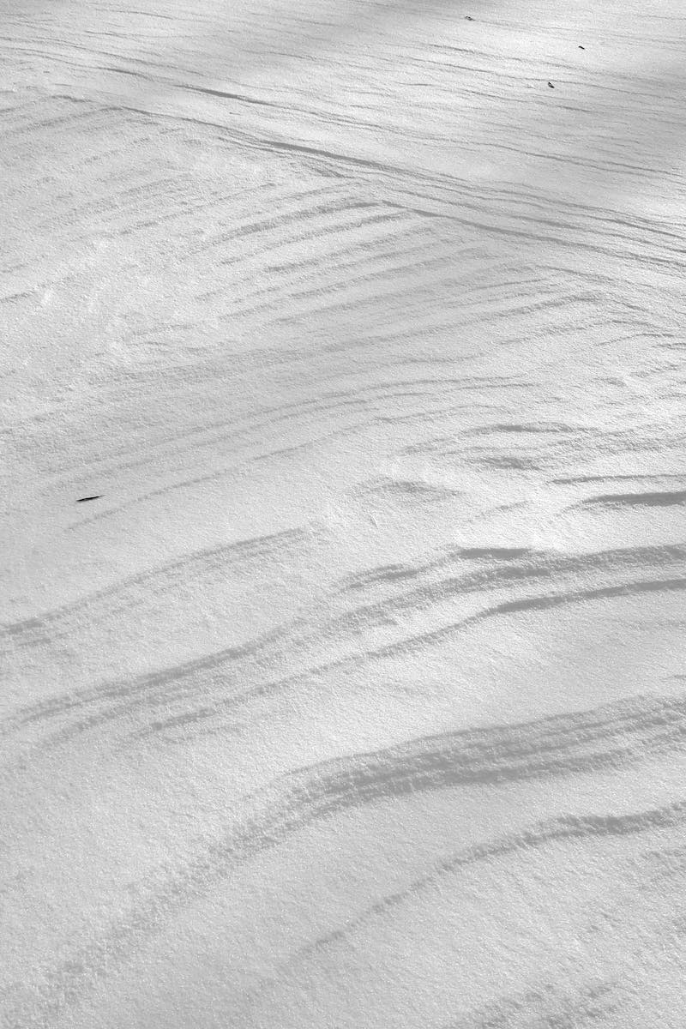
Partial Fraction Decomposition - Repeated Linear Factors
• Decomposing rational expressions with repeated linear factors in the denominator
• Use the same approach as linear factors
• Assign a separate constant for each repetition
• Solve for the values of the constants
Photo by Pexels

Slide 6
Partial Fraction Decomposition - Quadratic Factors
• Decomposing rational expressions with quadratic factors
• Quadratic factors that cannot be factored/reduced
• No real roots, cannot solve for values
• Express as irreducible quadratics in the form (ax^2 + bx + c)/(dx^2 + ex + f)
Photo by Pexels

Slide 7
Improper Rational Expressions
• Dealing with improper rational expressions
• Perform long division to obtain a quotient and remainder
• The quotient becomes a separate term in the partial fraction decomposition
• Apply decomposition to the remainder
Photo by Pexels

