Slide 1
The Power of Innovation
Revolutionizing the World through Cutting-edge Technologies

Slide 2
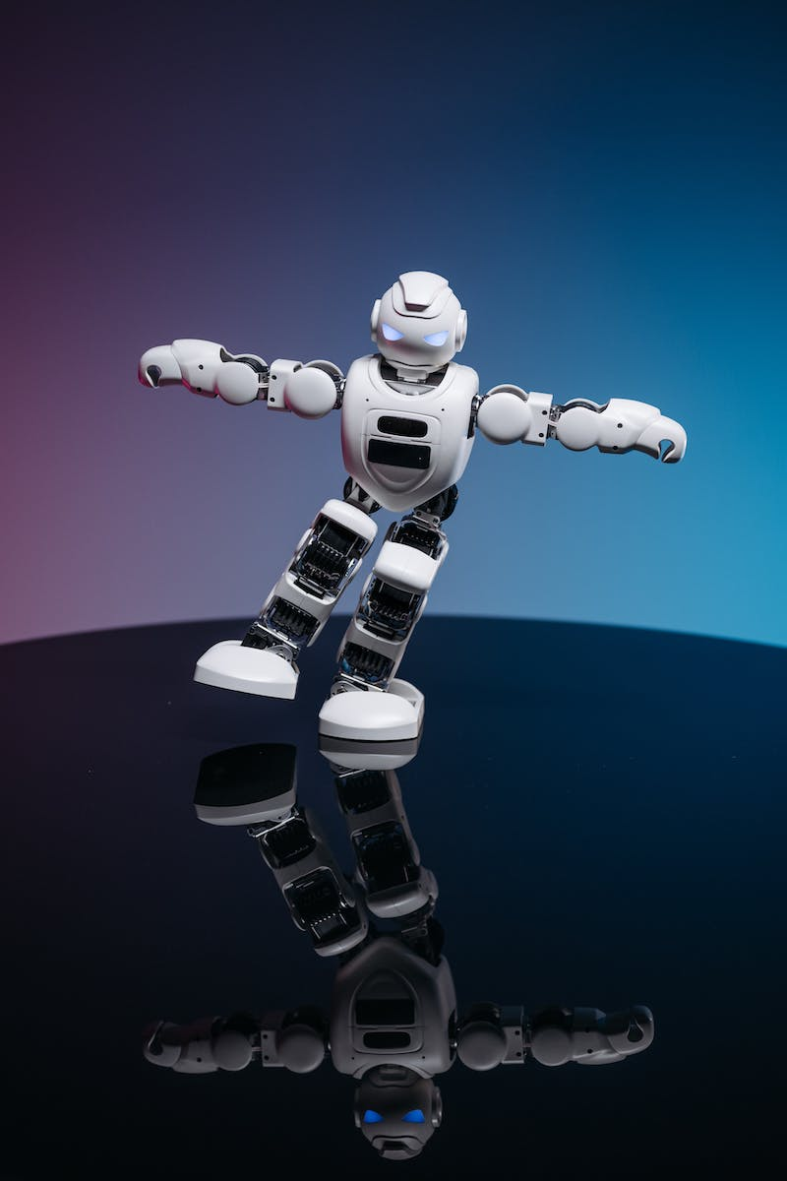
Introduction
• Welcome to the world of innovation
• Defining innovation and its impact
• Overview of key technologies driving innovation
• Importance of embracing innovation in today's world
Photo by Pexels

Slide 3
Artificial Intelligence
• Understanding the fundamentals of AI
• Applications of AI in various industries
• AI's impact on efficiency and decision-making
• Challenges and ethical considerations
Photo by Pexels

Slide 4
Internet of Things (IoT)
• Defining IoT and its components
• Examples of IoT devices and their benefits
• Impact of IoT on industries and daily life
• Security and privacy concerns
Photo by Pexels

Slide 5
Blockchain Technology
• Understanding the fundamentals of blockchain
• Applications of blockchain beyond cryptocurrencies
• Benefits of decentralized and immutable systems
• Potential challenges and future prospects
Photo by Pexels

Slide 6
Augmented Reality (AR)
• Defining AR and its key components
• Applications of AR in various fields
• Enhancing user experiences through AR
• Current limitations and future possibilities
Photo by Pexels

Slide 7
Conclusion
• Recap of key technology innovations
• Impact on industries and society
• The need for continued innovation
• Inspiration for individuals and organizations

