Slide 1
AI in the Sports Industry
Top 10 Applications

Slide 2
Maximizing Broadcasting and Streaming
• AI enhances broadcasting and streaming quality.
• AI selects relevant camera angles during games.
• AI provides detailed statistics in real-time.
• AI enhances commentary and replays.
Photo by Pexels

Slide 3
Optimizing Ad Opportunities
• AI provides better advertising chances for brands.
• Machine learning helps negotiate with advertisers.
• AI enables targeting specific game fractions.
• AI improves ad revenue for the sports industry.
Photo by Pexels

Slide 4
Automated Sports Journalism
• AI-powered journalism is transforming sports media.
• AI creates videos highlighting exciting moments.
• AI saves time in curating sporting content.
• AI improves the efficiency of sports journalism.
Photo by Pexels

Slide 5
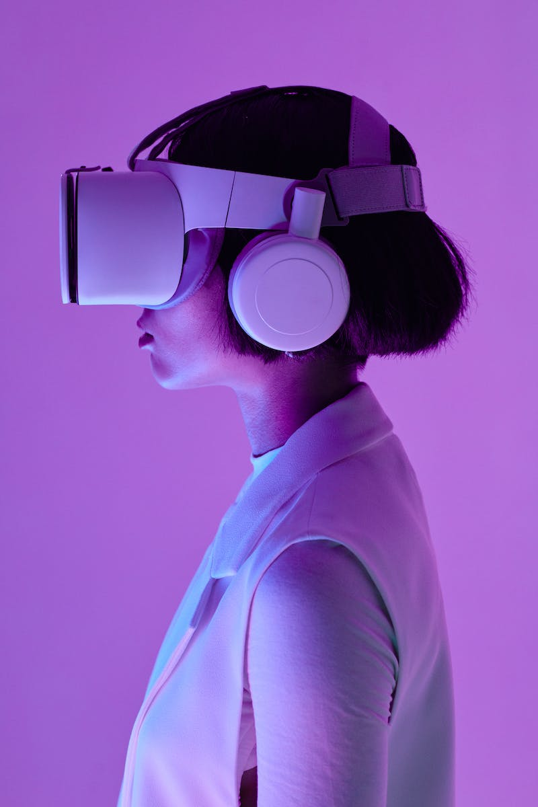
Match Predictions with AI
• AI algorithms can predict game results.
• AI gathers and analyzes large amounts of data.
• AI offers better predictions than humans.
• AI assists bettors in maximizing their winnings.
Photo by Pexels

Slide 6
Personalized Training and Diet Plans
• AI helps create personalized plans for athletes.
• AI evaluates performance on training appliances.
• AI provides prompt advice to improve performance.
• AI enhances training and maximizes potential.
Photo by Pexels

Slide 7
Scouting and Recruitment
• Computer vision aids scouting in sports.
• AI tracks players and collects performance data.
• Data insights assist in informed recruitment decisions.
• AI enhances team building and performance.
Photo by Pexels

Slide 8
Predictive Analysis and Ticketing
• Predictive analytics improves ticketing efficiency.
• AI predicts attendance and fan behavior.
• AI helps optimize commodities and services.
• AI enhances fan experience at sports events.
Photo by Pexels

Slide 9
Improving Fan Engagement
• AI technology enhances fan attention and engagement.
• AI-driven creations fascinate and inspire audiences.
• Improved viewer journey across sports events.
• AI and technology transforming the fan experience.
Photo by Pexels

Slide 10
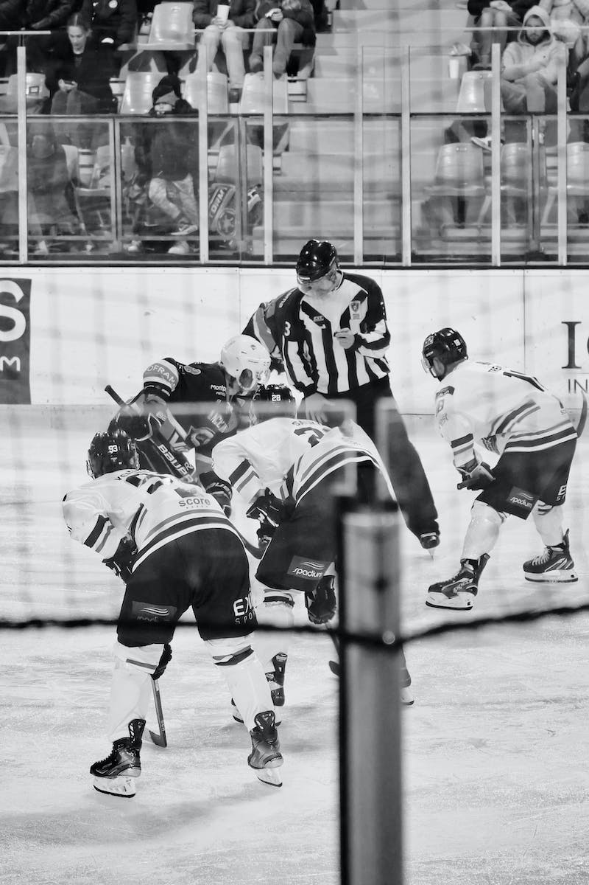
Creating an AI Referee
• AI referee improves accuracy in decision-making.
• AI prevents wrong rulings based on limited data.
• Big game-changing decisions refereed more accurately.
• AI enhances fairness and integrity in sports.
Photo by Pexels

Slide 11
Improving Player Performance with AI
• AI helps coaches enhance players' performance.
• AI provides insights into squad dynamics.
• AI assists in overcoming opponents' weaknesses.
• Data-driven approach to maximizing player potential.
Photo by Pexels

