Slide 1
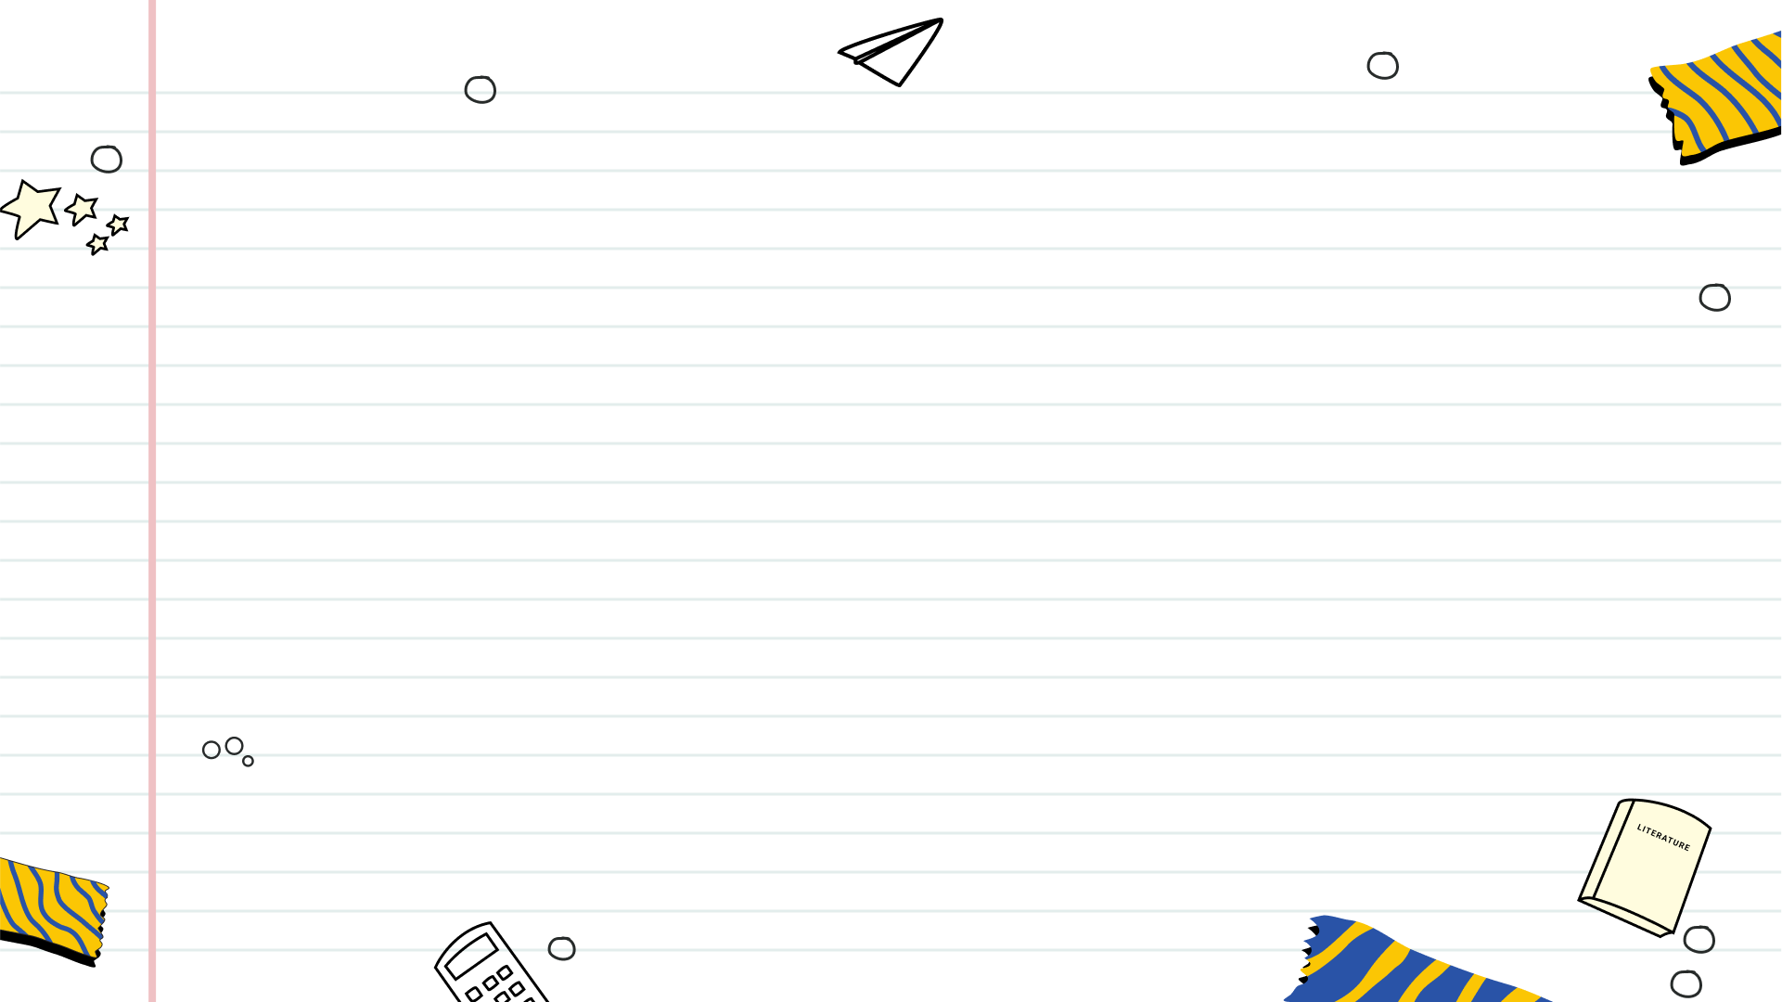

Toys: A World of Wonder and Play
Exploring the magic, history, and impact of toys on our lives

Slide 2
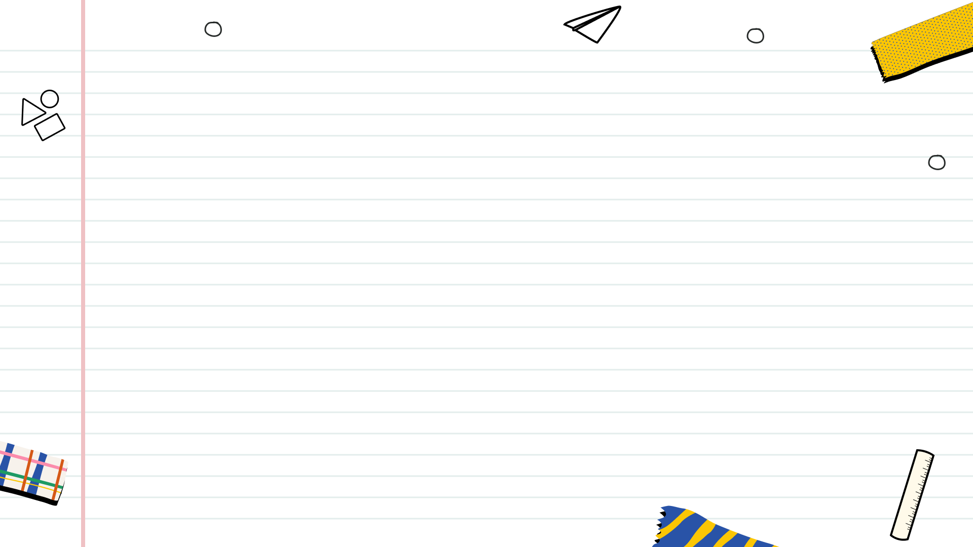

Table of Contents
1
The Magic of Toys
2
Toys Through the Ages
3
The Power of Play
4
Toys: Building Blocks of Development
5
Toy Materials Through Time
6
Classic Toys: Enduring Fun

Slide 3
Table of Contents
7
Tech Toys: A New Era
8
Toys: Mirrors of Culture
9
Ed Toys: Worth It?
10
Tomorrow's Playground

Slide 4
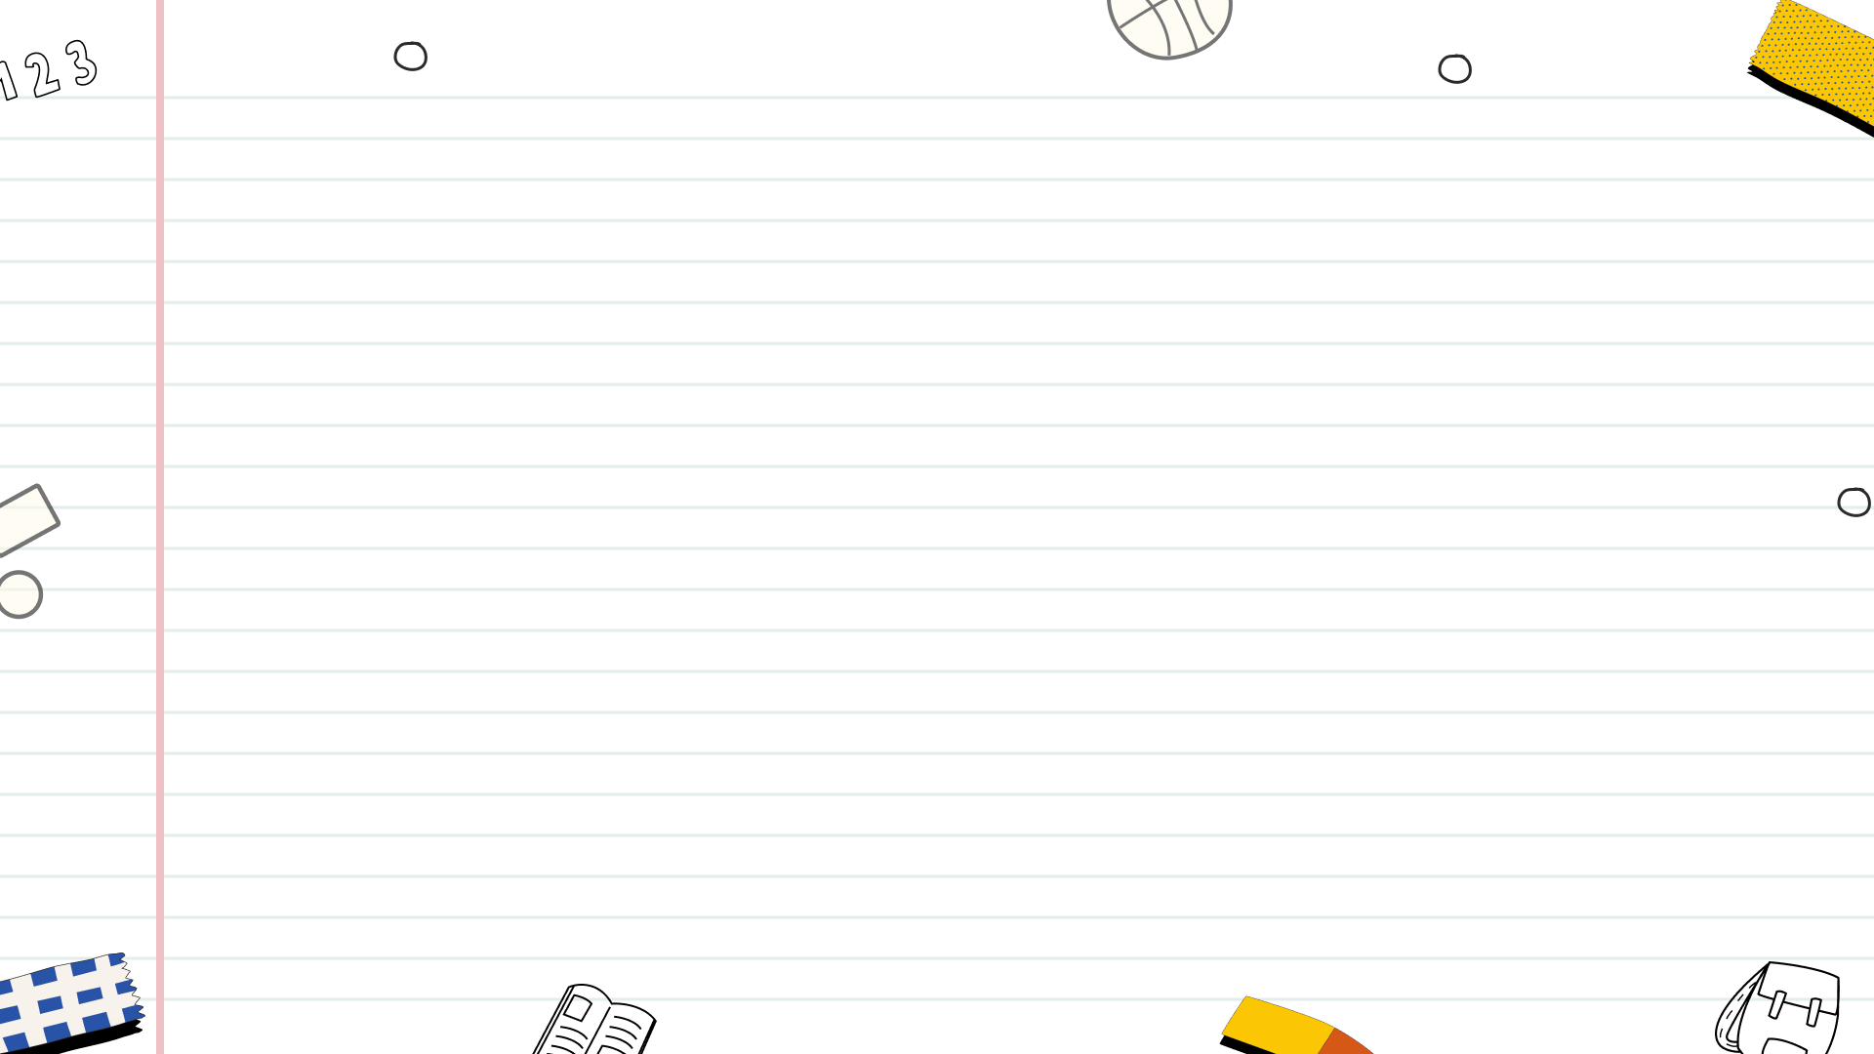

The Magic of Toys
Toys are not just for children; they provide comfort, nostalgia, and a sense of playfulness for adults of all ages.
From building blocks to dolls, toys reflect and transmit cultural values, stories, and traditions across different societies.
Toys facilitate learning through play, encouraging creativity, problem-solving, and social skills in an engaging way.
With their boundless potential, toys unlock imagination, foster innovation, and inspire countless hours of entertainment and exploration.
Photo by Pexels

Slide 5

Toys Through the Ages
-3000
1400s
1900
1980
Ancient Beginnings
Crafted Play
Mass Production Era
Digital Revolution
Early toys, like rattles and dolls crafted from natural materials (clay, wood, stone), emerged in ancient civilizations like Egypt and Mesopotamia. These objects served not only as amusement but also...
The Renaissance witnessed a surge in handcrafted wooden toys, including dolls, toy soldiers, and miniature furniture. These toys were often commissioned by wealthy families, highlighting social stratification and artistic skill....
The Industrial Revolution revolutionized toy production, enabling mass manufacturing of tin toys, teddy bears, and board games. This era marked the rise of iconic toy companies and the accessibility of...
The advent of personal computers and video game consoles ushered in the digital era of play. Electronic toys and video games became increasingly popular, transforming play patterns and introducing new...

Slide 6
Toys Through the Ages
2010
Smart Toys Emerge
Connected and interactive toys entered the market, featuring artificial intelligence and augmented reality. These 'smart toys' learn and adapt to children's play, providing personalized experiences and integrating technology seamlessly into...

Slide 7
The Power of Play
Play provides a joyful environment where children learn naturally through exploration and experimentation, fostering a love of learning.
Play ignites imagination, allowing children to explore possibilities, develop unique ideas, and express themselves freely.
Through play, children encounter challenges, develop critical thinking skills, and learn to devise creative solutions independently.
Collaborative play teaches essential social skills such as communication, cooperation, empathy, and conflict resolution with peers.

Slide 8
Toys: Building Blocks of Development
Toys like puzzles and building blocks enhance problem-solving and spatial reasoning from an early age, promoting cognitive development.
Rattles, stacking cups, and balls aid in refining fine and gross motor skills, crucial for physical coordination.
Dolls, action figures, and board games encourage cooperation, communication, and empathy among children during play.
Art supplies, musical instruments, and dress-up clothes foster imagination and self-expression through creative play activities.

Slide 9
Toy Materials Through Time
1800s
1900s
1950s
2000s
Wood & Metal Reign
Celluloid's Debut
The Plastic Boom
Eco-Friendly Shift
Early toys were primarily crafted from wood and metal. These materials provided durability and allowed for simple designs, reflecting the craftsmanship of the era. Think rocking horses, tin soldiers, and...
Celluloid, an early plastic, revolutionized toy manufacturing. It allowed for more intricate designs and brighter colors. However, its flammability posed safety concerns, paving the way for safer plastic alternatives. This...
The introduction of polyethylene and PVC led to a surge in plastic toys. These materials were durable, inexpensive, and easily molded into various shapes. This era saw the rise of...
Growing environmental awareness has spurred a demand for sustainable toy materials. Manufacturers are exploring bioplastics, recycled plastics, and sustainably sourced wood. This represents a move towards eco-conscious toy production, prioritizing...

Slide 10

Classic Toys: Enduring Fun
Simple blocks foster creativity and problem-solving skills. Their versatility provides endless possibilities for imaginative construction projects and designs.
These toys encourage role-playing and storytelling, allowing children to explore different characters and scenarios through imaginative play.
These vehicles stimulate curiosity about mechanics and transportation, offering opportunities for creative play and learning about motion.
Board games promote strategic thinking, social interaction, and friendly competition, while providing hours of entertainment for families and friends.
Photo by Pexels

Slide 11


Tech Toys: A New Era
Enhanced interactivity and engagement keep children entertained and learning for longer periods.
Educational games and apps can improve cognitive skills, problem-solving abilities, and creativity.
Digital toys offer personalized learning experiences tailored to a child's individual needs and pace.
Excessive screen time can lead to eye strain, sleep disturbances, and sedentary lifestyles for kids.
The high cost of advanced tech toys can create a disparity in access for children of different backgrounds.
Privacy concerns arise from data collection and online interactions within digital toy platforms.

Slide 12

Toys: Mirrors of Culture
Toys often embody a society's values, showcasing ideals like family, achievement, and gender roles through play scenarios.
Children develop their sense of self through play, and toys contribute to their understanding of who they are.
Toys act as vehicles for cultural transmission, passing down traditions, stories, and historical narratives through play.
Globalization impacts toy design, introducing diverse cultural elements and blurring traditional boundaries within play experiences.
Photo by Pexels

Slide 13
Ed Toys: Worth It?
Targeted skill development through focused design that enhances specific cognitive or motor abilities more effectively than generic toys.
High-quality materials and construction ensure durability, providing long-term value and potentially being passed down to younger children.
Engaging and stimulating design often captures children's attention for longer periods, fostering deeper learning and exploration opportunities.
High cost can be a barrier, limiting access for families with tighter budgets, making comparable, affordable alternatives more attractive.
Over-reliance on specific toys may hinder creativity and imaginative play, restricting children's ability to invent their own games and scenarios.
Children may quickly outgrow specialized toys, rendering them obsolete and creating waste; interest in them can be fleeting too.

Slide 14

Tomorrow's Playground
Toys now bridge the gap between tactile, real-world fun and engaging digital realms, creating a richer experience.
Expect to see more AR, VR, and AI integrated into toys, offering interactive and personalized play patterns.
Toys are increasingly focused on learning through play, fostering creativity and problem-solving skills in children.
AI-powered toys can adapt to a child's learning pace and preferences, offering tailored and dynamic play sessions.
Photo by Pexels

