Slide 1
Organic Chemistry: Naming Organic Compounds and Functional Groups
Understanding the Basics and Reactions

Slide 2
Introduction to Organic Chemistry
• Organic chemistry deals with carbon-based compounds and their functional groups.
• Functional groups are groups of atoms responsible for characteristic reactions.
• In organic chemistry, carbon chains are common, with functional groups attached.
• Recognizing functional groups is essential for naming organic compounds.
Photo by Pexels

Slide 3
Naming Organic Compounds
• Organic compounds are named based on their functional groups.
• Functional groups determine the characteristic reactions of the compound.
• Main functional groups include alkanes, alkenes, alcohols, and carboxylic acids.
• Understanding functional groups is crucial for naming and understanding compounds.
Photo by Pexels

Slide 4
Alkanes and Alkenes
• Alkanes have single carbon-carbon bonds and are saturated hydrocarbons.
• Alkenes have carbon-carbon double bonds and are unsaturated hydrocarbons.
• Alkanes and alkenes can undergo combustion and substitution reactions.
• Naming alkanes and alkenes follows specific rules based on their carbon chains.

Slide 5
Alcohols and Carboxylic Acids
• Alcohols have the OH group as their functional group.
• Carboxylic acids have the COOH group as their functional group.
• Alcohols and carboxylic acids undergo combustion and reaction with other compounds.
• Naming alcohols and carboxylic acids follows specific rules based on their carbon chains.
Photo by Pexels

Slide 6
Esters and Functional Group Reactions
• Esters are formed from the reaction of carboxylic acids and alcohols.
• Functional group reactions involve combining and transforming organic functional groups.
• Understanding esters and functional group reactions is essential for organic chemistry understanding.
Photo by Pexels

Slide 7
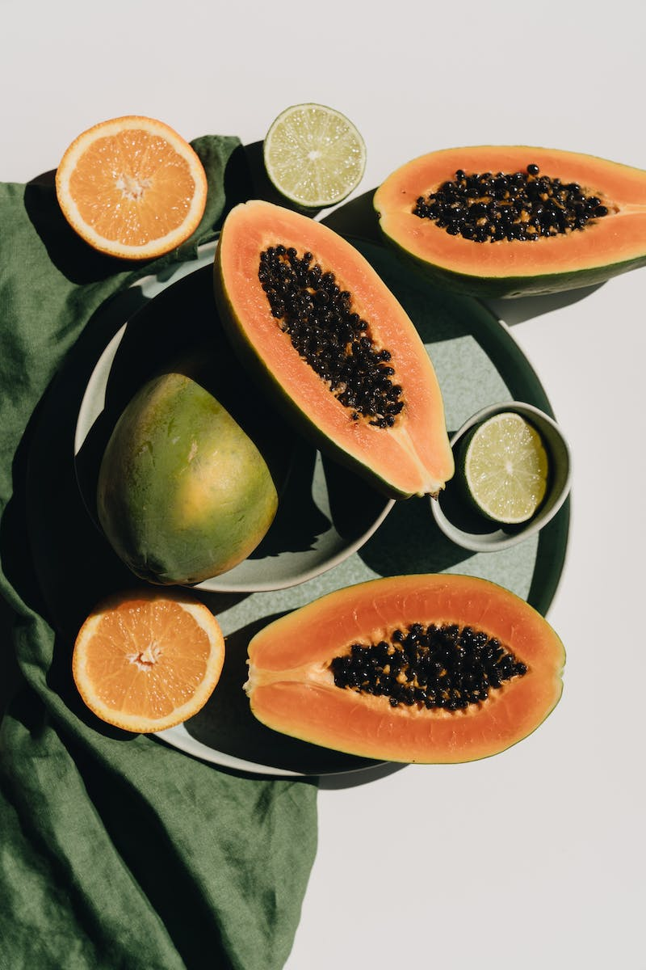
Properties and Uses of Organic Compounds
• Organic compounds have various properties and uses.
• Properties include combustion, solvency, and reactivity.
• Organic compounds are used as fuels, solvents, and in various industries.
• Understanding the properties and applications of organic compounds is crucial in practical contexts.
Photo by Pexels

Slide 8
Polymerization and Polymer Types
• Polymerization is the process of building large molecules (polymers) from smaller monomers.
• Addition and condensation polymerization are the two main methods.
• Synthetic polymers include nylon and terylene.
• Natural polymers include proteins and carbohydrates.

Slide 9
Structural Isomerism
• Structural isomerism occurs when molecules have the same molecular formula but different structures.
• Recognition of structural isomerism is important for understanding chemical and physical properties.
• Different structures can lead to varying reactivities and behaviors.
• Structural isomerism affects the naming and properties of organic compounds.
Photo by Pexels

