Slide 1
Power Lifting: Unleashing Inner Strength
Exploring the World of Colombian Lifting Champions

Slide 2
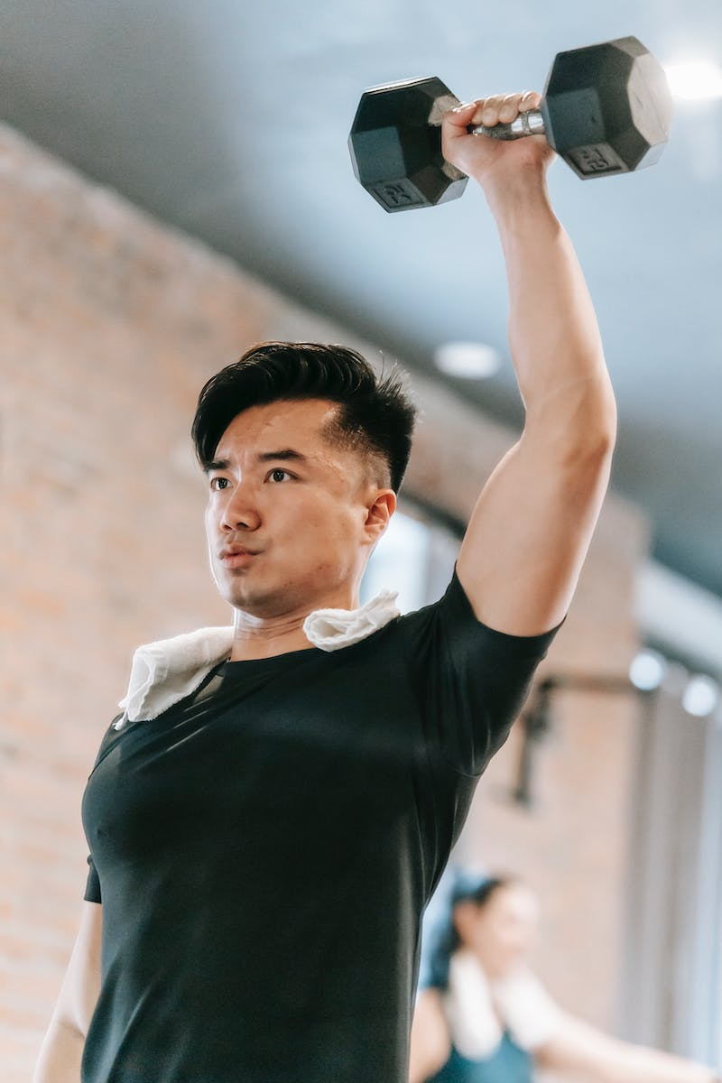
Introduction to Power Lifting
• Power Lifting is a strength sport that focuses on three main lifts: squat, bench press, and deadlift.
• It requires immense physical and mental strength.
• Colombian lifters have gained recognition in the international powerlifting community.
• Let's dive deeper into their training and achievements.
Photo by Pexels

Slide 3
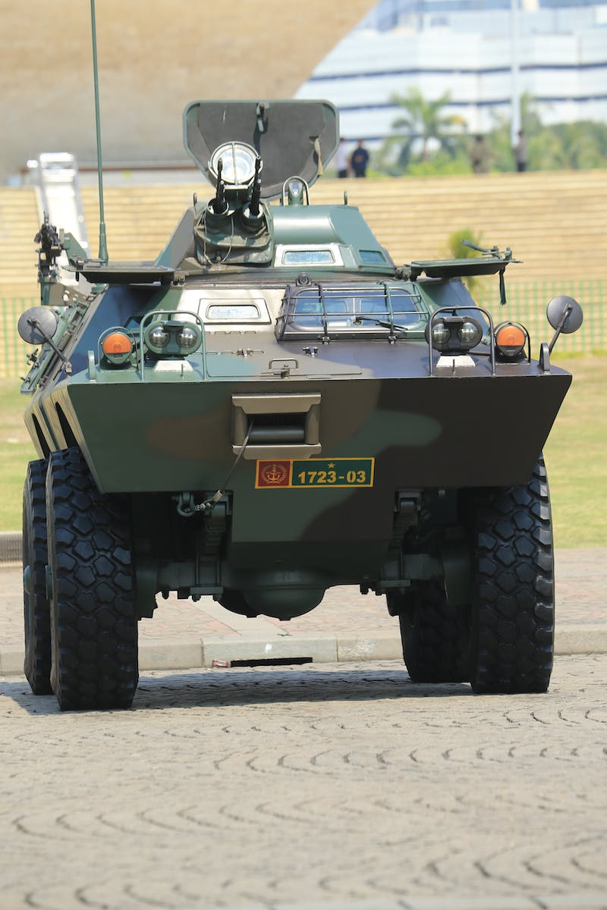
Colombian Lifting Champions
• Colombian lifters like Gomez and Bai have made significant contributions to the sport.
• They excel in power lifting competitions and inspire others with their dedication.
• These athletes have become household names in Colombia and beyond.
• Let's discover their journey to becoming champions.
Photo by Pexels

Slide 4
Training Regimen of Colombian Lifters
• Colombian lifters follow a disciplined training regimen to maximize their strength and performance.
• Their training includes specific exercises for each of the power lifts.
• They also focus on improving their mental resilience and mindset.
• Let's explore their training techniques and strategies.
Photo by Pexels

Slide 5
Colombian Lifters' Impact on the Sport
• Colombian lifters have elevated the standard of power lifting.
• Their impressive performances have inspired a new generation of lifters.
• They have contributed to the growth and popularity of the sport.
• Let's delve deeper into their impact and legacy.
Photo by Pexels

Slide 6
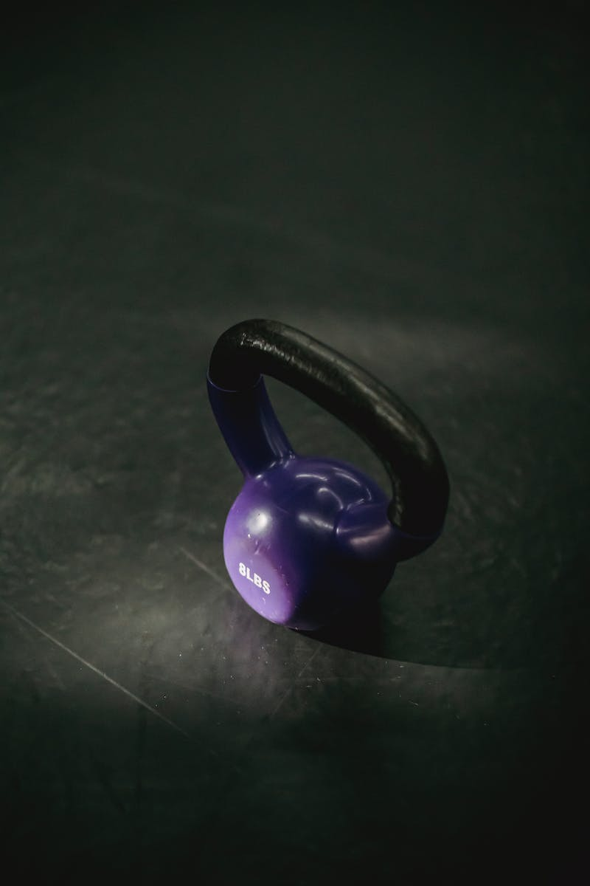
Conclusion
• Colombian lifters, with their dedication and passion, have redefined power lifting.
• They continue to inspire others to push their limits and unleash their inner strength.
• Their journey showcases the power of determination and hard work.
• Let's celebrate their achievements and the sport of power lifting!
Photo by Pexels

