Slide 1
Contradictions in Islamic Beliefs
Exploring the inconsistencies in Muslim beliefs about the Bible and the Quran

Slide 2
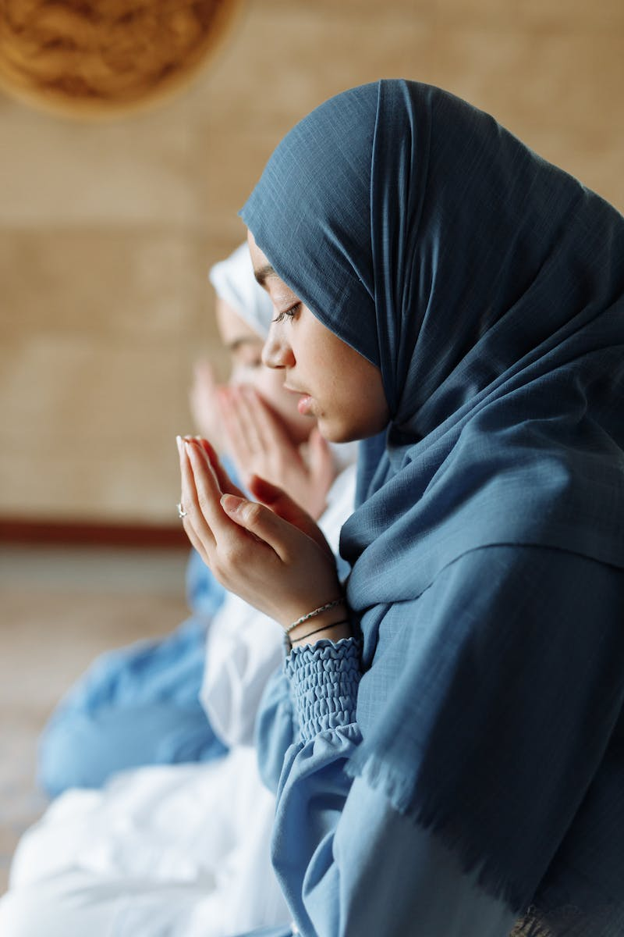
Introduction
• Muslims commanded to say they believe in what is revealed to them and Christians
• Contradiction: Muslims claim the Bible is corrupted and reject it
• Contradiction: Muslims claim our God is a false god
• Facts: Christian belief in the Trinity and Jesus' crucifixion
• Conclusion: Muslims cannot believe in the Bible and the Quran
Photo by Pexels

Slide 3
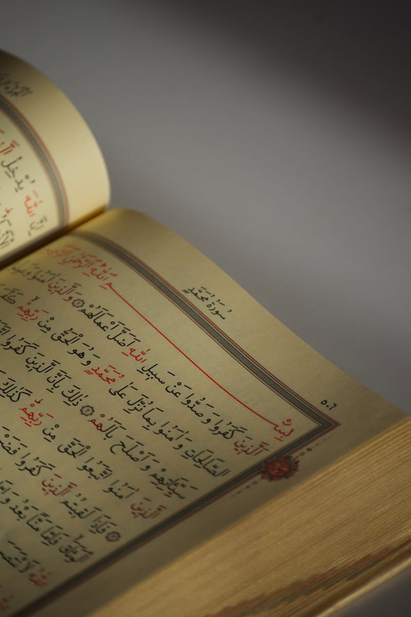
Corruption of the Bible
• Quran affirms Torah and gospel revealed by Allah
• Muslims claim the Bible was corrupted by men
• Contradiction: Allah's guidance ended up misguiding
• Verse: Quran declares that no one can change Allah's words
• Contradiction: Muslims assert Bible was corrupted by Paul or later Christians
• Facts: Quran confirms Christians had the gospel during Muhammad's time
Photo by Pexels

Slide 4
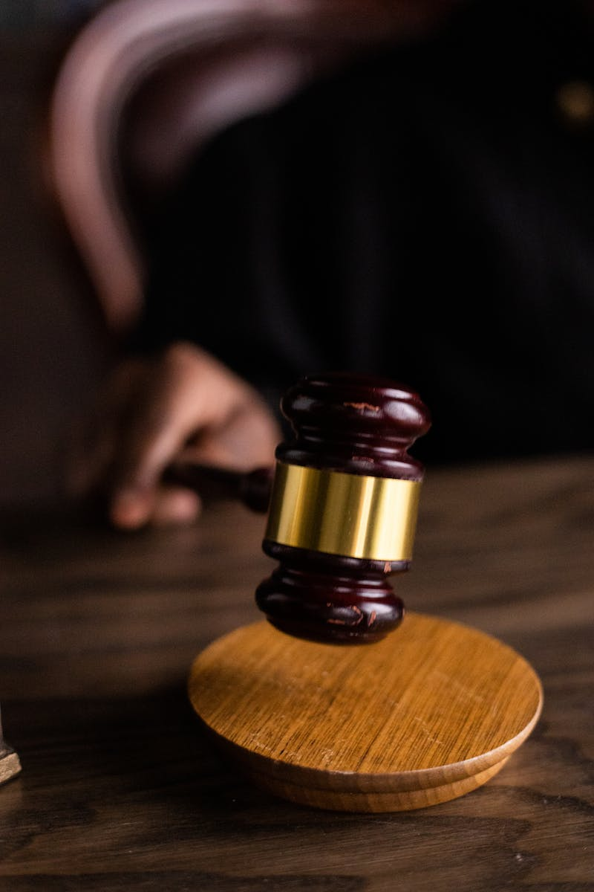
Authority of the Gospel for Christians
• Quran commands Christians to judge by the gospel
• Contradiction: Muslims assume Quran judges the Bible
• Verse: Quran states people of the book have no ground to stand upon without the Torah and gospel
• Contradiction: Why Allah appeals to a corrupt book
• Conclusion: Quran affirms the authority of the gospel for Christians
Photo by Pexels

Slide 5
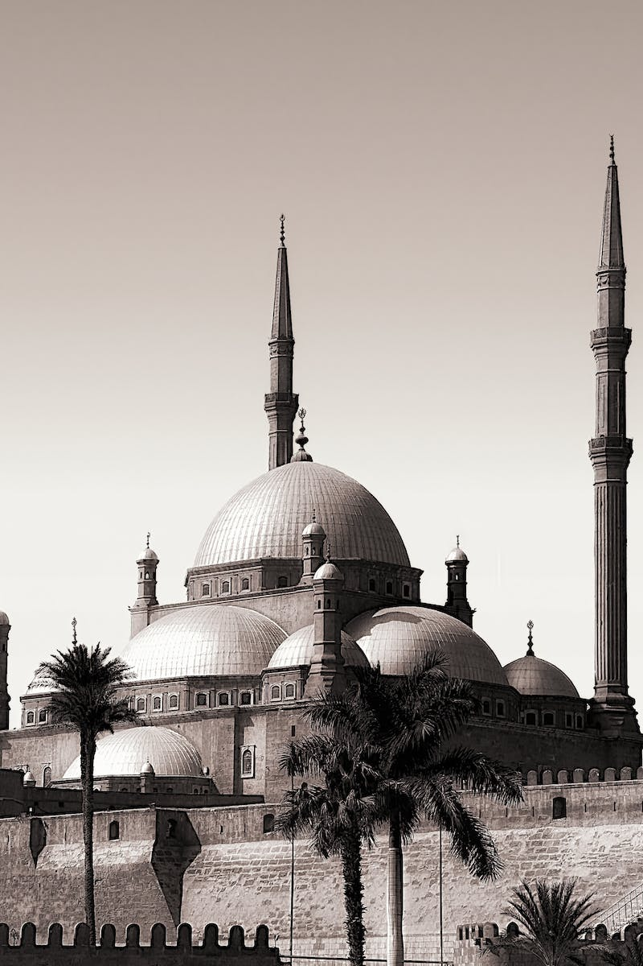
Muhammad and Doubts about Revelations
• Muhammad had doubts about his revelations
• Allah commanded Muhammad to seek confirmation from the people of the book
• Contradiction: Muhammad's lack of serious verification
• Facts: Quran affirms inspiration, preservation, and authority of the people of the book's scriptures
• Conclusion: Quran puts Muslims in an inescapable dilemma
• Call to action: Encourage Muslims to obey the gospel
Photo by Pexels

