Slide 1
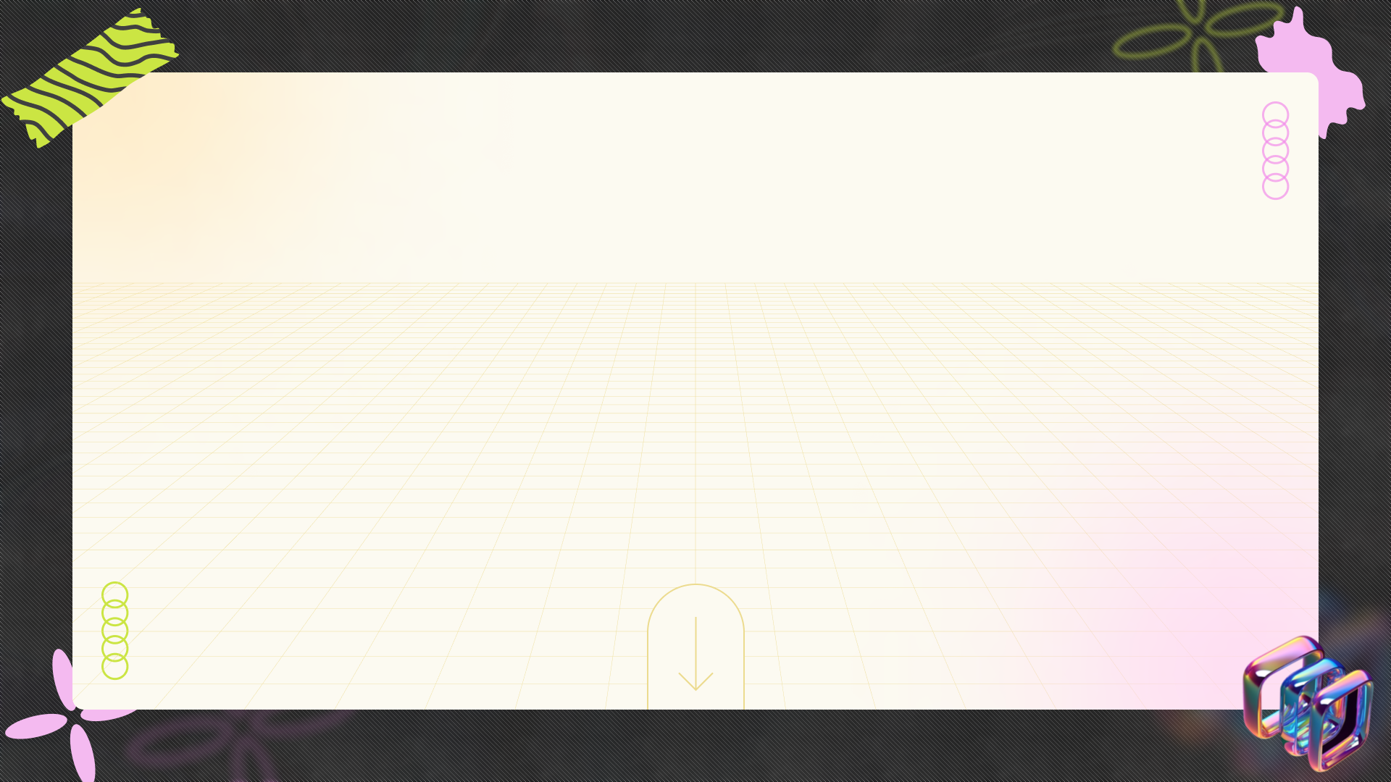
Navigating the Dichotomy: This and That Explored
+
+
+
A comprehensive analysis of contrasting concepts and their interplay in various contexts
+
+
+

Slide 2



Table of Contents
01
This vs. That: Foundations
02
The Core Differences: A Head-to-Head Comparison, Highlighting the key distinctions between 'this' and 'that' across different attributes.
03
'This': Advantages and Considerations
04
The 'That' Factor
05
Real-World 'This': In Action
06
Real-World 'That'
07
This vs. That: A Quantitative Showdown
08
This & That: Evolving
09
This & That: A Powerful Pairing

Slide 3
Table of Contents
10
Decision Dynamics: 'This' vs 'That'

Slide 4

This vs. That: Foundations
'This' signifies immediacy, proximity, and direct reference to the speaker's current context.
'That' implies distance, separation, and a reference outside of the immediate context.
Grasping these concepts is crucial for comparative analysis and clear communication later in the presentation.
Examine the parameters of 'this,' including spatial, temporal, and conceptual closeness to the speaker.

Slide 5
This vs. That: Foundations
Delving into the breadth of 'that,' focusing on distance, difference, and external references.
Highlighting the fundamental contrasts between 'this' and 'that' to avoid ambiguity and confusion.

Slide 6

The Core Differences: A Head-to-Head Comparison, Highlighting the key distinctions between 'this' and 'that' across different attributes.
1.
Functionality Focus
2.
Scalability Impact
'This' prioritizes core feature set, while 'that' emphasizes broader, extended functionality for diverse applications.
'This' offers limited scalability, whereas 'that' provides superior scalability to accommodate future growth needs.
3.
User Experience
4.
Cost Implications
'This' has a streamlined user interface, contrasting with 'that's' more complex and feature-rich user experience.
'This' presents a lower initial cost, but 'that' offers better long-term value based on its performance metrics.

Slide 7
The Core Differences: A Head-to-Head Comparison, Highlighting the key distinctions between 'this' and 'that' across different attributes.
5.
Integration Ease
6.
Security Protocols
'This' simplifies integration with existing systems, compared to 'that' requiring custom adjustments for smooth transition.
'This' employs basic security, 'that' implements advanced protocols safeguarding data and infrastructure from potential threats.

Slide 8



'This': Advantages and Considerations
The Upside
Potential Downsides
  Increased efficiency and productivity through streamlined workflows and automated processes, freeing up valuable time.
  Enhanced collaboration among team members fostering creativity and innovation, leading to better problem-solving skills.
  Improved decision-making capabilities with access to comprehensive data analytics, allowing for more informed choices.
  Initial implementation costs can be significant, requiring investment in new infrastructure and staff training programs.
  Potential for disruption during the transition phase, impacting ongoing operations and temporarily reducing overall output.
  Dependency on technology and infrastructure creates vulnerabilities to system failures and cyber security threats.

Slide 9
'This': Advantages and Considerations
The Upside
Potential Downsides
  Greater flexibility and adaptability to changing market conditions, enabling quicker responses and strategic adjustments.
  Risk of over-reliance on automated systems, potentially diminishing critical thinking skills and problem-solving abilities.

Slide 10


The 'That' Factor
Using 'that' can enhance clarity, particularly when distinguishing between restrictive and nonrestrictive clauses, leading to more precise meaning.
Omitting 'that' can sometimes improve sentence flow, making writing sound more natural and less formal, depending on context.
'That' is generally more common in formal writing, while its omission might be preferred in informal or conversational styles.
Leaving out 'that' can occasionally create ambiguity, especially in complex sentences where the relationship between clauses is unclear.
Photo by Pexels

Slide 11
The 'That' Factor
Consider how 'that' affects readability. Too many instances can make writing feel clunky; too few might confuse the reader.
Photo by Pexels

Slide 12
Real-World 'This': In Action
Adoption Rate
25%
Cost Savings
1.5k $
Efficiency Gain
15%
User Satisfaction
4.8/5

Slide 13
Real-World 'This': In Action
Error Reduction
8%
Scalability Index
2x
Implementation Time
2 weeks

Slide 14

Real-World 'That'
'That' introduces essential clauses, providing clarity and distinguishing specific information, crucial for precise understanding in complex sentences.
Using 'that' to report what someone said ensures accurate conveyance of information, avoiding ambiguity and maintaining the original message's intent.
'That' seamlessly integrates clauses acting as objects, creating concise and informative sentences that clearly define the action's target or receiver.
'That' complements nouns, adding essential details and enriching meaning, allowing for a deeper and more nuanced expression of ideas and concepts.
Photo by Pexels

Slide 15
Real-World 'That'
'That' is often favored in formal writing, lending a sense of precision and objectivity to the text, crucial for academic and professional documents.
Photo by Pexels

Slide 16
This vs. That: A Quantitative Showdown
Conversion Rate
2.5%
Customer Acquisition
1.2k
Average Spend
55$
Market Share
15%

Slide 17
This vs. That: A Quantitative Showdown
User Engagement
2M
Cost Savings
10k

Slide 18


This & That: Evolving
1500
Early Usage
The terms 'this' and 'that' were commonly used to denote proximity and distance, respectively. Texts...
Explore the intertwined history of 'this' and 'that'.
Uncover key milestones in their usage and meaning.
Expanding Roles
1750
As language evolved, 'this' and 'that' began to acquire broader roles, venturing beyond simple spatial...
1900
Modern Context
The 20th century witnessed a further diversification of 'this' and 'that'. They are increasingly used...

Slide 19
This & That: Evolving
2023
Digital Age
In the digital age, 'this' and 'that' retain their core meanings but are also influenced...
Explore the intertwined history of 'this' and 'that'.
Uncover key milestones in their usage and meaning.

Slide 20
This & That: A Powerful Pairing
'This' and 'that' begin as distinct entities, holding unique properties and individual characteristics.
Identifying the areas where 'this' and 'that' intersect, revealing opportunities for connection.
How the interaction of 'this' and 'that' creates a result greater than the sum of parts.
Acknowledging areas of potential tension or disagreement between 'this' and 'that'.

Slide 21
This & That: A Powerful Pairing
Achieving optimal coexistence, maximizing benefits and minimizing negative impacts on either entity.
Exploring avenues for future collaboration and evolution of 'this' and 'that' together.

Slide 22
Decision Dynamics: 'This' vs 'That'
Efficiency Gain
15%
Cost Reduction
20k $
Time Saved
10 hrs
Error Rate
2%

Slide 23
Decision Dynamics: 'This' vs 'That'
User Satisfaction
4.5/5
Market Share
12%
ROI
1.8x

