Slide 1


Unlocking Child Development: A Comprehensive Guide
Understanding the key milestones and nurturing growth potentials

Slide 2


Table of Contents
1
Understanding Child Development
2
Movement Milestones Unveiled
3
Unlocking Young Minds
4
Emotional Blueprint: Nature vs. Nurture
5
Building Blocks for Brighter Futures

Slide 3


Understanding Child Development
1
Physical Growth
2
Cognitive Skills
Encompasses changes in body size, motor skills, and physical health from infancy through adolescence. Crucial milestones achieved.
Focuses on intellectual abilities, learning, memory, problem-solving, and language acquisition. Forming crucial connections early.
3
Emotional Growth
4
Social Development
Involves understanding and managing feelings, developing empathy, and forming secure attachments. Builds emotional resilience.
Covers interactions with others, building relationships, understanding social norms, and developing moral reasoning. Essential social skills.

Slide 4

Movement Milestones Unveiled
Infancy (0-2)
Early Childhood (3-5)
Middle Childhood (6-8)
Later Childhood (9-11)
Reflexes Emerge
Mastering Coordination
Refinement & Sport
Advanced Movement
Newborns exhibit reflexes like grasping and rooting, gradually developing head control, rolling over, and sitting. They begin exploring their environment through movement, laying the foundation for crawling and walking. Early...
Preschoolers refine gross motor skills like running, jumping, and climbing, while also developing fine motor skills like drawing and using utensils. Increased coordination allows for more complex play activities. Physical...
Children further enhance their motor skills, becoming more proficient in sports and other physical activities. Hand-eye coordination improves, leading to better performance in games and activities requiring precision. This stage...
Children develop more specialized motor skills, excelling in specific sports or activities based on their interests and abilities. Growth spurts can temporarily affect coordination, requiring adjustments in training and expectations....

Slide 5
Unlocking Young Minds
Explore the four distinct stages of cognitive development, from sensorimotor to formal operational thinking.
Infants learn through senses and actions, developing object permanence. Birth to around two years old.
Sociocultural influences on learning: the Zone of Proximal Development and scaffolding concepts.
Learning is a collaborative process; knowledge is constructed through interaction and cultural tools.

Slide 6


Emotional Blueprint: Nature vs. Nurture
Strong attachment fosters trust, resilience, and healthier relationships throughout life, providing a secure base for exploration and growth.
Empathy promotes compassion, understanding, and prosocial behaviors, leading to stronger communities and reduced conflict. It is the bedrock of positive interaction.
Effective self-regulation improves decision-making, reduces impulsivity, and enhances academic and professional success, setting the stage for well-being.
Insecure attachment can lead to anxiety, avoidance, and difficulties in forming lasting relationships, hindering emotional connection and stability.
Lack of empathy can result in detachment, aggression, and impaired social skills, leading to isolation and difficulty in understanding others' perspectives.
Poor self-regulation can manifest as impulsivity, emotional outbursts, and difficulty managing stress, impacting personal and professional lives.

Slide 7
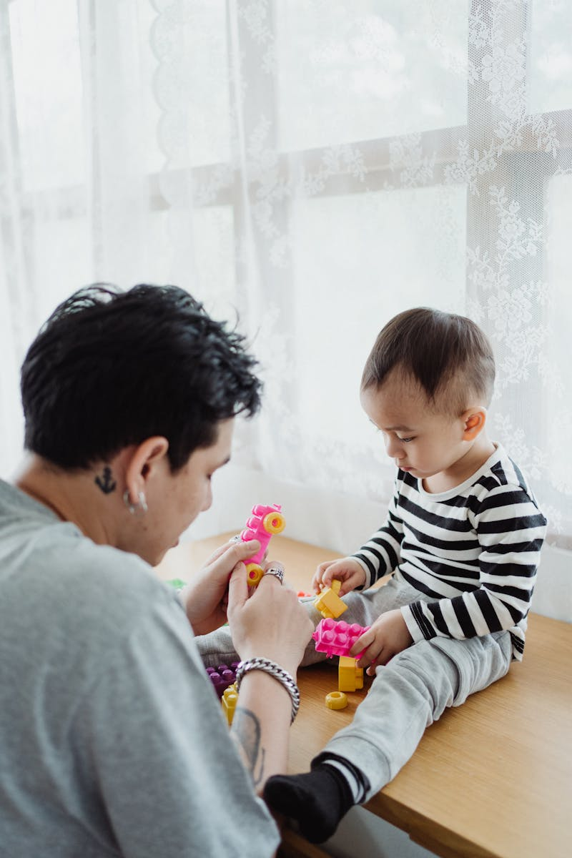
Building Blocks for Brighter Futures
Active parental involvement creates a strong foundation for a child's social, emotional, and academic success, shaping their growth.
Access to excellent education equips children with the knowledge and skills needed to thrive in a rapidly changing world.
Comprehensive healthcare ensures children's physical and mental well-being, supporting their ability to learn and grow to their full potential.
Safe and supportive environments foster emotional security, allowing children to explore, learn, and develop resilience.
Photo by Pexels

