Slide 1
Cloud Computing Models
Exploring Infrastructure as a Service, Software as a Service, Platform as a Service, and more

Slide 2
Introduction to Cloud Computing
• Running an application on the internet without your own equipment
• Infrastructure as a Service (IaaS)
• Hardware as a Service (HaaS)
• Outsourcing equipment
Photo by Pexels

Slide 3
Infrastructure as a Service (IaaS)
• Outsourced hardware and infrastructure
• Responsible for loading application and data
• May or may not include operating system
• Security of data is the user's responsibility
Photo by Pexels

Slide 4
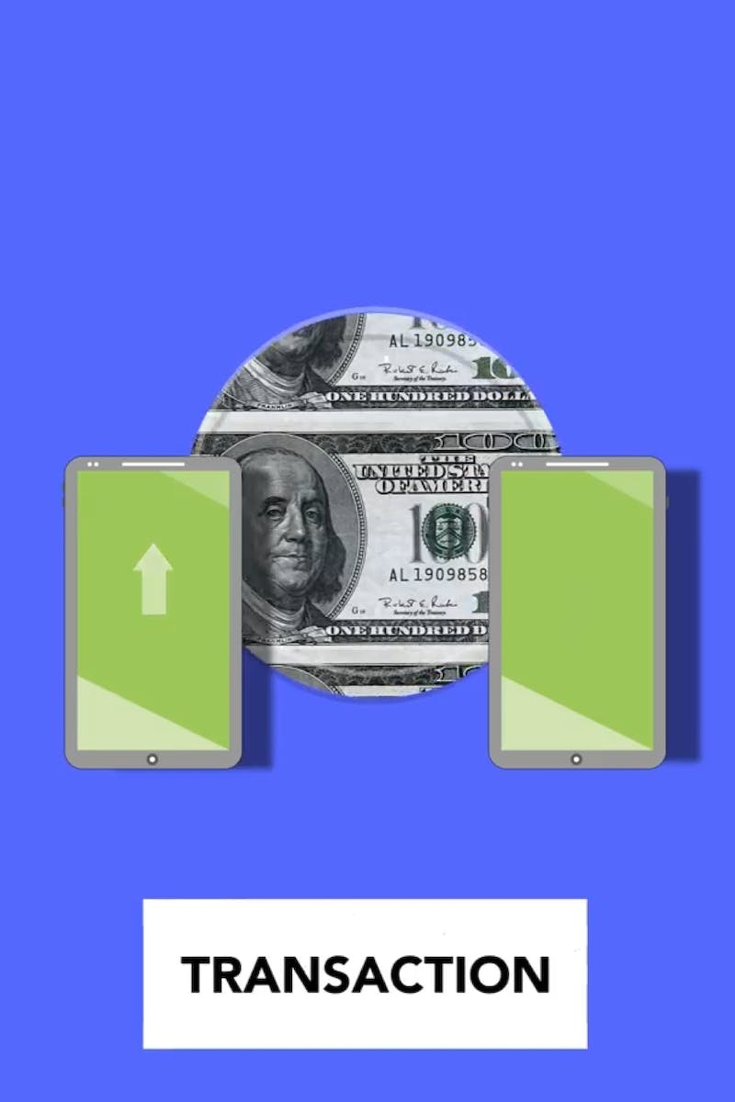
Software as a Service (SaaS)
• No need to create software or manage infrastructure
• Application and data located in the cloud
• Provider is responsible for managing and securing data
• End user only needs to log in and use the application
Photo by Pexels

Slide 5
Platform as a Service (PaaS)
• Cloud-based system for building applications
• Provider manages infrastructure and provides building blocks
• Users can build applications without worrying about servers or data centers
• Building blocks pre-designed for common application components
Photo by Pexels

Slide 6
On-Premises Deployment
• All components are hosted in the user's own data center
• Network, servers, operating systems, and applications are all in-house
• No reliance on cloud providers
• Full control and responsibility for infrastructure
Photo by Pexels

Slide 7
Public, Community, Private, and Hybrid Cloud Models
• Public model: Accessible to everyone on the internet
• Community model: Multiple organizations sharing resources
• Private model: Cloud technology within the user's own data center
• Hybrid model: Combination of public and private cloud
Photo by Pexels

Slide 8
Desktop as a Service (DaaS)
• Cloud-based technology for managing workstations and desktops
• Allows remote access to a full desktop environment
• Minimal hardware resources required on the user's end
• Bandwidth is a significant requirement for remote desktop access
Photo by Pexels

Slide 9
Conclusion
• Different cloud computing models for various needs
• Choosing the right model based on requirements and responsibilities
• Key considerations: hardware, infrastructure, software, and data management
• Cloud computing offers flexibility, scalability, and simplified management
Photo by Pexels

