Slide 1
The Role of Peace in Political Leadership
Exploring the importance of peace in shaping effective politicians

Slide 2
Introduction
• Peace is a crucial element for effective political leadership.
• The impact of peace on political candidates and parties.
• Understanding the role of peace in shaping politicians and policies.
• Exploring the benefits of a peaceful approach in politics.
Photo by Pexels

Slide 3
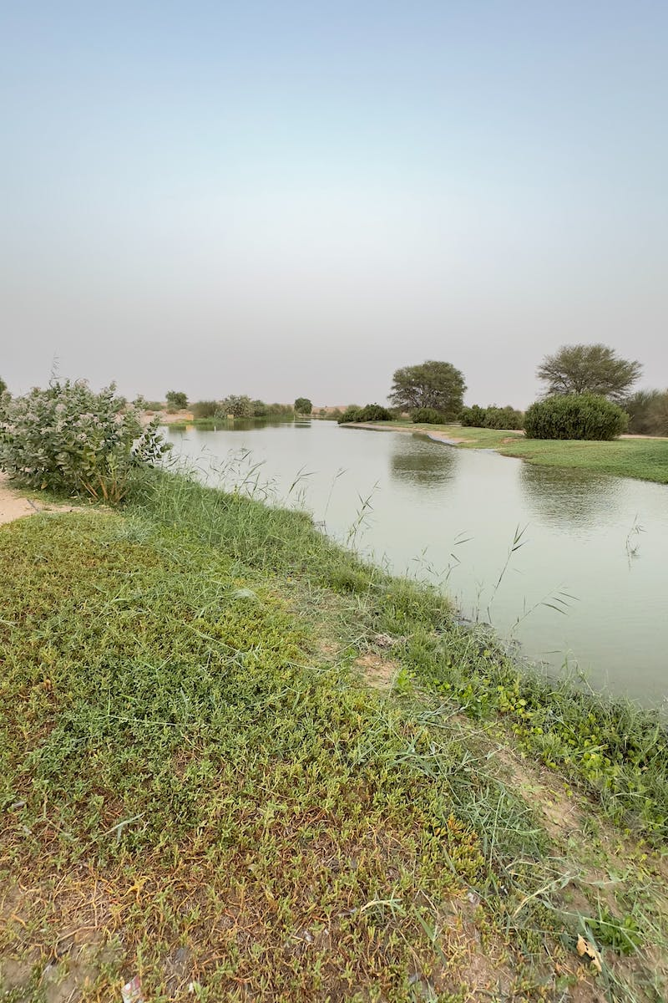
The Need for Peaceful Politicians
• The importance of having politicians who prioritize peace.
• Building trust with constituents through peaceful actions.
• Promoting diplomacy and conflict resolution in policy-making.
• Creating a peaceful and stable political environment.
Photo by Pexels

Slide 4
The Impact of Peaceful Policies
• Benefits of policies that prioritize peace.
• Reduction in violence and conflicts within society.
• Improved quality of life for citizens.
• Promotion of economic growth and development.
Photo by Pexels

Slide 5
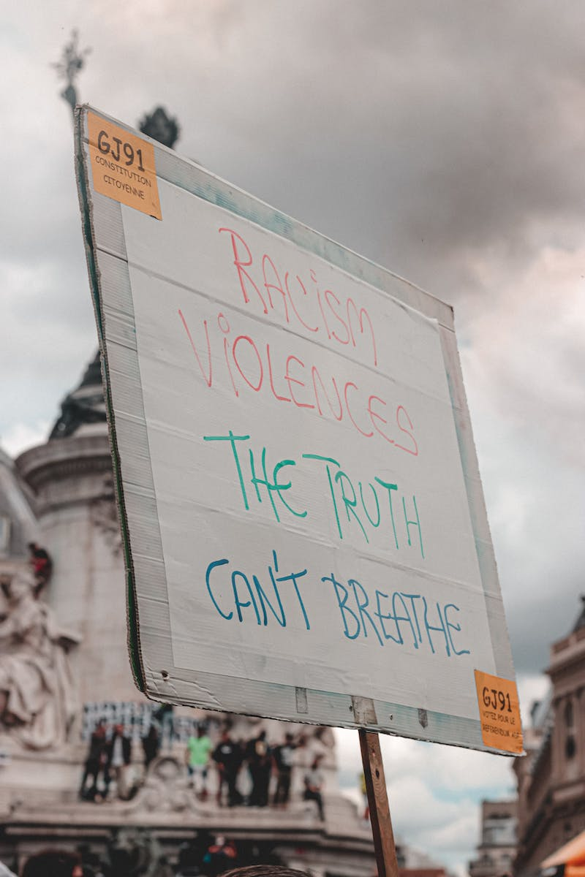
Challenges and Obstacles
• Overcoming resistance to peaceful policies.
• Navigating political opposition and conflicting agendas.
• Addressing the complexities of international relations.
• Balancing peace with other national interests.
Photo by Pexels

Slide 6
Conclusion
• The significance of peace in political leadership.
• Encouraging politicians to embrace a peaceful approach.
• Fostering a culture of peace within society.
• Motivating future generations to prioritize peace in politics.
Photo by Pexels

