Slide 1
Solid Waste Management: Challenges and Solutions
A Comprehensive Overview of Solid Waste Management Practices

Slide 2
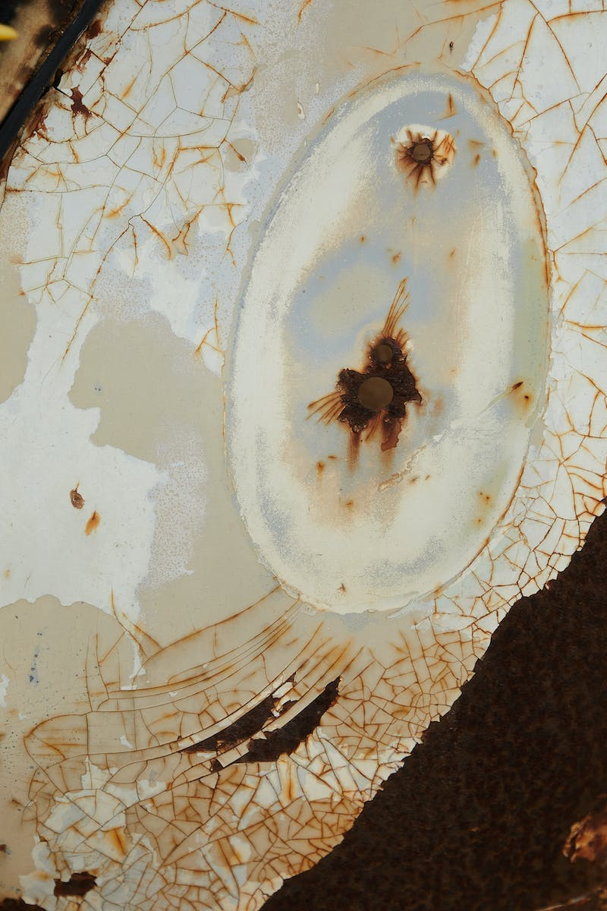
Introduction to Solid Waste Management
• Solid waste refers to any unwanted or discarded material that is not liquid or gas.
• Solid waste management involves the collection, transportation, and disposal of waste to minimize its impact on the environment.
• Various types of solid waste include municipal waste, industrial waste, and special waste.
• Proper management of solid waste is crucial to prevent pollution and protect public health.
Photo by Pexels

Slide 3
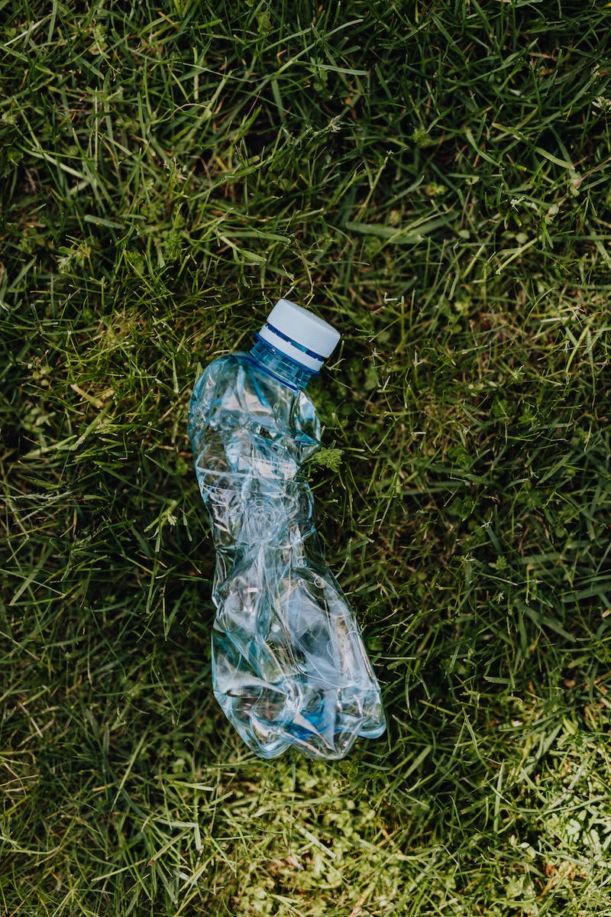
Current Challenges in Solid Waste Management
• Worrying rise in solid waste generation due to population growth and urbanization.
• Flash floods caused by improper disposal of waste, leading to clogged drainage systems.
• Mineral extraction from solid waste poses environmental risks, such as soil and water contamination.
• Solid waste management practices need improvement to address these challenges effectively.
Photo by Pexels

Slide 4
Legislative Framework for Solid Waste Management
• Republic Act 9003: Solid Waste Management Act of 2000 is the primary law governing waste management in the Philippines.
• The act establishes provisions for waste segregation, recycling, and proper disposal.
• The National Solid Waste Management Commission and the National Ecology Center play crucial roles in implementing this law.
• Efforts are being made to enforce the act and establish material recovery facilities for waste segregation.
Photo by Pexels

Slide 5
Status and Data on Solid Waste Management
• The National Solid Waste Management Status Report (2015) provides valuable insights into waste management practices.
• In 2015, the report identified 40,087.45 tons of waste generated, an increase from previous years.
• Hong Kong's waste management practices in 2016 serve as a benchmark for improvement.
• The report emphasizes the need for better waste segregation and management efforts.
Photo by Pexels

Slide 6
Types of Solid Waste
• Biodegradable waste: Organic waste that can be decomposed by natural processes.
• Nuclear waste: Radioactive waste produced by nuclear power plants or other nuclear activities.
• Solid waste: Non-liquid and non-gaseous waste materials generated from various sources.
• Electronic waste: Discarded electronic devices and components that can be hazardous if not properly managed.
Photo by Pexels

Slide 7
Environmental Organizations and Initiatives
• Bantay Kalikasan: An organization focused on protecting the environment and promoting sustainable practices.
• Clean and Green Foundation: A foundation dedicated to environmental conservation and awareness.
• Material Recovery Facilities: Established under Republic Act 9003, these facilities promote waste segregation and recycling.
• Republic Act 115: Legislation supporting the establishment and operation of material recovery facilities.
Photo by Pexels

Slide 8
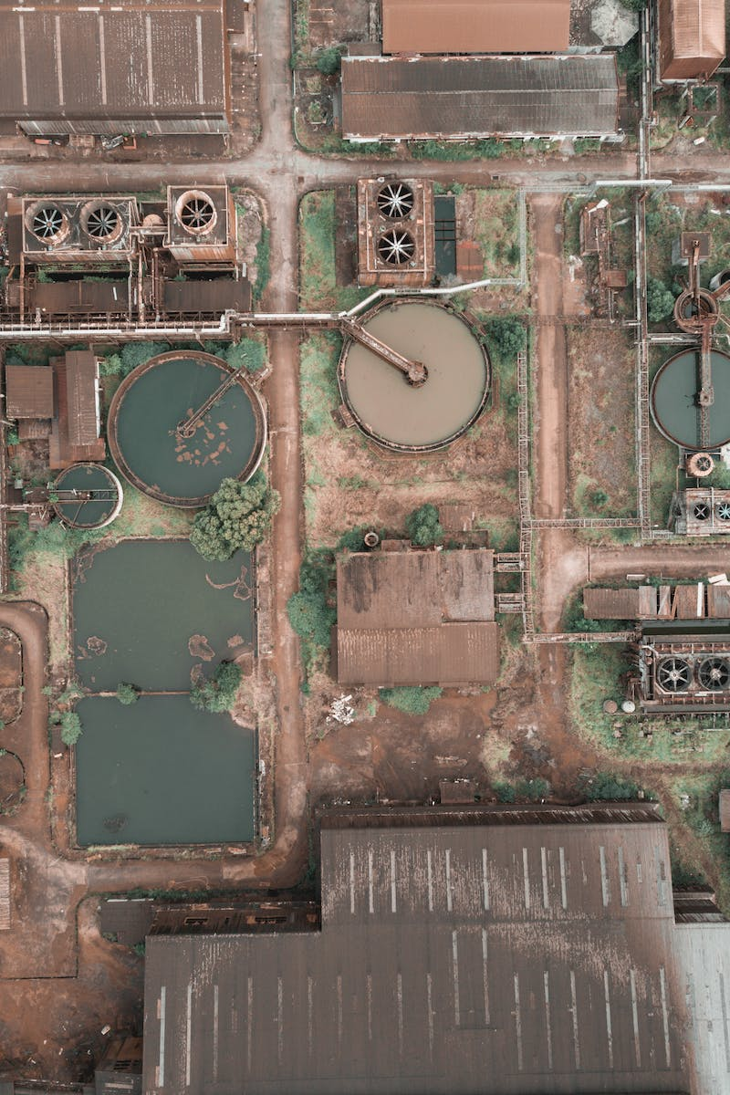
Conclusion
• Solid waste management is a pressing issue that requires effective solutions.
• Legislation, awareness campaigns, and improved waste management practices are essential for a sustainable environment.
• Collaboration between government bodies, NGOs, and communities is crucial for successful waste management.
• Continued efforts and innovation are needed to mitigate the challenges and achieve sustainable solid waste management.
Photo by Pexels

