Slide 1
The Art of Baking
Discover the Secrets to Creating Perfect Bread

Slide 2
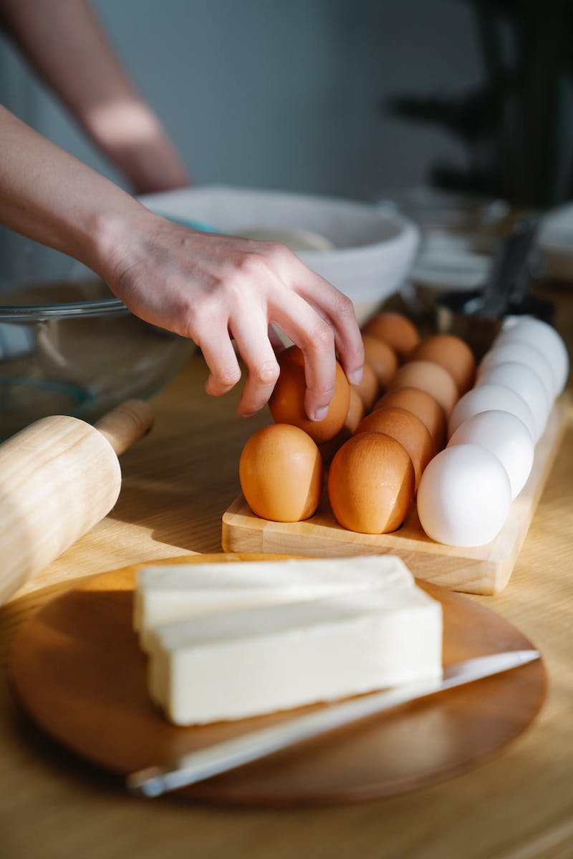
Introduction to Baking
• Learn the basics of bread making
• Explore the importance of ingredients
• Understand the role of temperature in dough
• Discover the art of kneading
• Master the technique of fermentation
• Unleash your creativity with bread shaping
Photo by Pexels

Slide 3
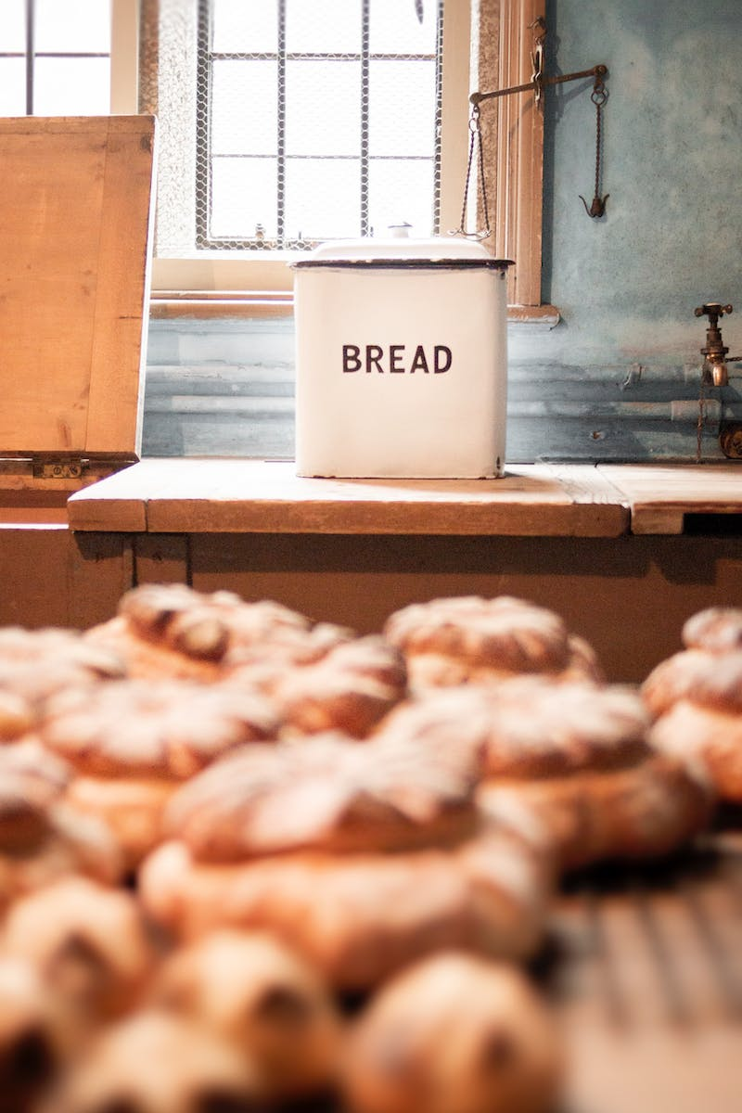
Ingredients for Perfect Bread
• Essential ingredients for bread
• Correct measurements for each ingredient
• The role of yeast or sourdough starter
• Special ingredients to enhance flavor and texture
Photo by Pexels

Slide 4
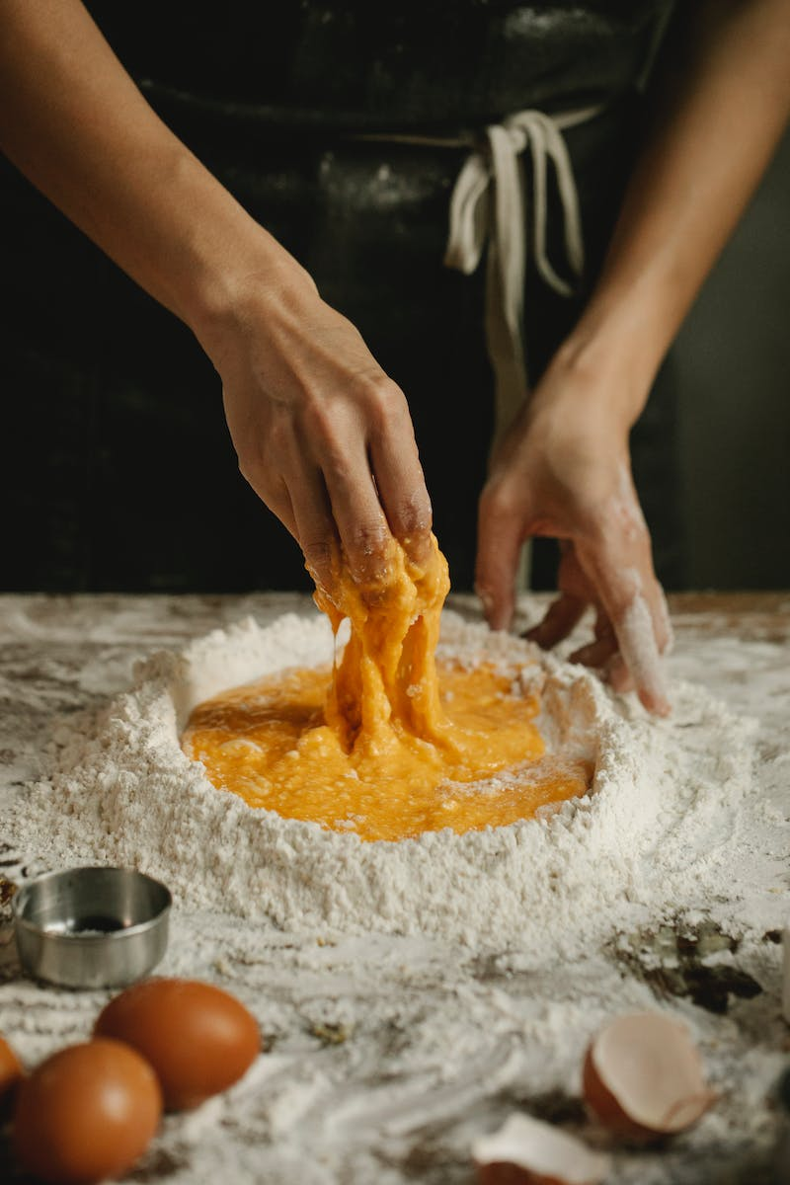
Temperature Control and Kneading
• Importance of temperature in dough
• Ideal temperature range for kneading
• Different techniques for kneading dough
• How to achieve the perfect dough consistency
Photo by Pexels

Slide 5
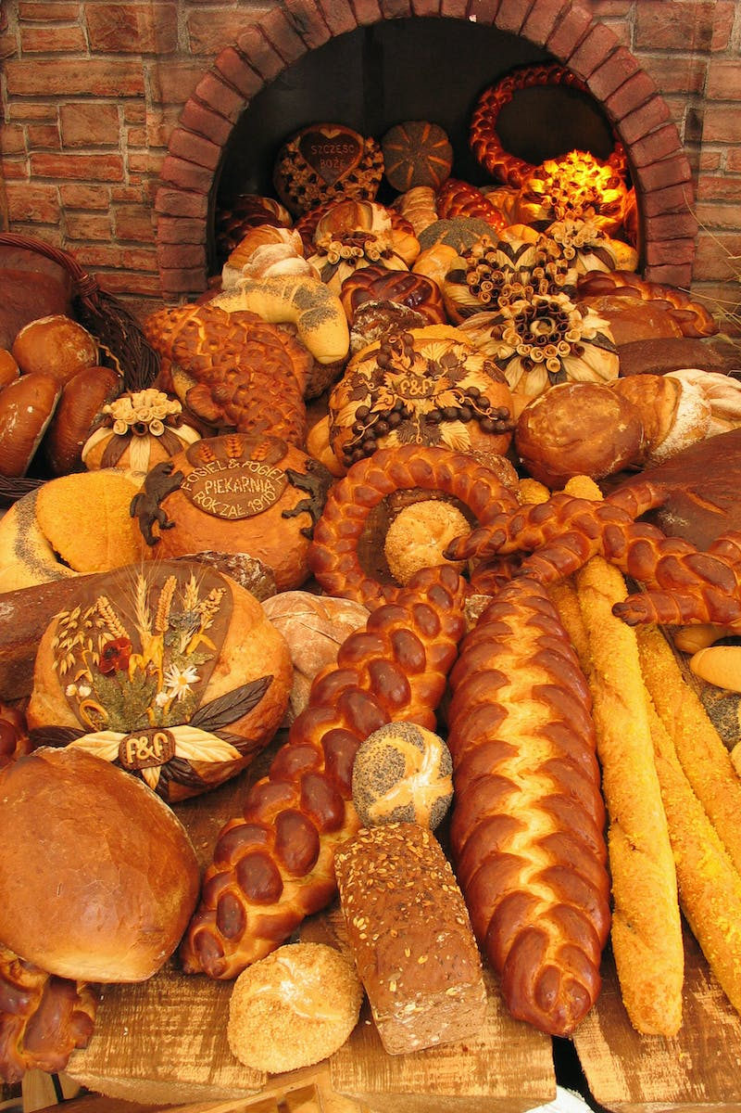
Mastering Fermentation
• Understanding the fermentation process
• Factors that affect fermentation
• Tips to control fermentation for desired results
• Signs of properly fermented dough
Photo by Pexels

Slide 6
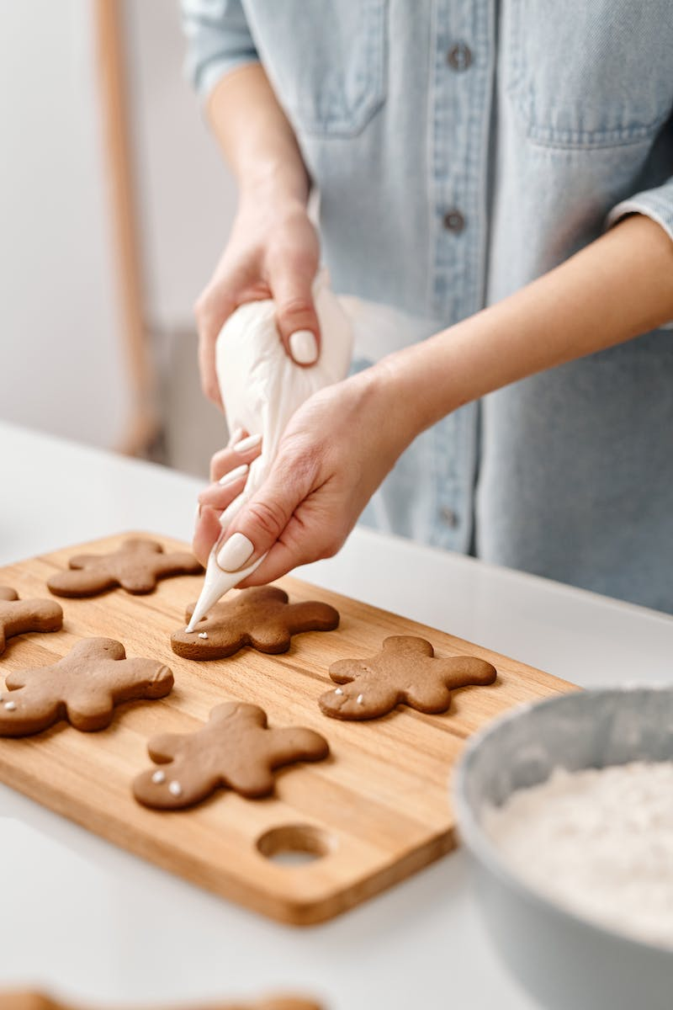
Art of Bread Shaping
• Techniques for shaping different types of bread
• Tips for achieving impressive bread shapes
• Importance of proper shaping for even baking
• Enhancing the aesthetic appeal of your bread
Photo by Pexels

Slide 7
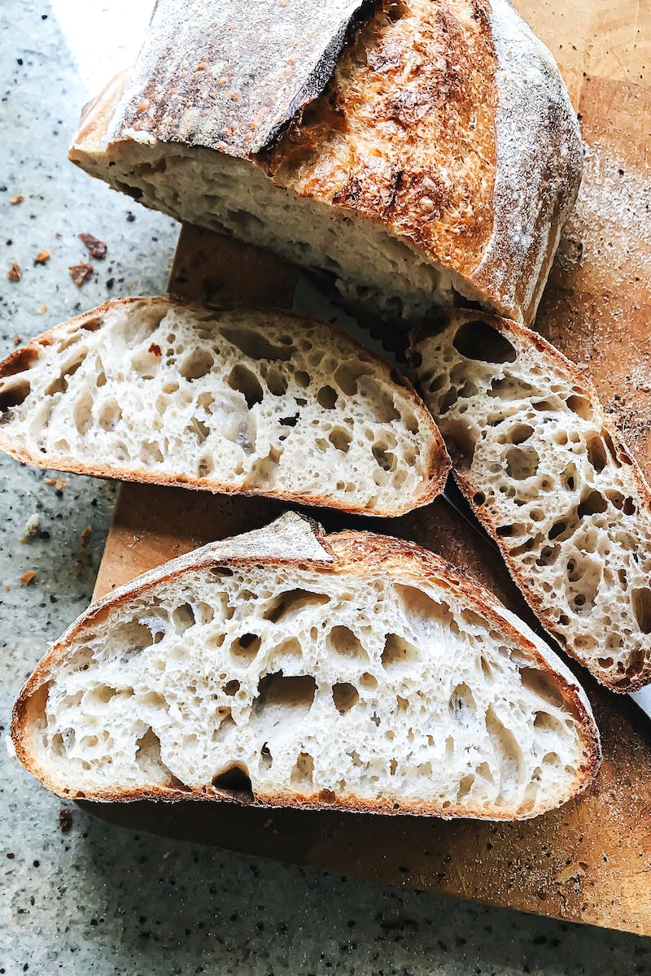
Conclusion
• Recap of the key elements of successful bread making
• Encouragement to experiment and explore new recipes
• Tips for troubleshooting common bread baking issues
• Resources for further learning and inspiration
Photo by Pexels

