Slide 1
The Impact of the Industrial Revolution
From Linear Development to Exponential Progress

Slide 2
Introduction
• The Industrial Revolution marked a turning point in human history
• It shifted from linear development to exponential progress
• Almost everything we rely on today has its origins in this pivotal episode
• Today, we will explore the significance of the Industrial Revolution
Photo by Pexels

Slide 3
The Origin of Humanity
• The kit of DNA analysis by Majeritage can reveal your genetic origins
• Discover your ancestral roots or find distant relatives
• Easy-to-use and straightforward process
• Explore the diversity of your genetic heritage
Photo by Pexels

Slide 4
Revolutionary DNA Results
• Personal experience with the Majeritage DNA analysis kit
• 51.8% Iberian heritage, specifically Asturias region
• 31% Northwestern European heritage
• 7.4% Italian, 7.8% Sub-Saharan African, 1.2% Nigerian, and 0.8% Native American
• Uncover your own genetic heritage with Majeritage
Photo by Pexels

Slide 5
The Industrial Revolution Begins
• Mid-18th century marked the start of the first Industrial Revolution
• Steam engine by James Watt (1769) accelerated industrial development
• Advancements in transportation, mining, textiles, and agriculture
• Great Britain led the industrialization, followed by other nations
• New class of wealthy bourgeoisie challenged the old order
Photo by Pexels

Slide 6
Impact on Society and Class Struggle
• Industrialization created a class divide and social tensions
• Bourgeoisie became revolutionary, driving movements like the French Revolution
• Working-class, or proletariat, faced harsh working conditions
• Marxist principles emphasized class struggle and worker empowerment
• Revolutionary ideals spread worldwide
Photo by Pexels

Slide 7
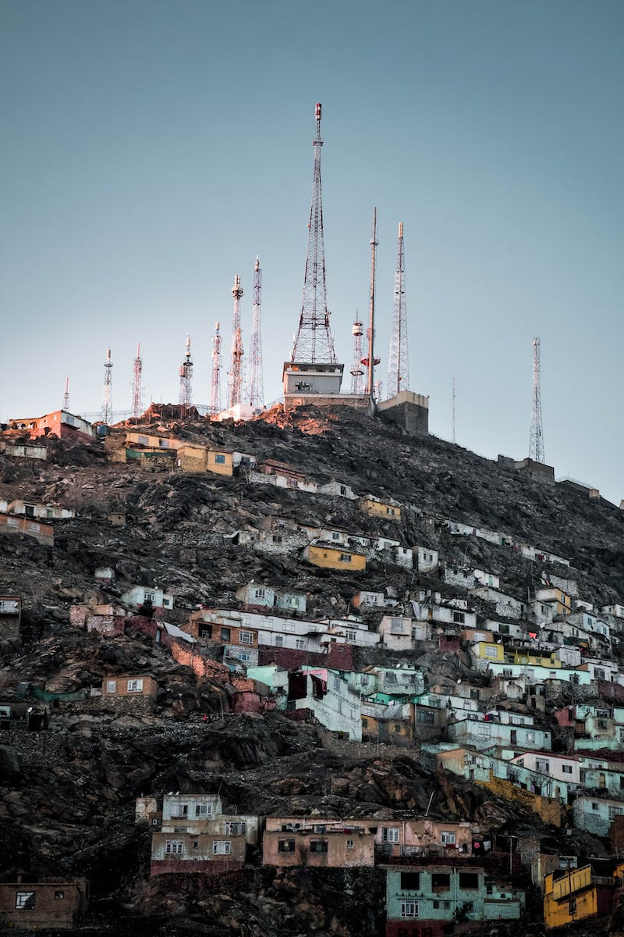
The Second Industrial Revolution
• Mid-19th century brought the second Industrial Revolution
• Major advancements in combustion engines and electricity
• Europe's industrial powers expanded globally
• Technological progress fueled conflicts like World War I
• Social and economic changes persisted
Photo by Pexels

Slide 8
Results of Industrialization
• Explosive population growth and demographic changes
• Improvements in healthcare and increased life expectancy
• Rapid increase in global GDP and energy consumption
• Persistent inequalities and environmental challenges
• Continued efforts for sustainable development
Photo by Pexels

Slide 9
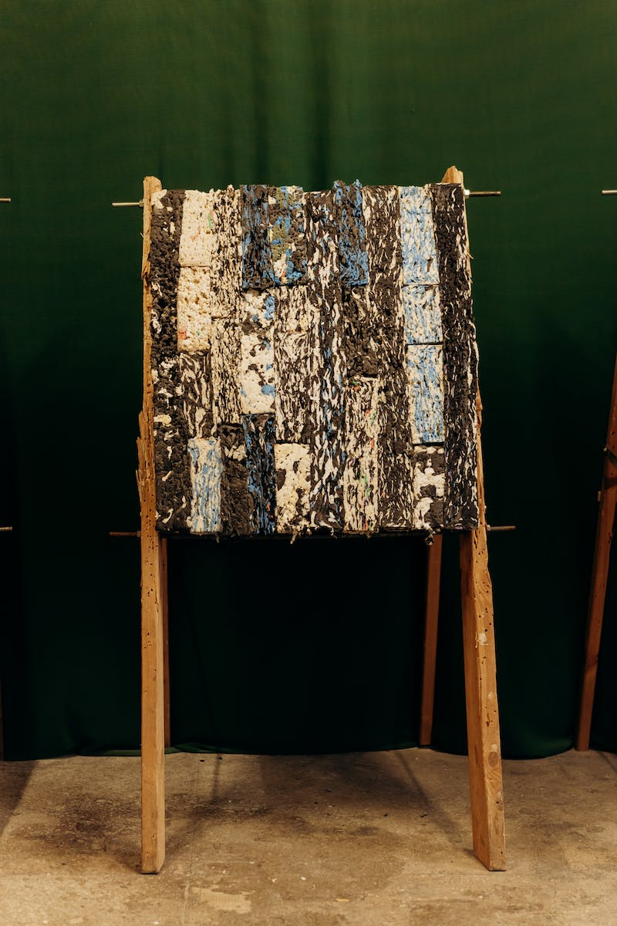
Conclusion
• The Industrial Revolution transformed the world
• From linear development to exponential progress
• Great benefits in terms of technology, healthcare, and economy
• Challenges and inequalities persist
• Continued efforts for a sustainable and equitable future
Photo by Pexels

