Slide 1
Arithmetic with Integers
Learning how to add and subtract integers

Slide 2
Introduction to Integers
• Negative numbers are part of a special set called integers
• Arithmetic with integers is more complicated than with whole numbers
• Two key rules: adding a negative is the same as subtracting a positive
• Subtracting a negative is the same as adding a positive
Photo by Pexels

Slide 3
Case 1: Making a Positive Number More Positive
• Adding positive numbers is regular addition
• Adding a negative number can be rewritten as subtraction
• Answer will always be positive in this case
Photo by Pexels

Slide 4
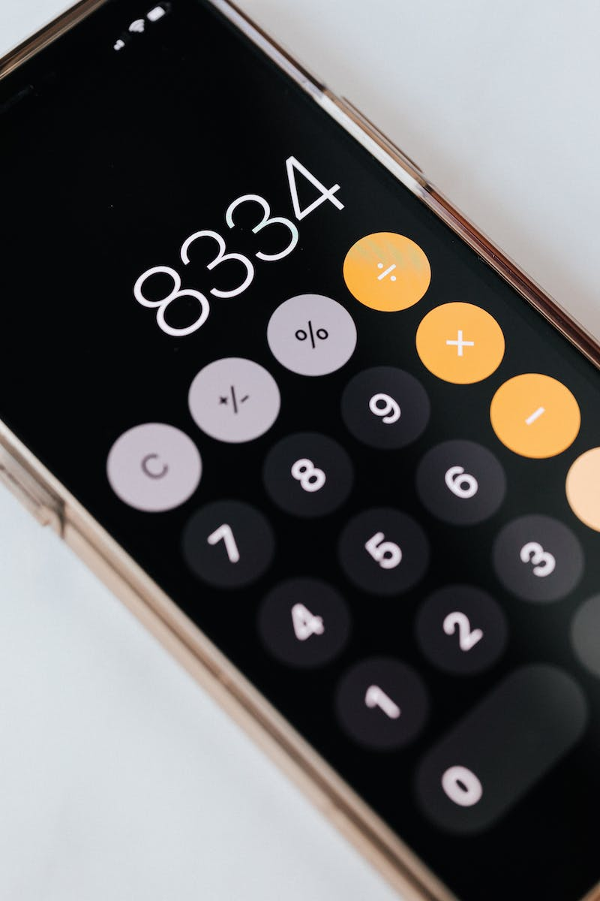
Case 2: Making a Positive Number More Negative
• Subtraction makes a positive number more negative
• Answer can be positive, negative, or zero
• Adding a negative can be rewritten as subtracting a positive
Photo by Pexels

Slide 5
Case 3: Making a Negative Number More Negative
• Adding a negative number makes a negative number more negative
• Answer will always be negative in this case
• Adding a negative can be rewritten as subtracting a positive
Photo by Pexels

Slide 6
Case 4: Making a Negative Number More Positive
• Adding a positive number makes a negative number more positive
• Answer can be positive, negative, or zero
• Adding a negative can be rewritten as subtracting a positive
Photo by Pexels

Slide 7
Strategy for Adding and Subtracting Integers
• Ask three key questions: starting sign, direction of change, resulting sign
• First question: starting with a positive or a negative number
• Second question: making the value bigger or smaller
• Third question: will the answer be positive, negative, or zero
Photo by Pexels

Slide 8
Practice and Conclusion
• Practice is key to mastering integer arithmetic
• Try a variety of problems with an answer key
• Don't get discouraged and rewatch the video for clarification
Photo by Pexels

