Slide 1
The Strange Characters of Mortal Kombat
Exploring the Unique and Bizarre Fighters of the Game

Slide 2
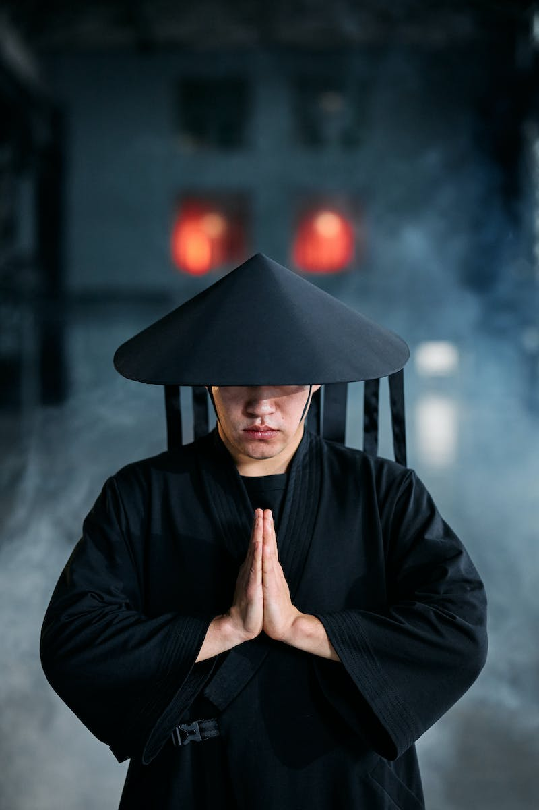
Introduction
• Mortal Kombat is known for its diverse and eccentric cast of characters
• Some fighters stand out due to their strange abilities and appearances
• This presentation will explore some of the most unusual characters in Mortal Kombat
• From a disfigured actor to a drunken master, there is no shortage of bizarre fighters
Photo by Pexels

Slide 3
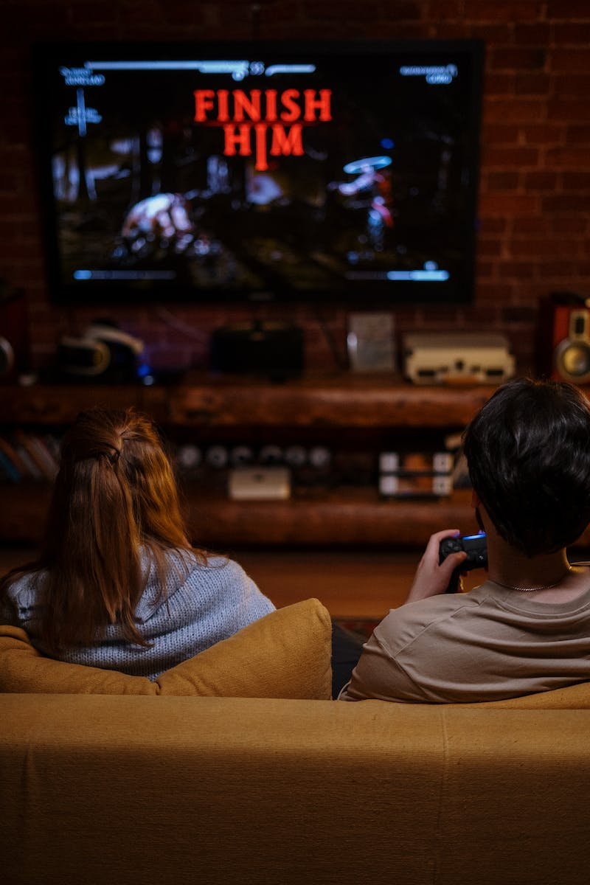
Havik - The Chaosrealm Revolutionary
• Havik is a character with a disfigured face and unique abilities
• He can manipulate his own body and use bones as weapons
• Havik lacks a clear backstory, originating from the Chaosrealm
• His abilities and origin make him a standout character in Mortal Kombat
Photo by Pexels

Slide 4
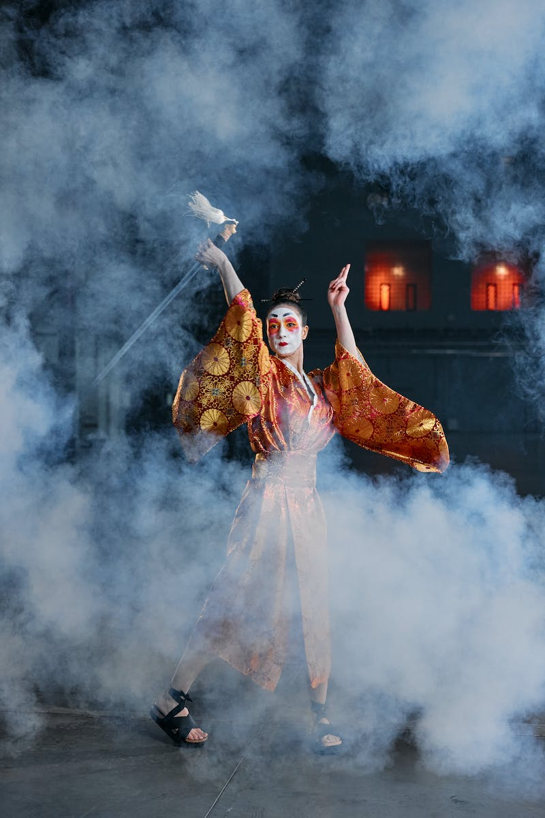
Mokap - The Motion Capture Actor Turned Fighter
• Mokap is a character based on a real-life motion capture actor
• He lacks a unique moveset but is a tribute to the behind-the-scenes work in Mortal Kombat
• Mokap's inclusion in the game was met with mixed reactions
• Despite his unusual concept, Mokap holds his own in battle with three fighting styles
Photo by Pexels

Slide 5
Kobra - The Unremarkable Outworld Warrior
• Kobra is a character that lacks any distinguishing features
• His design is uninspired, resembling a generic fighter
• Kobra's backstory and abilities are dull, making him uninteresting to players
• His existence in Mortal Kombat is perplexing when compared to other unique characters
Photo by Pexels

Slide 6
Meat - The Gruesome Experiment
• Meat is a character composed entirely of exposed muscle and bone
• Originally an Easter egg, Meat became a full-fledged character in Mortal Kombat Armageddon
• His gruesome appearance and unique moveset make him a noteworthy addition
• Despite his grotesque nature, Meat's storyline adds depth to the character
Photo by Pexels

Slide 7
Conclusion
• Mortal Kombat has a history of featuring strange and unusual characters
• These fighters add diversity and intrigue to the game's roster
• While some characters may be overlooked or disliked, they all contribute to the game's overall charm
• The world of Mortal Kombat is a haven for bizarre and unconventional fighters
Photo by Pexels

