Slide 1
The Golden Bread: A Lesson in Vanity and Humility
A story of self-discovery and the true meaning of beauty

Slide 2
Introduction
• The story of Marion and her daughter Na
• The stark contrast between their personalities
• The allure of Na's beauty
• The theme of vanity and self-importance
Photo by Pexels

Slide 3
Na's Refusal to Help
• Na's reluctance to assist her mother
• Her disdain for getting dirty or ruining her appearance
• Examples of Na's selfish behavior
• The consequence of Na's refusal to work
Photo by Pexels

Slide 4
Rejection of Marriage Proposals
• Numerous suitors come to ask for Na's hand
• Na's shallow reasons for rejecting them
• Marion's disappointment and concern
• The importance of love and humility
Photo by Pexels

Slide 5
Na's Dream and Mother's Surprise
• Na's dream of a prince wanting to marry her
• Her mother's astonishment and realization
• The significance of Na's laughter in her sleep
• The start of a new perspective for Na
Photo by Pexels

Slide 6
Na's Marriage Proposal
• The arrival of a golden carriage and a handsome man
• Na's excitement and willingness to marry
• Marion's concern and skepticism
• The sudden change in Na's perspective
Photo by Pexels

Slide 7
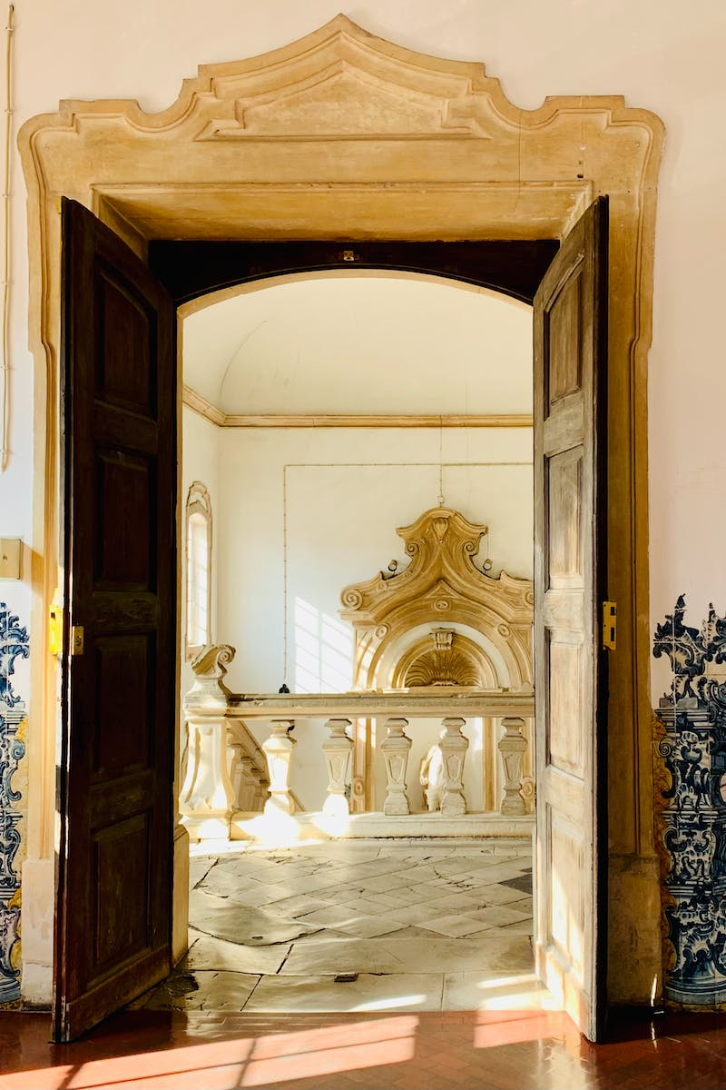
The Disappointment of Riches
• The journey to a beautiful golden castle
• Na's awe and excitement
• The revelation of gold as inedible
• The realization of Na's misguided desires
Photo by Pexels

Slide 8
Na's Change of Heart
• Na's desire to go back home to her mother
• Her realization of the true value of love
• The importance of humility and gratitude
• Na's transformation and newfound appreciation
Photo by Pexels

Slide 9
Conclusion
• Reflecting on Na's journey and transformation
• The importance of inner beauty and character
• The enduring lesson of the golden bread
• The power of self-reflection and personal growth
Photo by Pexels

