Slide 1
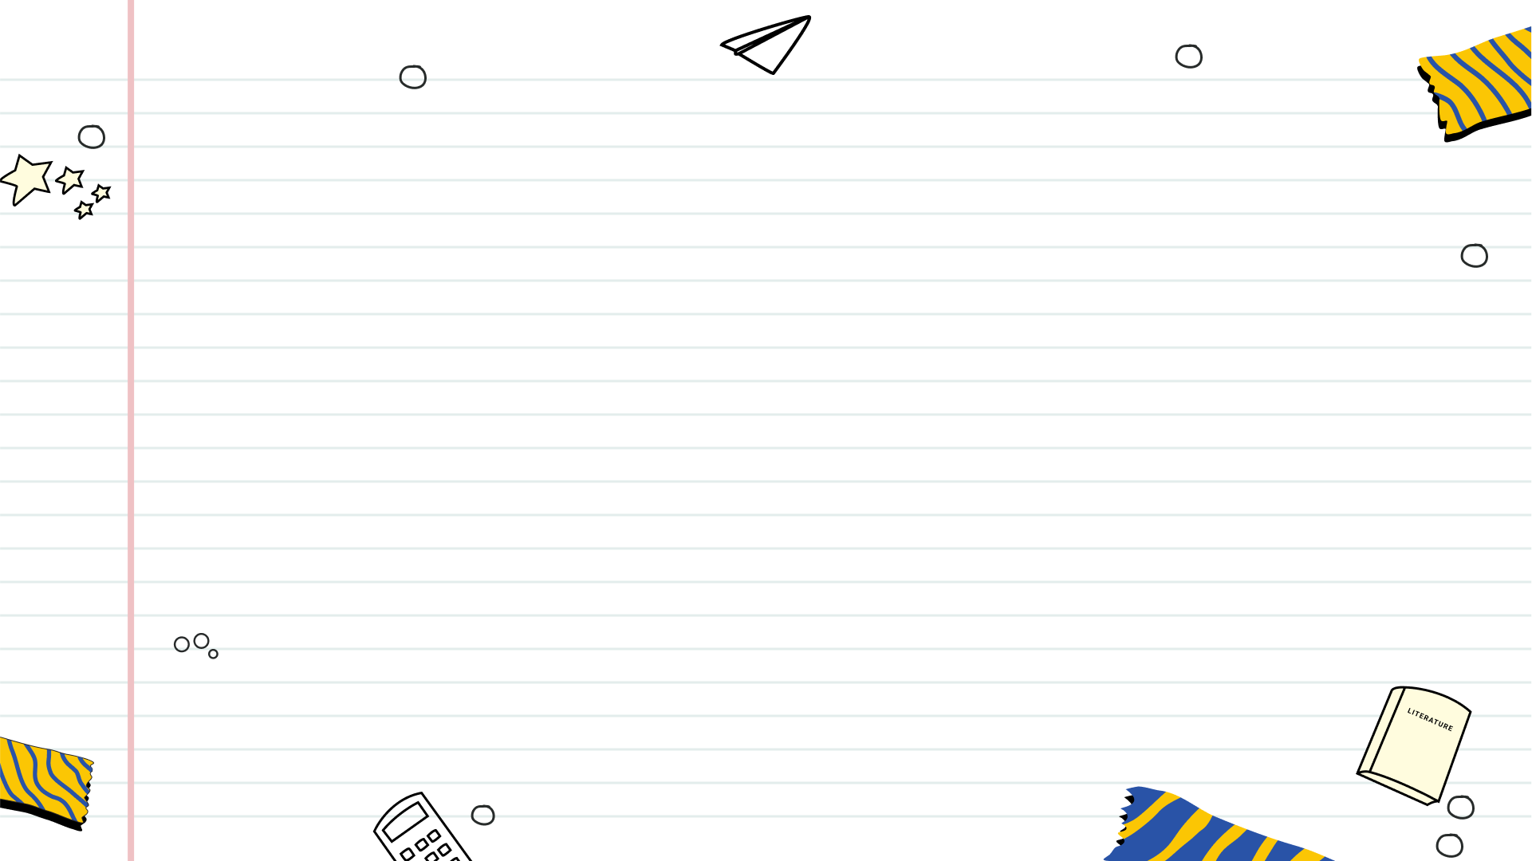

Snack Attack! Rebrand the Aisle
A High School Graphic Design Project exploring logo and packaging design.

Slide 2
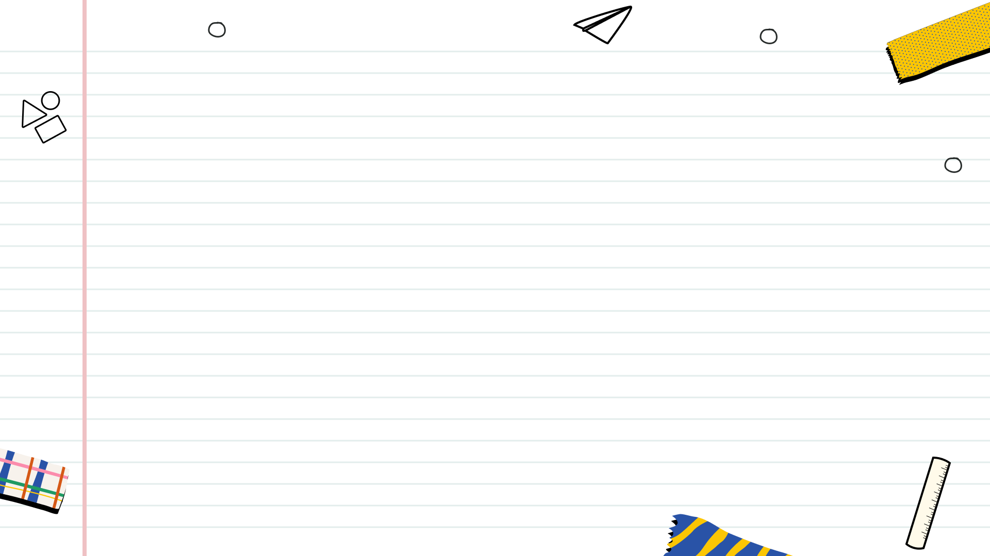

Table of Contents
1
Snack Aisle Revolution
2
Logo & Packaging: Deep Dive
3
Snack Rebranding Sprint Timeline
4
Rebranding: Target Audience Focus
5
Unleash Your Creativity
6
Brand Voice Through Design

Slide 3
Table of Contents
7
Mood Board Magic
8
Rebrand: Deliverable Two
9
Deliverable 3: Package Perfection
10
Snack Attack: Brand or Brew?

Slide 4
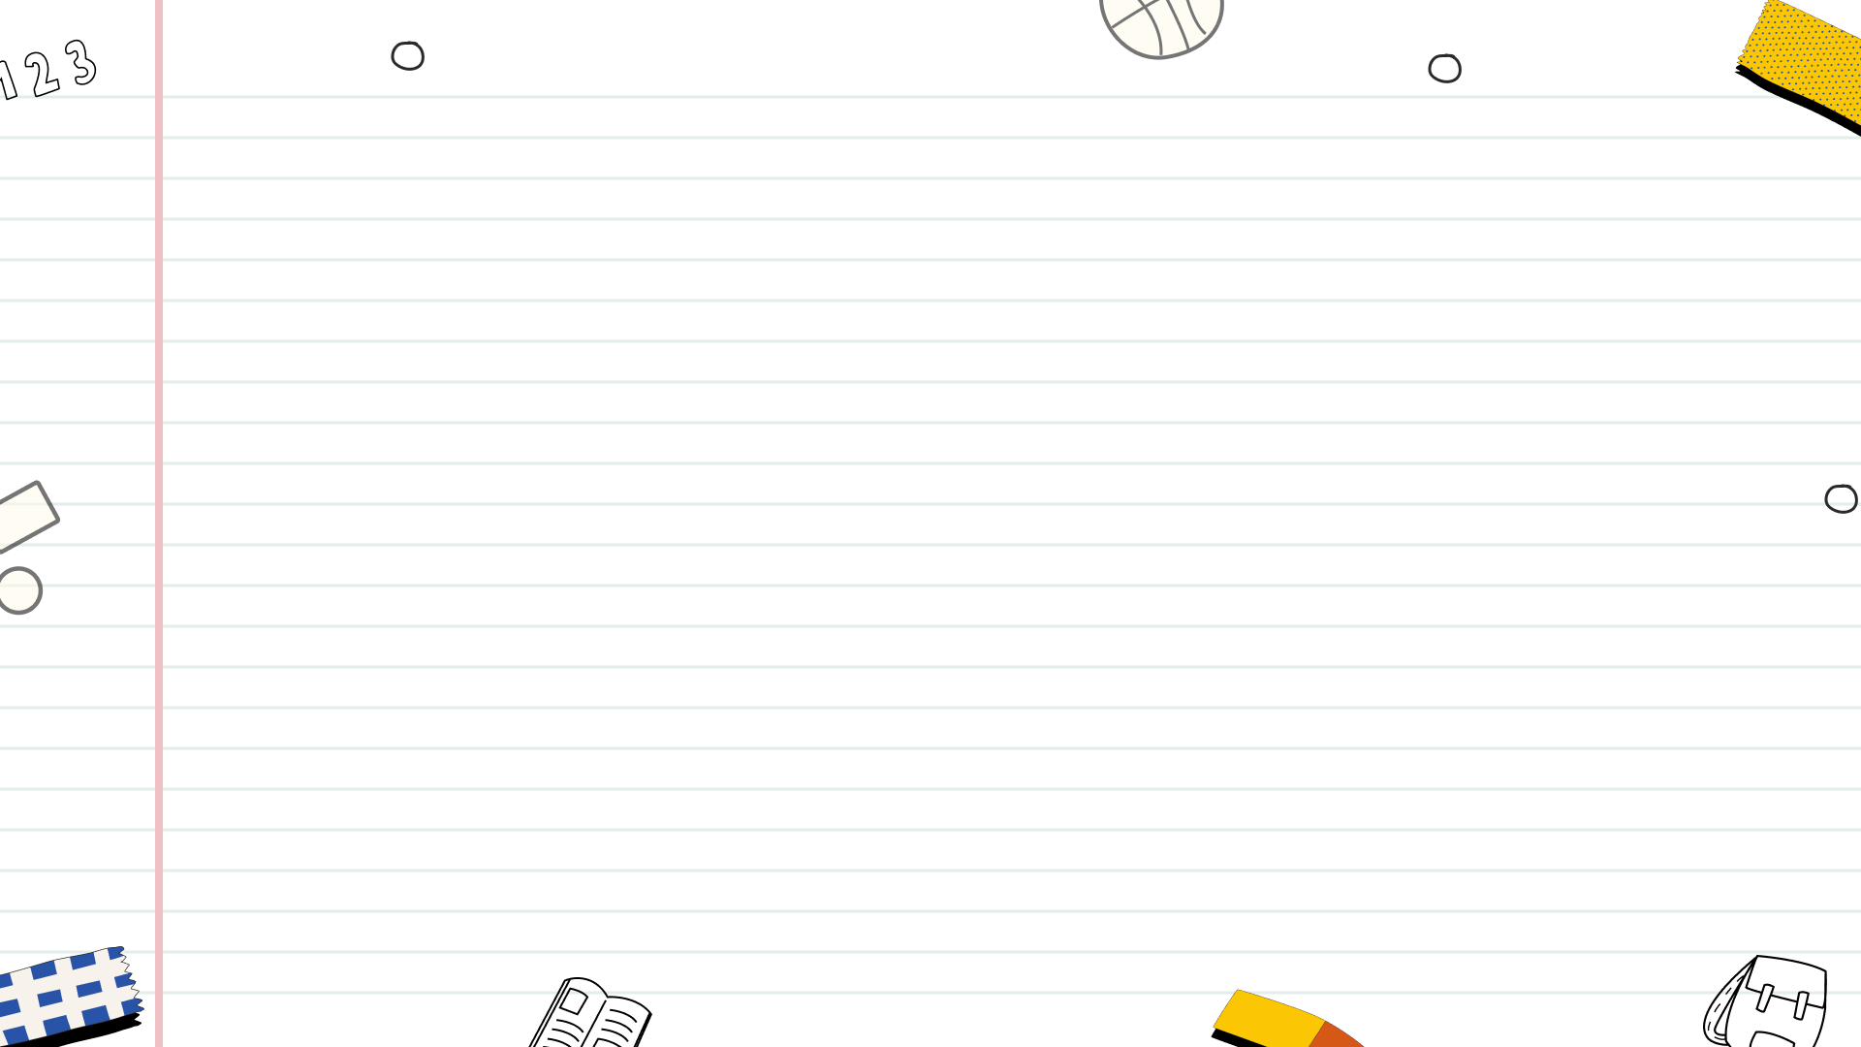
Snack Aisle Revolution
Rebrand the snack aisle to attract a new generation of consumers. Captivating design is key!
Redesign existing packaging, or create entirely new designs, tailored to specific demographics.
Identify and understand the nuances of your chosen target audience. Align design choices accordingly.
Utilize industry-standard design software to execute your vision and bring creative concepts to life.

Slide 5



Logo & Packaging: Deep Dive
Develops practical design skills applicable to real-world branding scenarios, enhancing portfolio quality significantly.
Provides a focused learning experience within the broader Logo & Packaging Design unit, improving overall comprehension.
Offers hands-on experience in translating conceptual ideas into tangible visual identities, boosting creative confidence.
May require significant time commitment outside of scheduled class hours, potentially impacting other coursework.
Success heavily relies on prior knowledge and understanding of design principles, necessitating supplementary learning.
The subjective nature of design evaluation can lead to uncertainty and potential frustration for some students.

Slide 6
Snack Rebranding Sprint Timeline
Week 1
Week 1
Week 2
Week 2
Ideation Ignition
Visual Identity
Prototype Creation
Final Presentation
Students brainstorm initial snack concepts, target demographics, and potential brand narratives. Market research and competitor analysis are crucial to identifying unique selling points. This sets the foundation for a compelling...
Design teams explore logo concepts, color palettes, typography, and packaging options. Visual elements must align with the brand narrative and appeal to the target audience. Iterative feedback and refinement are...
Students develop physical or digital prototypes showcasing the rebranded snack and its packaging. This stage involves creating mock-ups, presentations, or interactive experiences to visualize the final product. User testing and...
Each team presents their rebranded snack concept, including the brand narrative, visual identity, and prototype. They articulate their design decisions, justify their marketing strategy, and demonstrate the product's potential impact....

Slide 7

Rebranding: Target Audience Focus
1
Define 'Who'
2
Understand Needs
Clearly define your target audience demographics and psychographics to tailor your rebranding efforts effectively for maximum impact.
Identify and deeply understand the core needs, desires, and pain points of your target audience. Prioritize these.
3
Preference Mapping
4
Behavioral Insights
Map out the preferences of your target audience regarding aesthetics, messaging, and brand values for alignment.
Analyze audience behavior patterns and online activity to personalize communication and optimize the rebranding strategy.

Slide 8

Unleash Your Creativity
Create scalable vector graphics, logos, and illustrations with precision, perfect for branding materials requiring sharp details and versatility.
Edit photos, create realistic mockups, and design visually stunning graphics, essential for enhancing your brand's image across platforms.
Utilize Canva's user-friendly interface to create quick and effective designs, ideal for social media content and presentations, accessible to everyone.
Consider your design skill level, project complexity, and budget when selecting software, ensuring a smooth and efficient rebranding process.
Photo by Google

Slide 9
Brand Voice Through Design
Communicate tone and brand personality through design choices, ensuring a consistent and recognizable identity.
Select fonts that reflect your brand's personality. Consider readability and emotional impact for a clear message.
Establish a clear visual hierarchy to guide the user's eye and highlight key information effectively and impactfully.
Use images that resonate with your target audience and reinforce your brand's core values and overall aesthetic.

Slide 10

Mood Board Magic
Gathering visual references from diverse sources to ignite creativity and define the project's aesthetic direction.
Exploring and curating color palettes that resonate with the brand and evoke the desired emotional response.
Defining the demographics and psychographics of the target audience to ensure relevance and impact.
Creating a cohesive and visually appealing board that communicates the project's overall style and tone.
Photo by Google

Slide 11
Rebrand: Deliverable Two
Generate multiple logo concepts exploring different styles aligning with the defined brand attributes. Think big, start wide!
Iterate on chosen concepts based on stakeholder feedback; refine elements for optimal impact and visual appeal. Be flexible.
Define the primary and secondary color palettes, ensuring brand consistency and a visually harmonious aesthetic. Be consistent!
Select typography that complements the logo, reinforcing the brand's overall message and personality. Choose wisely!

Slide 12

Deliverable 3: Package Perfection
Prioritize eye-catching visuals. Highlight the snack's unique selling points and flavor profile. Make it instantly appealing on the shelf.
Include nutritional information, ingredients, and branding. Ensure clarity and compliance. Tell the snack's story succinctly and honestly.
Explore suitable packaging materials. Think about sustainability, preservation, and visual impact. Align with brand values and product needs.
Maintain a consistent brand aesthetic. Use established colors, fonts, and logos. Reinforce brand recognition and customer loyalty.
Photo by Google

Slide 13
Snack Attack: Brand or Brew?
Rebranding leverages existing recognition, saving time and resources on initial market awareness and customer acquisition efforts significantly.
A familiar product with a fresh twist can attract both loyal customers and new audiences, broadening market reach and potential revenue.
Rebranding allows for strategic adjustments to target new demographics or address evolving consumer preferences effectively and quickly.
Rebranding might alienate existing loyal customers who prefer the original brand, impacting sales and brand reputation negatively and unexpectedly.
Requires careful market research to avoid missteps that could damage brand equity; misinterpreting customer preferences is a dangerous risk.
May face challenges in differentiating from competitors if the rebranding is not unique or innovative enough in this ever-changing landscape.

