Slide 1
Introduction to Vectors in Physics
Understanding the Concept and Application of Vectors in Physics

Slide 2
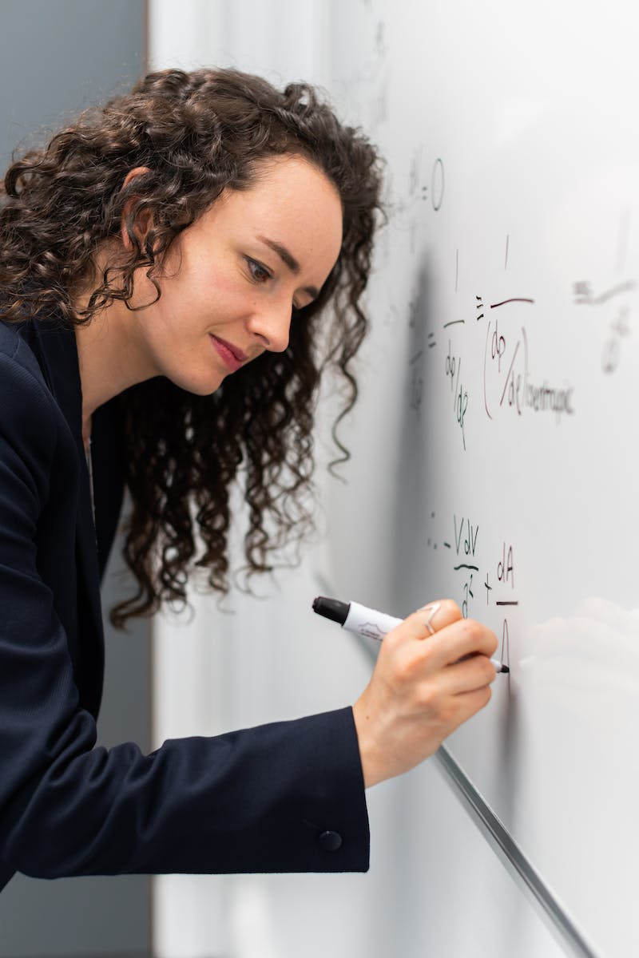
Physics: The Study of Physical Quantities
• Physics involves the study of physical quantities and their behavior.
• Physical quantities include displacement, time, mass, velocity, distance, speed, acceleration, temperature, density, energy, and work.
• Vectors are used to represent these physical quantities.
• Vectors are represented by a letter with an arrow on top or bolded.
Photo by Pexels

Slide 3
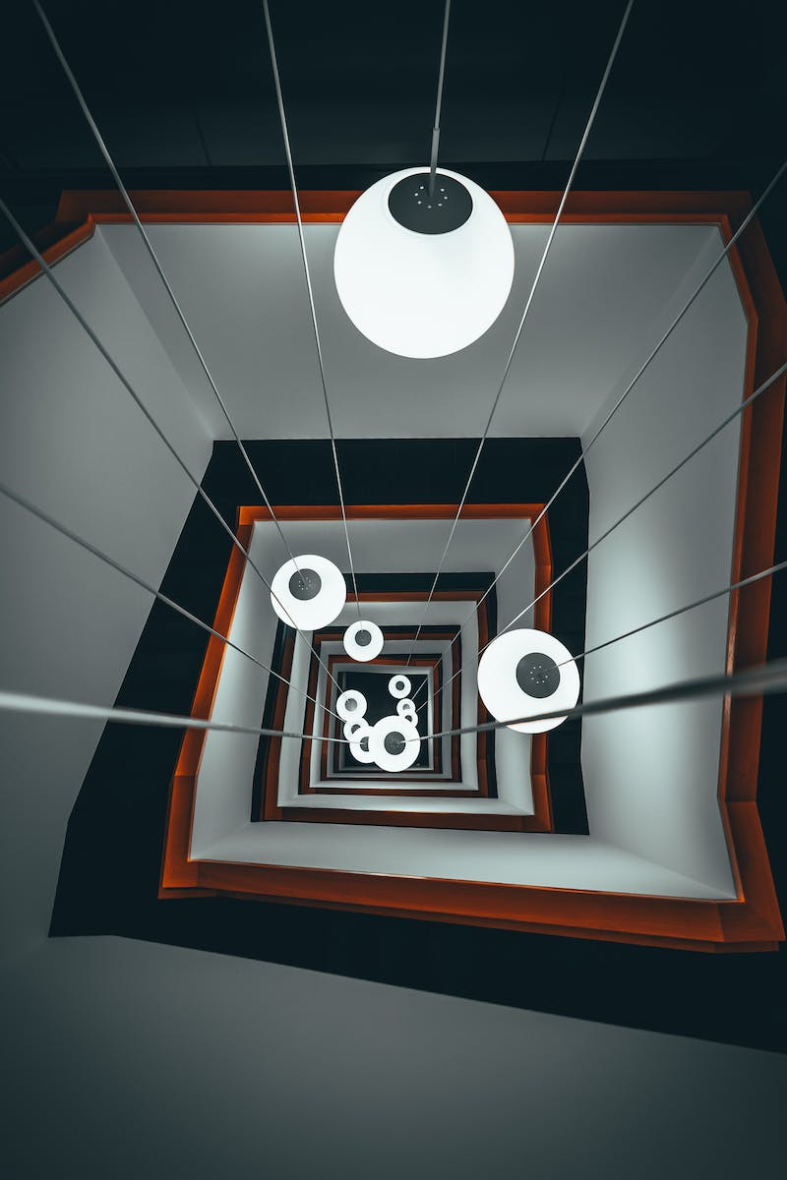
Properties of Vectors
• Vectors can be parallel or in the same direction.
• If two vectors have the same magnitude and direction, they are equal.
• The location in space doesn't affect their equality.
• Vectors can also be multiplied by a scalar quantity.
Photo by Pexels

Slide 4
Vector Addition
• When adding two or more vectors, they must have the same unit.
• Graphical or analytical methods can be used for vector addition.
• Graphical method: Connect the tail of the first vector to the head of the last vector.
• Analytical method: Add the corresponding components of the vectors.
Photo by Pexels

Slide 5
Properties of Vector Addition
• Vector addition is commutative, meaning the order doesn't matter.
• The sum of vectors can be represented as a negative vector.
• The zero vector is achieved when vectors of equal magnitude and opposite direction cancel each other out.
• The minimum number of vectors with equal magnitude to produce the zero vector is two.
Photo by Pexels

Slide 6
Applications of Vectors
• Vectors have applications in various fields of physics.
• For example, displacement vectors can be used to represent spatial movements.
• Vectors are also used in force calculations and other physical phenomena.
• Understanding vectors is essential for solving physics problems accurately.
Photo by Pexels

Slide 7
Conclusion
• Vectors play a fundamental role in physics.
• They represent physical quantities and their behavior.
• Understanding vector properties and operations is essential for accurate analysis and problem-solving in physics.
• Further exploration of vectors will enhance your understanding of various phenomena in the physical world.
Photo by Pexels

