Slide 1
The Future of Artificial Intelligence
Exploring the impact and possibilities of AI

Slide 2
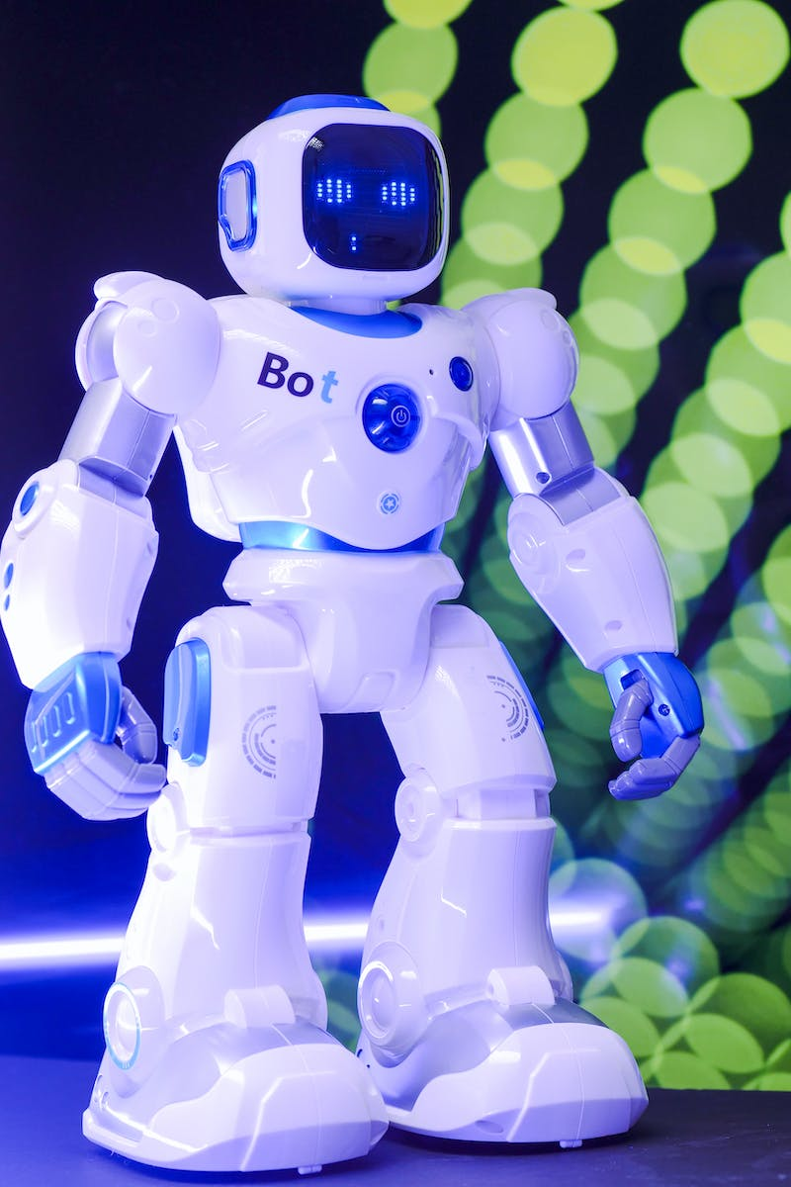
Introduction to Artificial Intelligence
• Definition and brief history
• Applications in various industries
• Current limitations and challenges
• Potential future developments
Photo by Pexels

Slide 3
Machine Learning and Deep Learning
• Difference between ML and DL
• Examples of ML and DL in action
• Training and neural networks
• Impact on data-driven decision making
Photo by Pexels

Slide 4
Ethical Considerations of AI
• AI bias and discrimination
• Privacy and data security concerns
• Job displacement and societal impacts
• Need for regulations and guidelines
Photo by Pexels

Slide 5
AI in Healthcare
• Diagnosis and treatment advancements
• Medical image analysis and diagnostics
• Drug discovery and personalized medicine
• Improving patient outcomes
Photo by Pexels

Slide 6
The Future of AI
• Advancements in natural language processing
• Automation and robotics integration
• Brain-computer interfaces
• Ethical considerations and AI governance
Photo by Pexels

