Slide 1
The Slow Party Program
Transforming Your Parties into Memorable Experiences

Slide 2
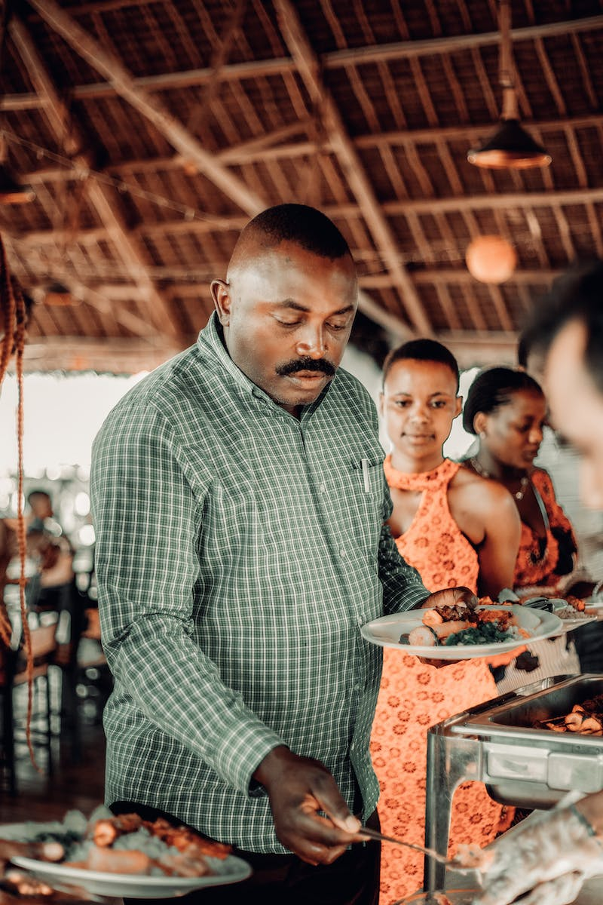
Introduction
• Why settle for average parties?
• Discover the power of the Slow Party Program
• Create unforgettable memories
• Embrace the art of intentionality
• Slow down and savor every moment
Photo by Pexels

Slide 3
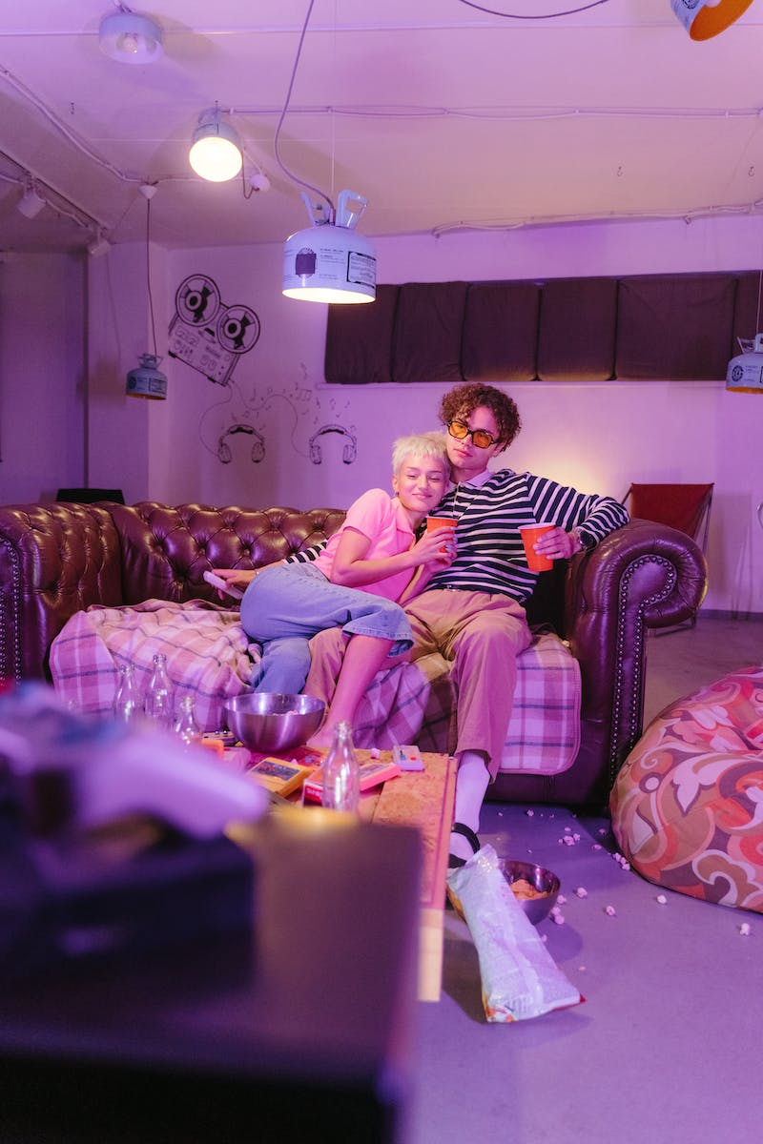
The Art of Mindful Arrivals
• Invite guests to arrive gradually
• Encourage personal introductions
• Create a warm and welcoming atmosphere
• Display a sign with party rules
• Offer a mini-orientation to the space
Photo by Pexels

Slide 4
The Power of Thoughtful Ambiance
• Set the mood with soft lighting
• Curate a personalized playlist
• Use aromatherapy to create a sensory experience
• Arrange cozy seating areas
• Provide conversation-sparking props
Photo by Pexels

Slide 5
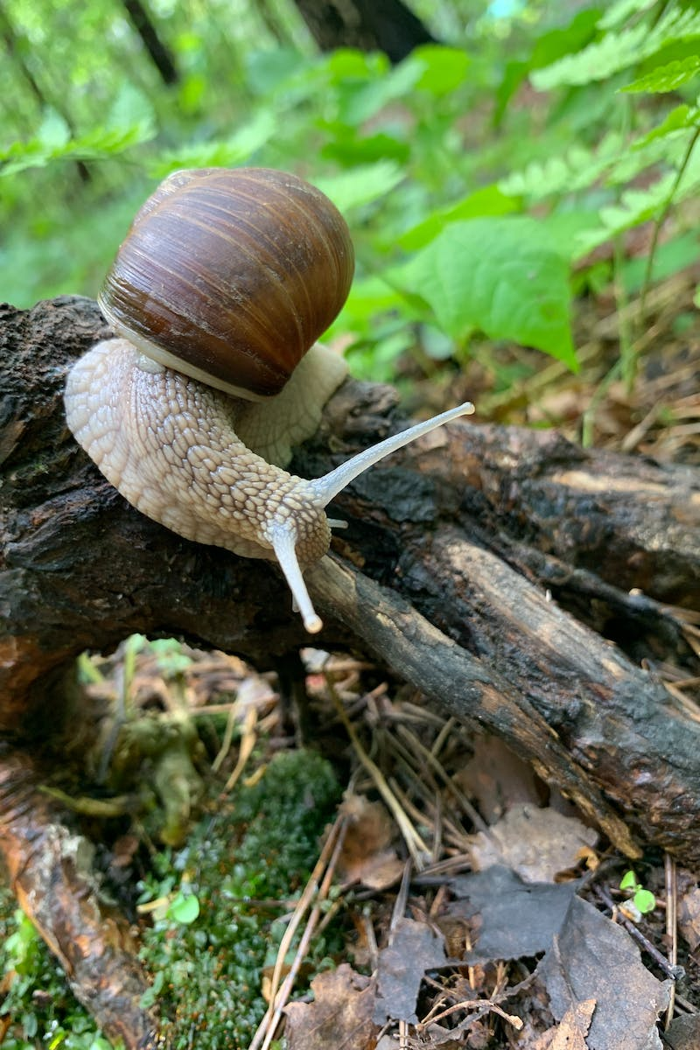
Slow Food and Sensational Flavors
• Prioritize locally-sourced and seasonal ingredients
• Embrace the art of slow cooking
• Create a menu that tells a story
• Encourage communal cooking
• Design unique and delightful food presentations
Photo by Pexels

Slide 6
Engaging Activities for Lasting Connections
• Curate interactive games and icebreakers
• Encourage creative collaborations
• Host themed workshops or demonstrations
• Organize meaningful group discussions
• Plan nostalgic and sentimental activities
Photo by Pexels

Slide 7
Closing with Reflection and Gratitude
• Facilitate a moment of silence and reflection
• Encourage sharing of memorable highlights
• Express gratitude to all attendees
• Provide a personalized token of appreciation
• Invite guests to future Slow Parties
Photo by Pexels

