Slide 1
The Power of Tools in Content Creation
Unlocking Creativity with On-Premises Solutions

Slide 2
Introduction
• Welcome to our presentation on the power of tools in content creation!
• Discover how on-premises solutions can enhance your creative process.
• Join us on this journey to explore the benefits of leveraging the right tools.
• Unleash your creative potential and streamline your workflow.
• Get ready to revolutionize the way you create content!
Photo by Pexels

Slide 3
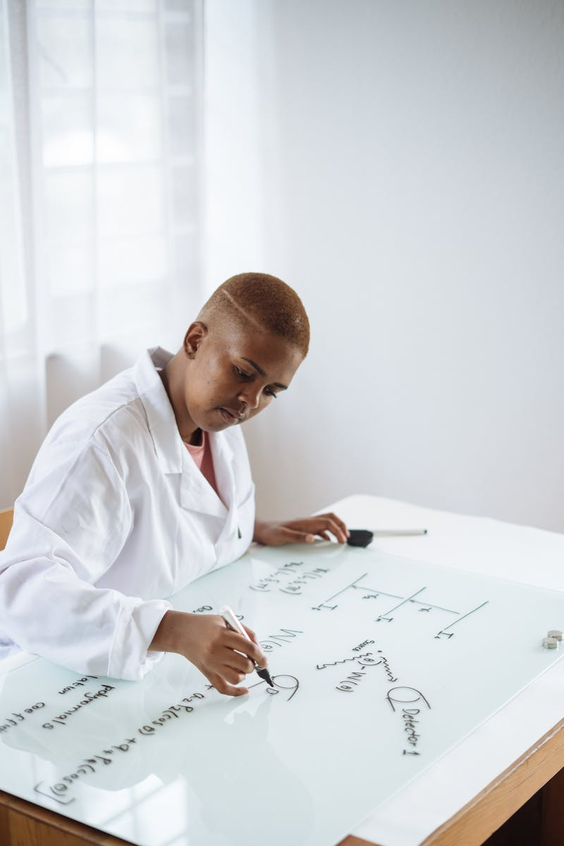
The Role of On-Premises Solutions
• Discover how on-premises solutions can transform your creative process.
• Gain full control over your content creation environment.
• Eliminate dependence on cloud-based services and ensure data security.
• Leverage the power of on-premises tools to meet specific business needs.
• Enhance collaboration and streamline workflows with localized solutions.
Photo by Pexels

Slide 4
Maximizing Efficiency with On-Premises Tools
• Optimize your workflow with on-premises tools designed for efficiency.
• Access powerful features and functionalities tailored to your needs.
• Minimize dependency on third-party applications and reduce bottlenecks.
• Experience faster rendering and processing times for seamless content creation.
• Improve productivity and save valuable time with localized solutions.
Photo by Pexels

Slide 5
Ensuring Quality and Consistency
• Maintain high-quality standards throughout your content creation journey.
• Achieve consistent branding and visual identity across your projects.
• Improve content accuracy and reduce errors with localized tools.
• Ensure seamless integration with existing workflows and software.
• Deliver compelling and polished content that resonates with your audience.
Photo by Pexels

Slide 6
Conclusion
• Embrace the power of on-premises solutions in your content creation journey.
• Unlock your creative potential and achieve remarkable results.
• Continuously explore new tools and technologies to stay ahead.
• Thank you for joining us and revolutionizing your content creation process!
Photo by Pexels

