Slide 1
Cleaning and Sanitizing Kitchen Premises
Exploring the Importance of Kitchen Hygiene

Slide 2
Welcome to our Cookie Class Online Discussion
• Join us as we dive into the exciting world of learning
• Reflect on previous lesson time and activities
• Engage in interactive quizzes and games
• Master the fundamentals of kitchen hygiene
Photo by Pexels

Slide 3
Activity 1: Jump Board Letters
• Directions: Right operator spelling opposite the scrum board letters
• Cleaning process that destroys harmful cells: Sanitized
• Part of the house where food is prepared: Kitchen
• Word that means removing unwanted substances: Cleaning
• Area in the kitchen for storing goods or supplies: Store Room
• Location for handwashing and hygiene practices: Sink
Photo by Pexels

Slide 4
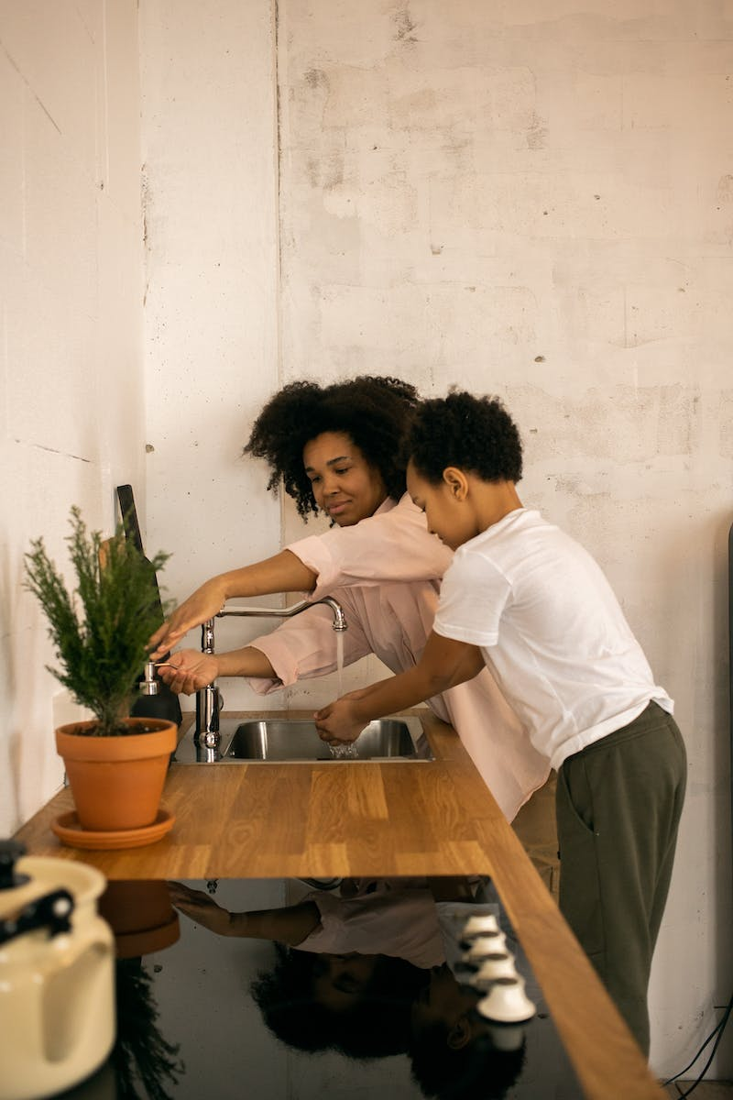
Lesson 1: Recognizing Teach Teaching Premises
• Explore the importance of cleaning and sanitizing kitchen premises
• Understand the link between hygiene and preventing food poisoning
• Definition of kitchen and its significance in a household
• Explanation of cleaning and sanitizing processes
• Identifying key areas in the kitchen that require attention
Photo by Pexels

Slide 5
Key Areas in the Kitchen That Need Cleaning
• Floor: The bottom surface of the kitchen area
• Sink: Ball-shaped fixture used for handwashing
• Refrigerator: Equipment that preserves food at a cold temperature
• Store Room: Space for storing goods or supplies
• Garbage Area: Location for disposing of waste
• Shelves: Flat surfaces attached to walls for storage
Photo by Pexels

Slide 6
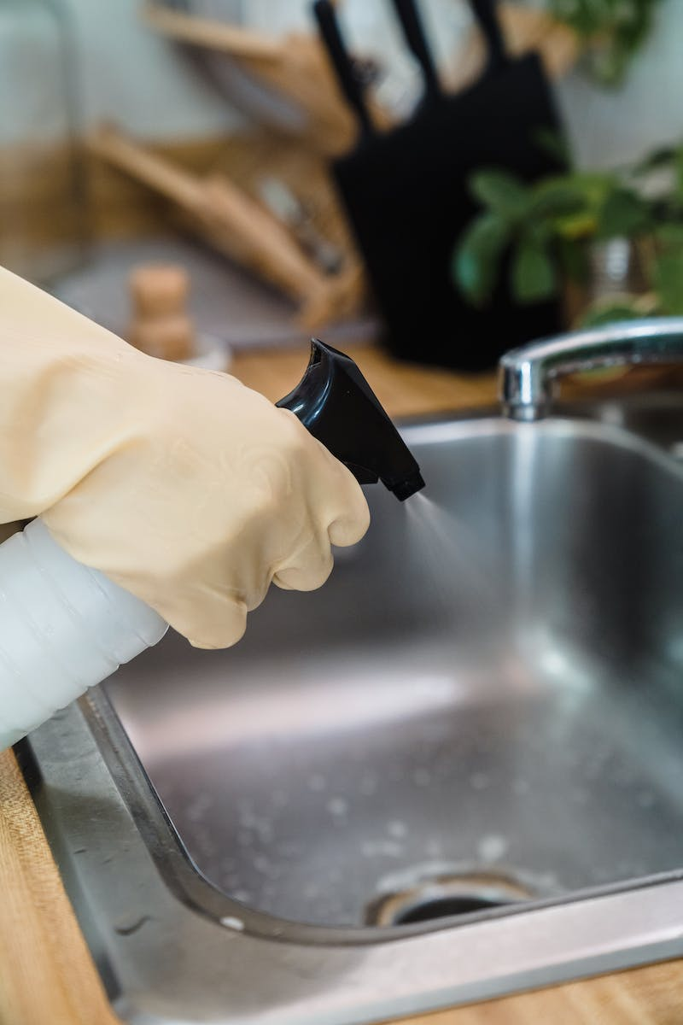
Lesson 2: Training the Kitchen Area
• Step-by-step process of cleaning kitchen premises
• Selection of appropriate cleaning compounds and chemicals
• Importance of following cleaning procedures and safety regulations
• Storage and maintenance of cleaning items and chemicals
• Emergency aid procedures in case of incidents or accidents
Photo by Pexels

Slide 7
Types of Sanitizers and Disinfectants
• Chemical sanitizers: Chlorine, carb acid, ammonia
• Physical sanitizers: Hot water, steam, dry heat, UV light
• Proper application and usage of sanitizing agents
Photo by Pexels

Slide 8
Practicing Kitchen Hygiene
• Daily cleaning of countertops and utensils
• Proper food storage to prevent contamination
• Cleaning the kitchen sink and removing stains
• Safe handling and storage of cleaning materials
• Importance of personal hygiene and handwashing
Photo by Pexels

Slide 9
Safety Measures in Kitchen Cleaning
• Ensure adequate ventilation
• Knowledge of basic first aid
• Proper clothing and footwear
• Use of gloves and eye protection
Photo by Pexels

Slide 10
Conclusion
• Thank the audience for their participation
• Reiterate the importance of kitchen hygiene
• Encourage continued practice of proper cleaning and sanitizing routines
Photo by Pexels

