Slide 1
The Power of Garlic
Exploring the Health Benefits and Culinary Uses of Garlic

Slide 2
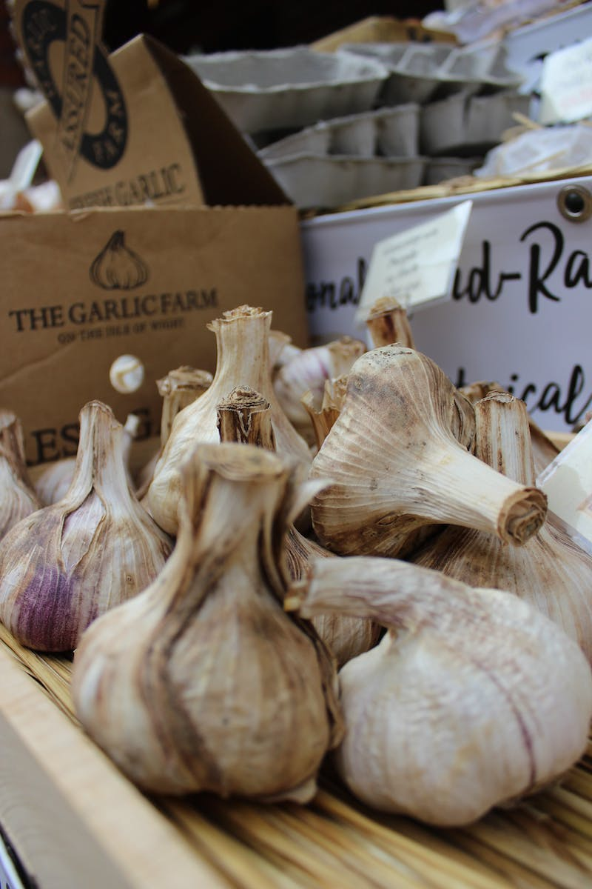
Introduction to Garlic
• Garlic is a popular herb with a rich history.
• It is known for its unique taste and strong aroma.
• Garlic belongs to the Allium family, which also includes onions and leeks.
• It has been used for both culinary and medicinal purposes for centuries.
Photo by Pexels

Slide 3
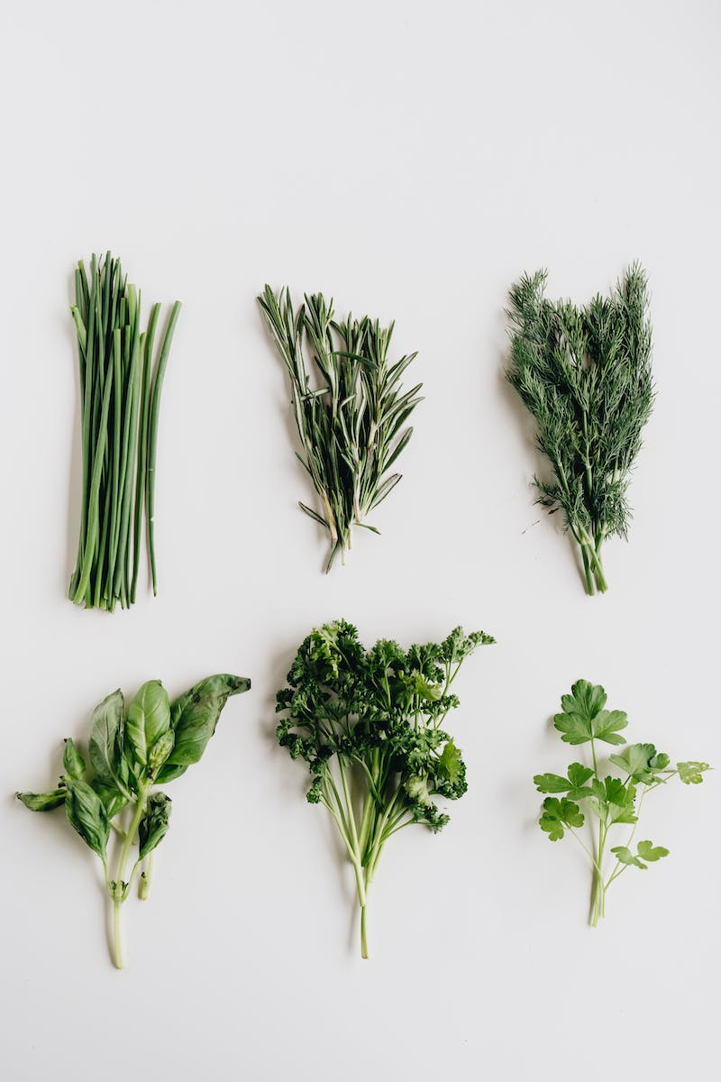
Nutritional Value of Garlic
• Garlic is low in calories and rich in essential nutrients.
• It is a good source of vitamin C, vitamin B6, and manganese.
• Garlic is also rich in antioxidants, which help protect the body against oxidative damage.
• It contains a compound called allicin, which has been linked to various health benefits.
Photo by Pexels

Slide 4
Health Benefits of Garlic
• Garlic has been associated with various health benefits.
• It may help lower blood pressure and reduce the risk of heart disease.
• Garlic has antimicrobial properties and may boost the immune system.
• It also has potential anti-inflammatory and anticancer effects.
Photo by Pexels

Slide 5
Culinary Uses of Garlic
• Garlic is a staple ingredient in many cuisines around the world.
• It adds flavor and aroma to a wide range of dishes.
• Garlic can be used in various forms, including fresh, minced, roasted, or powdered.
• It pairs well with meats, vegetables, pasta, and sauces.
Photo by Pexels

Slide 6
Garlic Varieties
• There are hundreds of garlic varieties worldwide.
• Different varieties vary in flavor, aroma, and intensity.
• Some popular garlic varieties include Rocambole, Purple Stripe, and Elephant garlic.
• Each variety has its own unique characteristics and culinary uses.
Photo by Pexels

Slide 7
Conclusion
• Garlic is a versatile herb with numerous health benefits.
• It adds depth and flavor to a wide array of dishes.
• Incorporating garlic into your diet can enhance both taste and nutrition.
• Explore different garlic varieties and enjoy the delights of this ancient herb.
Photo by Pexels

