Slide 1
Exploring the Intriguing World of Madame Striker
Unveiling the Secrets Behind the Mysterious Madame Striker

Slide 2
Introducing Madame Striker
• Madame Striker - a hidden gem of the underground
• Legendary figure with an enigmatic past
• Known for her unmatched skills and fierce demeanor
• Master of deception and a force to be reckoned with
Photo by Pexels

Slide 3
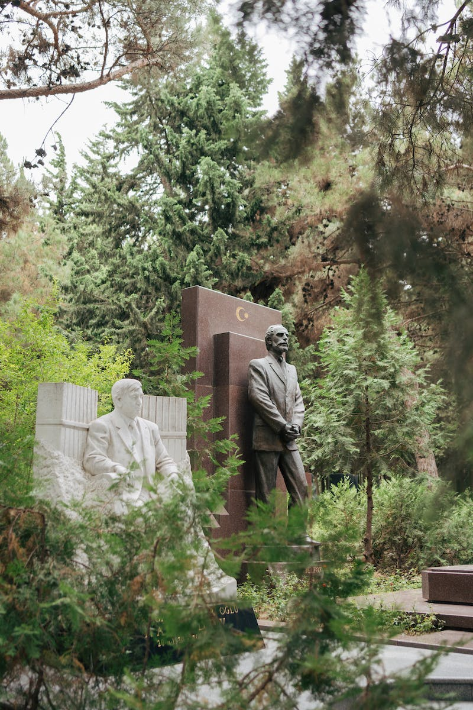
Unraveling the Origins
• Origins shrouded in secrecy
• Speculations suggest a connection to Azerbaijan
• Rumored association with powerful figures
• John Mo Thor, the key to uncovering the truth
Photo by Pexels

Slide 4
Double Agent Revelation
• Surprising reveal: Madame Striker is a double agent
• Masterful deception for a greater cause
• Central Bureau of Strikers (CBS): A secretive organization
• Strategic brilliance to ensure success
Photo by Pexels

Slide 5
The Bright Side of Madame Striker
• Reputation for brightening lives amidst chaos
• Acts of kindness behind her fierce facade
• Supporter of underprivileged communities
• A beacon of hope in a dark world
Photo by Pexels

Slide 6
The Discreet Collaboration
• Unlikely alliances with the British Intelligence (Brit MI6)
• Forging mutually beneficial partnerships
• Exchange of valuable information
• The dynamic between Madame Striker and Brit MI6
Photo by Pexels

