Slide 1
The Power of Small Actions: Changing the World One Task at a Time
Lessons from a Navy SEAL

Slide 2
Make Your Bed
• The first task of the day
• Gives a sense of pride and encouragement
• Reinforces the importance of little things
• Provides encouragement for tomorrow
Photo by Pexels

Slide 3
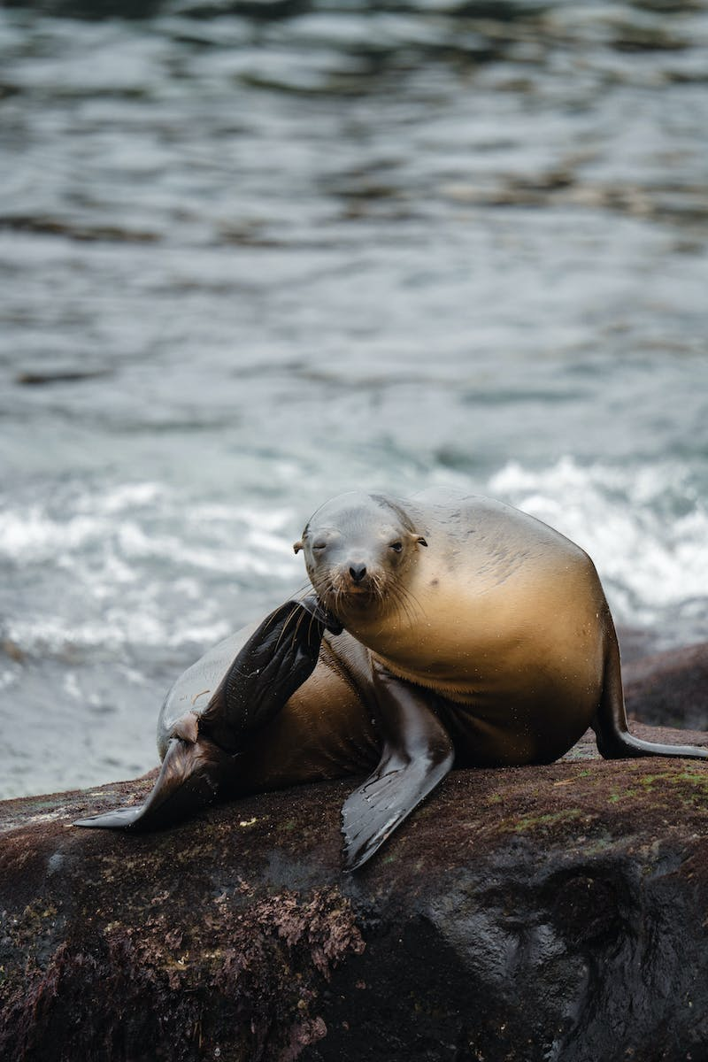
The Wisdom of a Simple Act
• Morning ritual during SEAL training
• Inspecting beds for perfection
• Seemed ridiculous, but had profound meaning
• Lessons learned from repetitive tasks
Photo by Pexels

Slide 4
Applying Lessons to Life's Struggles
• Lessons applicable to everyone
• Overcoming struggles and moving forward
• Importance of small actions in personal growth
• Changing ourselves and the world around us
Photo by Pexels

Slide 5
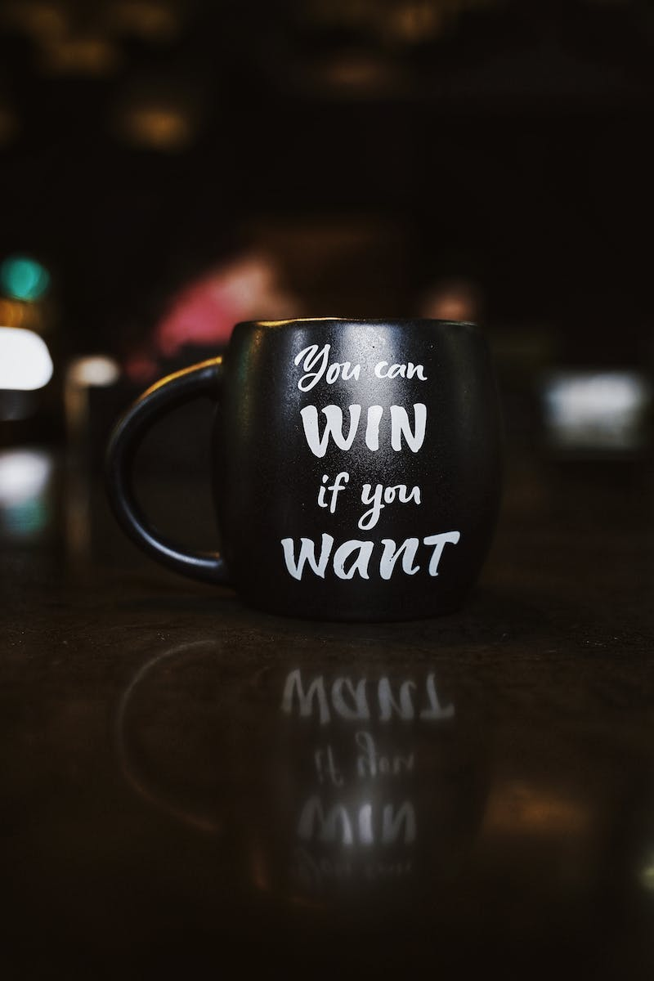
The Power of One
• Examples of individuals who changed the world
• The influence of hope and determination
• Everyone has the potential to make a difference
• The ripple effect of one person's actions
Photo by Pexels

Slide 6
The Importance of Resilience
• Challenges and failures are part of the journey
• Facing adversity with composure and inner strength
• Stepping up in tough times and supporting others
• Never giving up despite setbacks
Photo by Pexels

Slide 7
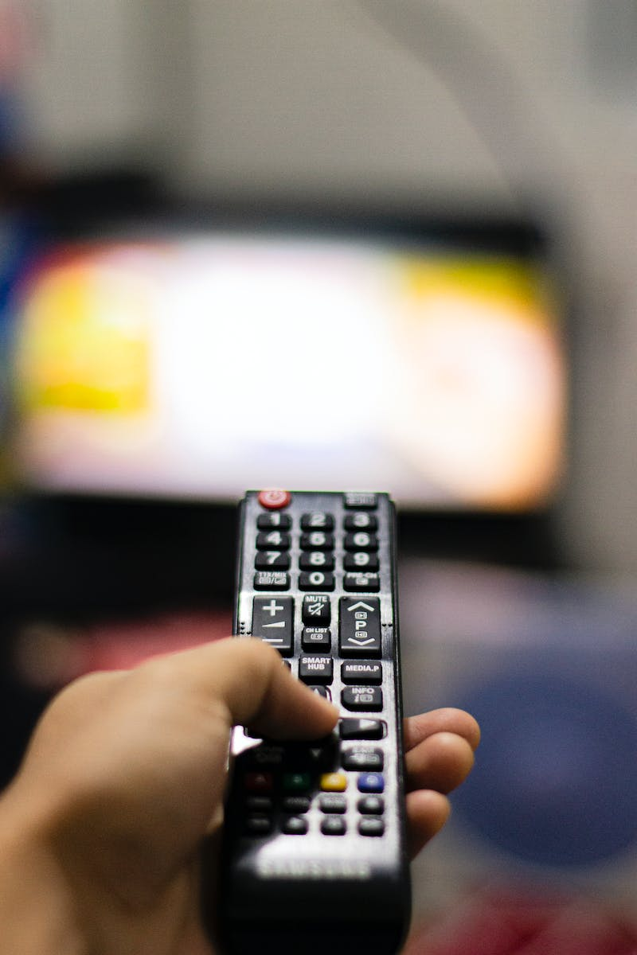
Starting a Ripple of Change
• Taking actions to change lives and the world
• Making a difference, no matter the scale
• The cumulative impact of individual efforts
• Inspiring the next generation
Photo by Pexels

Slide 8
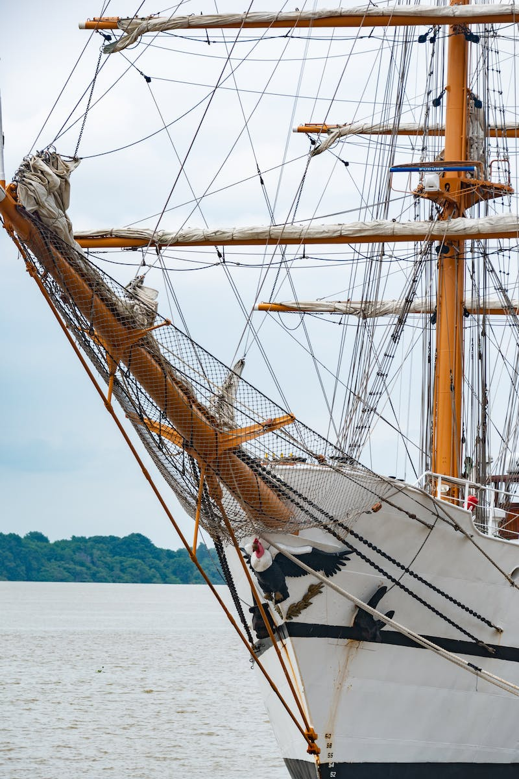
Never Ring the Bell
• Story of the bell in SEAL training
• Symbolizes giving up and quitting
• Enduring hardships for growth and achievement
• The value of perseverance and determination
Photo by Pexels

