Slide 1
The Power of Artificial Intelligence
Transforming Industries and Revolutionizing the Future

Slide 2
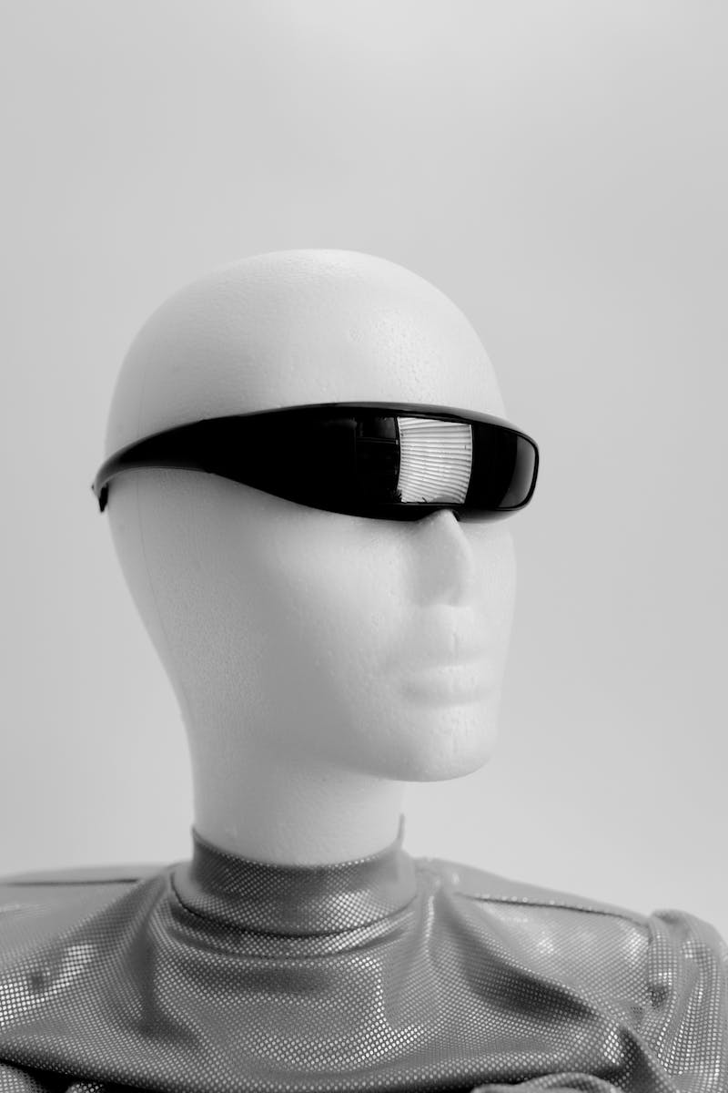
Introduction to Artificial Intelligence
• AI refers to the simulation of human intelligence in machines.
• It has been transforming industries across the globe.
• Advancements in AI have the potential to revolutionize the future.
• Machine learning and deep learning are key components of AI.
• AI has applications in various sectors like healthcare, finance, and transportation.
Photo by Pexels

Slide 3
Applications of Artificial Intelligence
• In healthcare, AI can improve diagnostics and treatment.
• AI is revolutionizing the finance industry with automated trading and risk analysis.
• Autonomous vehicles are a result of AI advancements in the transportation sector.
• AI-powered virtual assistants are enhancing customer experiences.
• AI is being utilized in cybersecurity to detect and prevent threats.
Photo by Pexels

Slide 4
Challenges and Ethical Considerations
• Privacy concerns arise with the increasing use of AI.
• AI may lead to job displacement and economic inequality.
• Bias in AI algorithms can perpetuate social inequalities.
• Ethical considerations are important to ensure responsible AI use.
• Regulation and policies need to keep pace with AI advancements.
Photo by Pexels

Slide 5
Future Trends in Artificial Intelligence
• AI integration with Internet of Things (IoT) will create smart environments.
• Advancements in natural language processing will enhance human-machine interactions.
• Explainable AI will increase transparency and accountability.
• AI in robotics will lead to significant advancements in automation.
• Collaborative AI will enable human-AI teamwork for complex problem-solving.
Photo by Pexels

