Slide 1
The Power of Artificial Intelligence
Exploring the Impact and Potential of AI Technologies

Slide 2
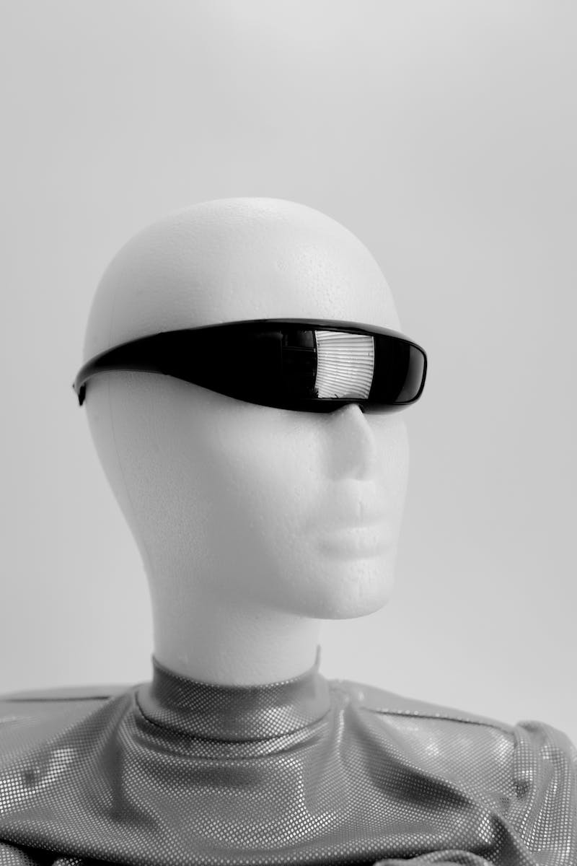
Introduction to AI
• AI is the simulation of human intelligence in machines.
• It enables machines to learn from experience and perform tasks that would typically require human intelligence.
• AI has a wide range of applications in various industries.
• It has the potential to revolutionize the way we live and work.
Photo by Pexels

Slide 3
Machine Learning
• Machine learning is a subset of AI.
• It involves providing machines with the ability to learn and improve from data without explicit programming.
• Supervised learning, unsupervised learning, and reinforcement learning are common types of machine learning techniques.
• Machine learning algorithms have been used in various fields, such as healthcare, finance, and marketing.
Photo by Pexels

Slide 4
Deep Learning
• Deep learning is a subset of machine learning.
• It involves training artificial neural networks with multiple layers to learn and make predictions.
• Deep learning has been highly successful in image recognition, natural language processing, and speech recognition tasks.
• Companies like Google and Facebook have employed deep learning for various applications.
Photo by Pexels

Slide 5
Applications of AI
• AI is being applied in various sectors, including healthcare, finance, transportation, and retail.
• In healthcare, AI is used for diagnosing diseases, drug discovery, and personalized medicine.
• In finance, AI is used for fraud detection, algorithmic trading, and risk assessment.
• AI is also enabling self-driving cars, improving logistics, and transforming customer service in the transportation industry.
Photo by Pexels

Slide 6
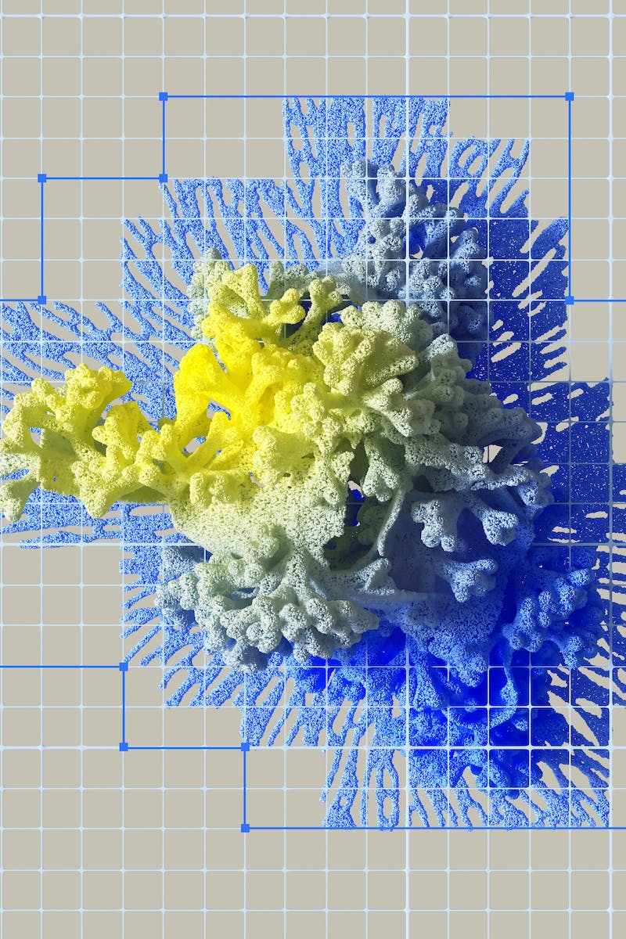
Ethical Considerations
• The rise of AI also raises ethical concerns.
• Issues like biased algorithms, lack of transparency, and potential job displacement need to be addressed.
• Regulations and guidelines are being developed to ensure ethical and responsible AI use.
• Collaboration between academia, industry, and policymakers is crucial to address these challenges.
Photo by Pexels

Slide 7
Future of AI
• The future of AI holds immense potential and possibilities.
• Advancements in AI are expected to drive innovation across various domains.
• AI may lead to the development of more autonomous systems, personalized experiences, and improved decision-making.
• It is essential to continue investing in research and development to unlock the full potential of AI.
Photo by Pexels

